Slide 1
“PROVIDENCE”
PART I
(JOSEPH)

Slide 2


Slide 3
PROVIDENCE
DOESN’T REQUIRE A MIRACULOUS INTERVENTION BY GOD
CAN BE DIFFICULT TO ASCERTAIN
  RE: ONESIMUS’ CONVERSION
  “For perhaps he departed for a while for this purpose, that you might receive him forever, no longer as a slave but more than a slave—a beloved brother, especially to me but how much more to you, both in the flesh and in the Lord” (PHILEMON vv. 15, 16)
EASIER TO DISCOVER WHEN LIFE IS READ BACKWARDS

Slide 4
JOSEPH
AN IMMORTAL
NARRATIVE
LIVED A LIFE OF
“DOWNS & UPS”
SON OF JACOB & RACHEL
11 BROTHERS
  BENJAMIN WAS HIS ONLY FULL BROTHER
  MOTHER DIED IN CHILDBIRTH
  (GEN. 35:16-20)

Slide 5
JOSEPH
HATED BY 10
BROTHERS
(GEN. 37:1-11)
SOLD BY
BROTHERS TO
MIDIANITE TRADERS FOR 20 PIECES OF SILVER (GEN. 37:28)
  DECEIVED JACOB INTO THINKING THAT JOSEPH HAD BEEN KILLED BY A WILD BEAST (GEN. 37:29-36)

Slide 6
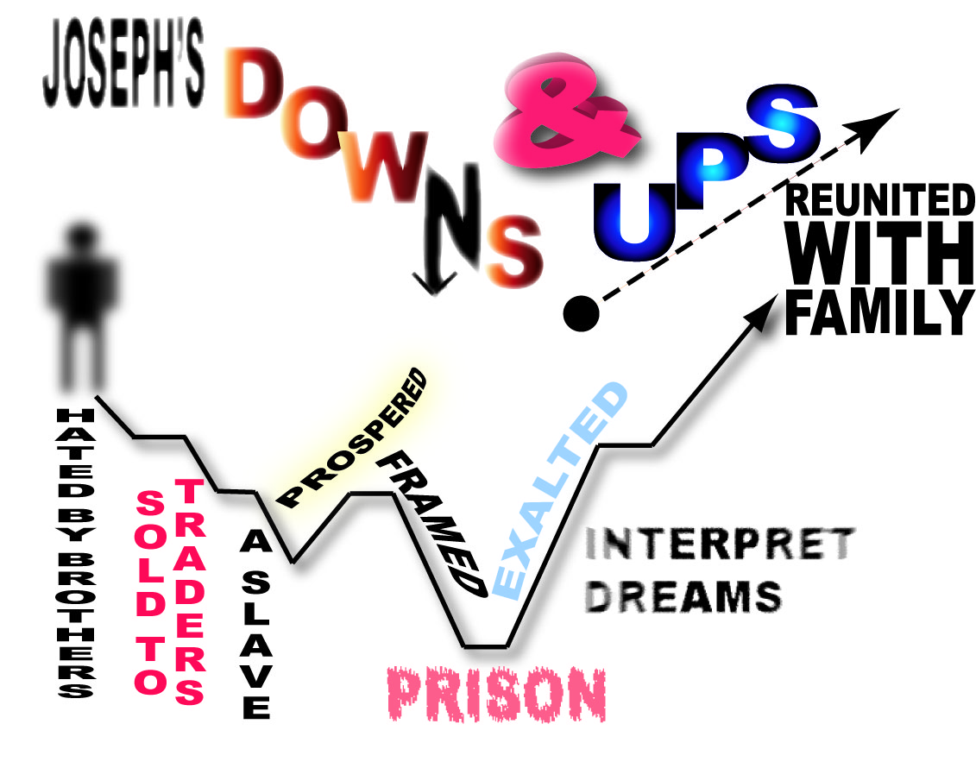

Slide 7
“Then Midianite traders passed by; so the brothers pulled Joseph up and lifted him out of the pit, and sold him to the Ishmaelites for twenty shekels of silver. And they took Joseph to Egypt”
Genesis 37:28
Joseph 17 yrs. Old
(Gen. 37:2)

Slide 8
“Now Joseph had been taken down to Egypt. And Potiphar, an officer of Pharaoh, captain of the guard, an Egyptian, bought him from the Ishmaelites who had taken him down there.”
Genesis 39:1

Slide 9
² The LORD was with Joseph, and he was a successful man; and he was in the house of his master the Egyptian.³ And his master saw that the LORD was with him and that the LORD made all he did to prosper in his hand. ⁴ So Joseph found favor in his sight, and served him. Then he made him overseer of his house, and all that he had he put under his authority.
Genesis 39:2-4

Slide 10
Genesis 39:7-18

Slide 11
So it was, when his master heard the words which his wife spoke to him, saying, "Your servant did to me after this manner," that his anger was aroused. Then Joseph’s master took him and put him into the prison, a place where the king’s prisoners were confined. And he was there in the prison.
Genesis 39:19, 20

Slide 12
SON
FROM:
SLAVE
PRISONER

Slide 13
DOES THIS SEEM UNFAIR?
WHY SHOULD A GOOD PERSON BE TREATED SO BAD?
WAS GOD UNJUST?
HAD GOD FORSAKEN JOSEPH?

Slide 14
21 But the LORD was with Joseph and showed him mercy, and He gave him favor in the sight of the keeper of the prison.
22 And the keeper of the prison committed to Joseph’s hand all the prisoners who were in the prison; whatever they did there, it was his doing.
23 The keeper of the prison did not look into anything that was under Joseph’s authority, because the LORD was with him; and whatever he did, the LORD made it prosper.
GENESIS 39:21-23

Slide 15
GENESIS 40
  CHIEF BUTLER “LIFT UP HEAD” (v. 13)
  CHIEF BAKER “LIFT OFF HEAD” (v. 19)
  JOSEPH 28 yrs. (GEN. 41:1, 46)
GENESIS 41
  PHARAOH
  2 YRS. LATER
  ELEVATED TO SECOND IN COMMAND OVER EGYPT

Slide 16
FROM:
RULER
SON
SLAVE
PRISONER

Slide 17
LIKE JESUS:
RULER
SON OF GOD
SON OF MAN
CRUCIFIED
PHIL. 2:5-11
Notes:
Should assign how many parallels are found between Jesus and Joseph.
Would rule over brothers
Hated by brothers.
Was sent by Father (cf. Gen. 37:13, 14; Jn. 12:49; 14:24)
Stripped of his cloths (Gen. 37:23; Matt. 27:27-31)
Cast into a pit/grave (Gen. 37:24; Matt. 27:58-60)
Sold for pieces of silver (Gen. 37:28; Matt. 27:9).
Was framed for something that He was not (Matt. 26:60, 61; Mk. 14:57, 58; cf. Jn. 2:19-21)
Is second in command (Gen. 41:40; 1 Cor. 11:3; Matt. 28:18).
30 years old (Gen. 41:46; Lk. 3:23)
Sent to preserve life (Gen. 45:5, 6; 50:17-21; Gal. 1:4; Titus 2:14; 1 Pet. 3:18).

Slide 18
GENESIS 42-45
JOSEPH 39 yrs. OLD WHEN REUNITED WITH FAMILY (GEN. 45:6)
  22 yrs. WITHOUT SEEING HIS FAMILY

Slide 19
WHY SO MUCH WRITTEN ABOUT JOSEPH IN THE BIBLE?
THE PROMISE TO ABRAHAM WAS NOT FULFILLED THROUGH JOSEPH’S SEED BUT 12 CHAPTERS ARE DEDICATED TO HIS LIFE’S STORY
  JUDAH, NOT JOSEPH WAS IN JESUS’ ANCESTRY

Slide 20
WHY SO MUCH WRITTEN ABOUT JOSEPH IN THE BIBLE?
IS THERE ANY DESIGN OF THIS STORY BEYOND THAT OF ENJOYMENT?
  ALL SCRIPTURE IS PROFITABLE FOR DOCTRINE . . . (2 TIM. 3:16)
  THESE 12 CHAPTERS ARE CERTAINLY PROFITABLE FOR THE DOCTRINE OF “PROVIDENCE”
  SHOWS HOW GOD CAN WORK BIG THINGS IN THE LIVES OF SIMPLE MEN

Slide 21
GOD’S PLAN WAS KNOWN
BEFORE JOSEPH
A FEW HUNDRED YEARS EARLIER GOD APPEARED TO JOSEPH’S GREAT GRAND-FATHER
12 Now when the sun was going down, a deep sleep fell upon Abram; and behold, horror and great darkness fell upon him.
13 Then He said to Abram: "Know certainly that your descendants will be strangers in a land that is not theirs, and will serve them, and they will afflict them four hundred years.
14 "And also the nation whom they serve I will judge; afterward they shall come out with great possessions.
GENESIS 15:12-14

Slide 22
THE SPECIFIC “LAND” WAS NOT REVEALED TO ABRAHAM
WHY WAS ISRAEL IN THE LAND OF EGYPT?

Slide 23
WHY?
BECAUSE THERE WAS AN INTERNATIONAL FAMINE AND EGYPT HAD FOOD
ABRAHAM
ISRAEL IN EGYPT

Slide 24
WHY?
BECAUSE JOSEPH WAS THE SECOND 2ND IN COMMAND IN EGYPT AND STORED FOOD FROM THE GOOD YEARS
ABRAHAM
EGYPT—FOOD
ISRAEL IN EGYPT

Slide 25
WHY?
BECAUSE JOSEPH INTERPRETED PHARAOH’S DREAM
ABRAHAM
EGYPT—FOOD
JOSEPH RULER
ISRAEL IN EGYPT

Slide 26
WHY?
BECAUSE THE BUTLER SUGGESTED THAT PHARAOH SUMMON JOSEPH
ABRAHAM
EGYPT—FOOD
JOSEPH INTER.
JOSEPH RULER
ISRAEL IN EGYPT

Slide 27
WHY?
BECAUSE JOSEPH HAD INTERPRETED THE BUTLER’S DREAM 2 YEARS PREVIOUSLY
ABRAHAM
EGYPT—FOOD
JOSEPH INTER.
JOSEPH RULER
BUTLER SUGG.
ISRAEL IN EGYPT

Slide 28
WHY?
BECAUSE JOSEPH HAD BEEN THROWN IN PRISON
ABRAHAM
BUTLER SUGG.
EGYPT—FOOD
JOSEPH INTER.
JOSEPH RULER
BUTLER’S DREAM
ISRAEL IN EGYPT

Slide 29
WHY?
BECAUSE POTIPHAR CHOSE TO PUT HIM IN PRISON
ABRAHAM
IN PRISON
BUTLER SUGG.
EGYPT—FOOD
JOSEPH INTER.
JOSEPH RULER
BUTLER’S DREAM
ISRAEL IN EGYPT

Slide 30
WHY?
BECAUSE JOSEPH WAS FRAMED BY POTIPHAR’S WIFE
ABRAHAM
POTIPHAR’S
CHOICE
IN PRISON
BUTLER SUGG.
EGYPT—FOOD
JOSEPH INTER.
JOSEPH RULER
BUTLER’S DREAM
ISRAEL IN EGYPT

Slide 31
WHY?
BECAUSE POTIPHAR’S WIFE TRIED TO SEDUCE HIM TO ADULTERY AND JOSEPH FLED FROM HER
ABRAHAM
FRAMED
POTIPHAR’S
CHOICE
IN PRISON
BUTLER SUGG.
EGYPT—FOOD
JOSEPH INTER.
JOSEPH RULER
BUTLER’S DREAM
ISRAEL IN EGYPT

Slide 32
WHY?
BECAUSE JOSEPH WAS GOOD LOOKING AND WAS OVER HER HUSBAND’S HOUSE
ABRAHAM
FRAMED
ATTEMPTED
SEDUCTION
POTIPHAR’S
CHOICE
IN PRISON
BUTLER SUGG.
EGYPT—FOOD
JOSEPH INTER.
JOSEPH RULER
BUTLER’S DREAM
ISRAEL IN EGYPT

Slide 33
WHY?
BECAUSE POTIPHAR HAD BOUGHT JOSEPH AS A SLAVE AND GOD BLESSED HIM THROUGH JOSEPH’S GOOD WORK
ABRAHAM
FRAMED
ATTEMPTED
SEDUCTION
POTIPHAR’S
CHOICE
IN PRISON
OVER HOUSE
EGYPT—FOOD
BUTLER SUGG.
JOSEPH INTER.
JOSEPH RULER
BUTLER’S DREAM
ISRAEL IN EGYPT

Slide 34
WHY?
BECAUSE JOSEPH’S BROTHERS SOLD HIM TO TRADERS FOR 20 PIECES OF SILVER
ABRAHAM
A SLAVE
FRAMED
ATTEMPTED
SEDUCTION
POTIPHAR’S
CHOICE
IN PRISON
OVER HOUSE
EGYPT—FOOD
BUTLER SUGG.
JOSEPH INTER.
JOSEPH RULER
BUTLER’S DREAM
ISRAEL IN EGYPT

Slide 35
WHY?
BECAUSE JOSEPH’S BROTHERS’ HATED HIM
ABRAHAM
SOLD
A SLAVE
FRAMED
ATTEMPTED
SEDUCTION
POTIPHAR’S
CHOICE
IN PRISON
OVER HOUSE
EGYPT—FOOD
BUTLER SUGG.
JOSEPH INTER.
JOSEPH RULER
BUTLER’S DREAM
ISRAEL IN EGYPT

Slide 36
WHY?
BECAUSE JACOB WAS PARTIAL AND JOSEPH’S DREAM’S INCITED THEM TO ANGER
ABRAHAM
SOLD
BROTHERS
HATED
A SLAVE
FRAMED
ATTEMPTED
SEDUCTION
POTIPHAR’S
CHOICE
IN PRISON
OVER HOUSE
EGYPT—FOOD
BUTLER SUGG.
JOSEPH INTER.
JOSEPH RULER
BUTLER’S DREAM
ISRAEL IN EGYPT

Slide 37
THINK
HOW JOSEPH’S BROTHERS UNJUST ACT PROVIDED A LINK IN THE CHAIN TO SAVE THEM IN EGYPT
WHAT IF THE BUTLER WOULD HAVE NOT DELAYED IN TELLING PHARAOH?
WHAT IF JOSEPH WAS INDIFFERENT TO THE BAKER AND BUTLER’S SAD COUNTENANCE IN PRISON?

Slide 38
THINK
WHAT IF JOSEPH’S CONDUCT IN PRISON WAS UNBECOMING AND HE WASN’T GRANTED CERTAIN LIBERTIES FROM THE KEEPER
WHAT IF POTIPHAR WOULD HAVE KILLED JOSEPH BECAUSE OF HIS WIFE’S FALSE ALLEGATION?
WHAT IF REUBEN WOULD HAVE FAILED TO PERSUADE HIS BROTHERS TO NOT KILL JOSEPH?
WHAT IF JACOB WOULD NEVER HAVE SENT JOSEPH TO CHECK ON HIS BROTHERS?

Slide 39
PROVIDENCE
IS NOT ABOUT GOD CONTROLLING OUR EVERY ACTION TO GET HIS WAY
  I.E., PUPPETS
IS ABOUT GOD USING OUR CHOICES & WORKS TO BRING ABOUT A GREATER WORK (PHIL. 2:13)
DOES NOT REQUIRE MIRACLES
  IN THE LONG CHAIN OF JOSEPH’S SALVATION FOR ISRAEL, ONLY A COUPLE OF LINKS WERE TOUCHED BY GOD’S MIRACULOUS FINGER

Slide 40
26 "And He has made from one blood every nation of men to dwell on all the face of the earth, and has determined their preappointed times and the boundaries of their dwellings,
27 "so that they should seek the Lord, in the hope that they might grope for Him and find Him, though He is not far from each one of us
IN THE NARRATIVE OF JOSEPH, WE SEE THE MEANING OF ACTS 17:26, 27

Slide 41
QUESTIONS REGARDING THE NARRATIVE OF
JOSEPH

Slide 42
QUESTIONS
Why did Joseph not go back to see his father when he was elevated to a ruler?

Slide 43
A WALK IN JOSEPH’S SHOES
At 17 yrs. old, father tells him to go check on brothers
Brothers conspire to kill him and cast him in a pit
Sold by his own flesh and bone
The hope that your wealthy father would find you and buy you back never happens
Gloomy days turn into weeks, months and finally 13 miserable years before being exalted by Pharaoh
Why go back to a people who hated you, sold you, and a father who never rescued you?

Slide 44
A WALK IN JOSEPH’S SHOES
51 Joseph called the name of the firstborn Manasseh: "For God has made me forget all my toil and all my father’s house."
52 And the name of the second he called Ephraim: "For God has caused me to be fruitful in the land of my affliction."
Genesis 41:51, 52
Notes:
Joseph would now have riches, honor, a wife and children. . .why remember the pain of his youth? Everything was going fine until he recognized his brothers in Egypt.

Slide 45
QUESTIONS
Why did God select such dishonorable men (sold brother, deceived father) to be the fathers of God’s special nation?

Slide 46
GOD SHAPES MEN THROUGH HIS PROVIDENTIAL WORKING
WHEN THE BROTHERS STOOD BEFORE JACOB HOLDING JOSEPH’S BLOODY COAT AND SAID:
  "We have found this. Do you know whether it is your son’s tunic or not?“
  (GEN. 37:32)
THEY EMBARKED ON A JOURNEY THEY HAD NOT THOROUGHLY BEEN PREPARED FOR!

Slide 47
GOD SHAPES MEN THROUGH HIS PROVIDENTIAL WORKING
THEY STOOD GUILTY AND HELPLESS BEFORE THEIR WEEPING FATHER KNOWING THAT THE TRUTH WOULD BE FAR MORE DISTRESSING TO HIM THAN THE LIE THEY FABRICATED
THEIR FATHER’S GRIEF WAS INCONSOLABLE
  “Then Jacob tore his clothes, put sackcloth on his waist, and mourned for his son many days. . .’ "For I shall go down into the grave to my son in mourning.’ ” (GEN. 37:34, 35)

Slide 48
GOD SHAPES MEN THROUGH HIS PROVIDENTIAL WORKING
THEIR OWN REMORSE
  For 22 years they were slaves to the consequences of a decision made out of jealousy and hatred
  When they do go to Egypt, they would rather reap the physical strain of foreign bondage than again witness their father’s heartache (gen. 44:18-34)

Slide 49
JESUS OUR BROTHER AND SAVIOR
LIKE JOSEPH
  HE LEFT HIS FATHER TO FIND HIS BRETHREN
  HE WAS PERSECUTED BY HIS BRETHREN AND LAID IN THE PIT OF DEATH
  BECAME THE SAVIOR OF HIS BRETHREN FROM THE FAMINE OF SIN IF WE WILL OBEY HIM (HEB. 5:9)

Slide 50
¹⁶ The Spirit Himself bears witness with our spirit that we are children of God,
¹⁷ and if children, then heirs—heirs of God and joint heirs with Christ, if indeed we suffer with Him, that we may also be glorified together.
ROMANS 8:16, 17

