Slide 1
Theme Of The Bible
Genesis 1:1-25
All verses from the NKJV unless noted.

Slide 2
“The Redemption Of Man From Sin”

Slide 3
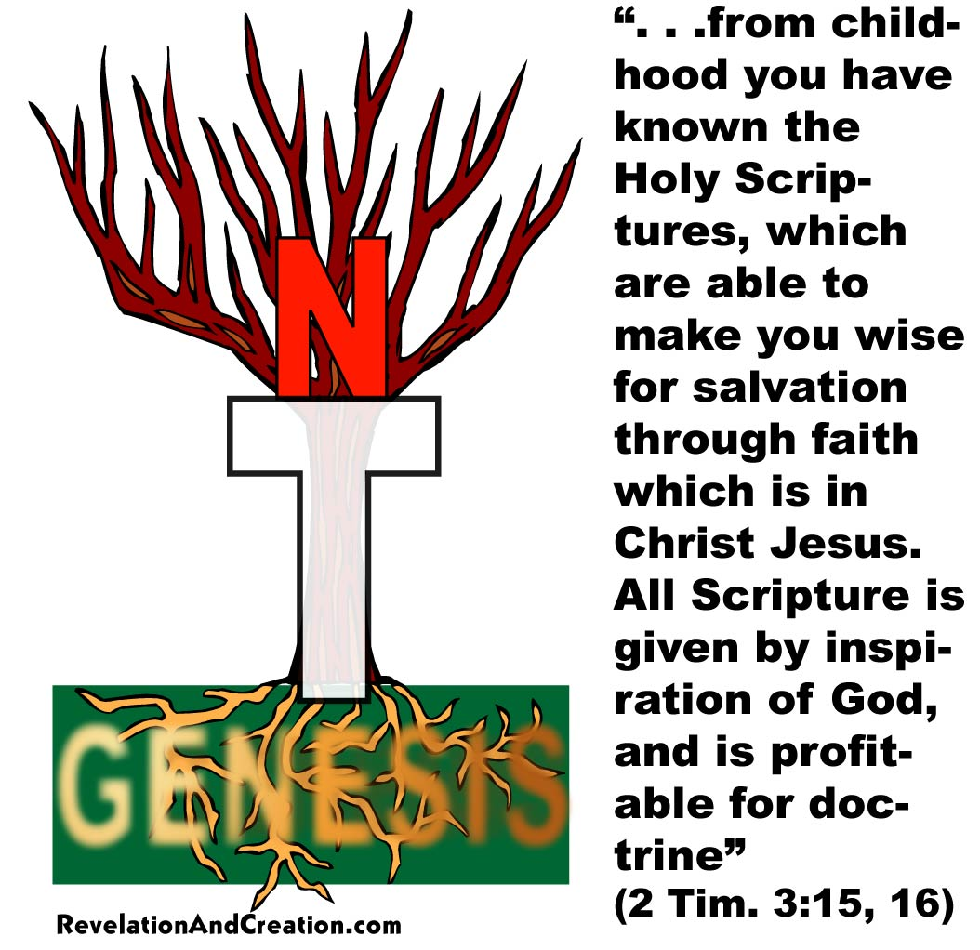
Genesis
Foundational to the Bible
  Bible without Genesis is like a house without a foundation or a tree without roots
  Over 200 quotations or allusion to Genesis in New Testament
Morris, Henry, The Genesis Record, pp. 677-681.
Notes:
Many of the doctrines we hold true from the New Testament are actually rooted in Genesis. The doctrine on what sin is. How do we know what sin is? Genesis teaches us that. The doctrine of marriage, modest, life, even salvation are rooted in Genesis.

Slide 4
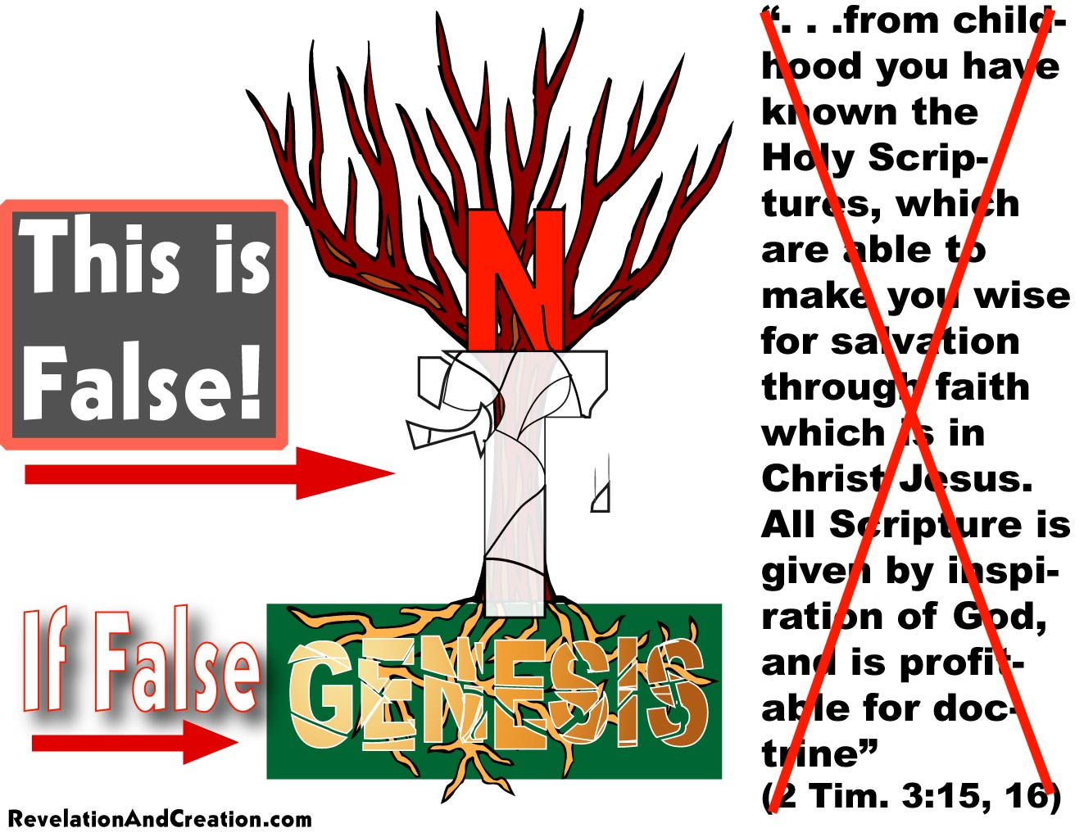
Genesis
Foundational to the Bible
  Bible without Genesis is like a house without a foundation or a tree without roots
  Over 200 quotations or allusion to Genesis in New Testament
Morris, Henry, The Genesis Record, pp. 677-681.

Slide 5
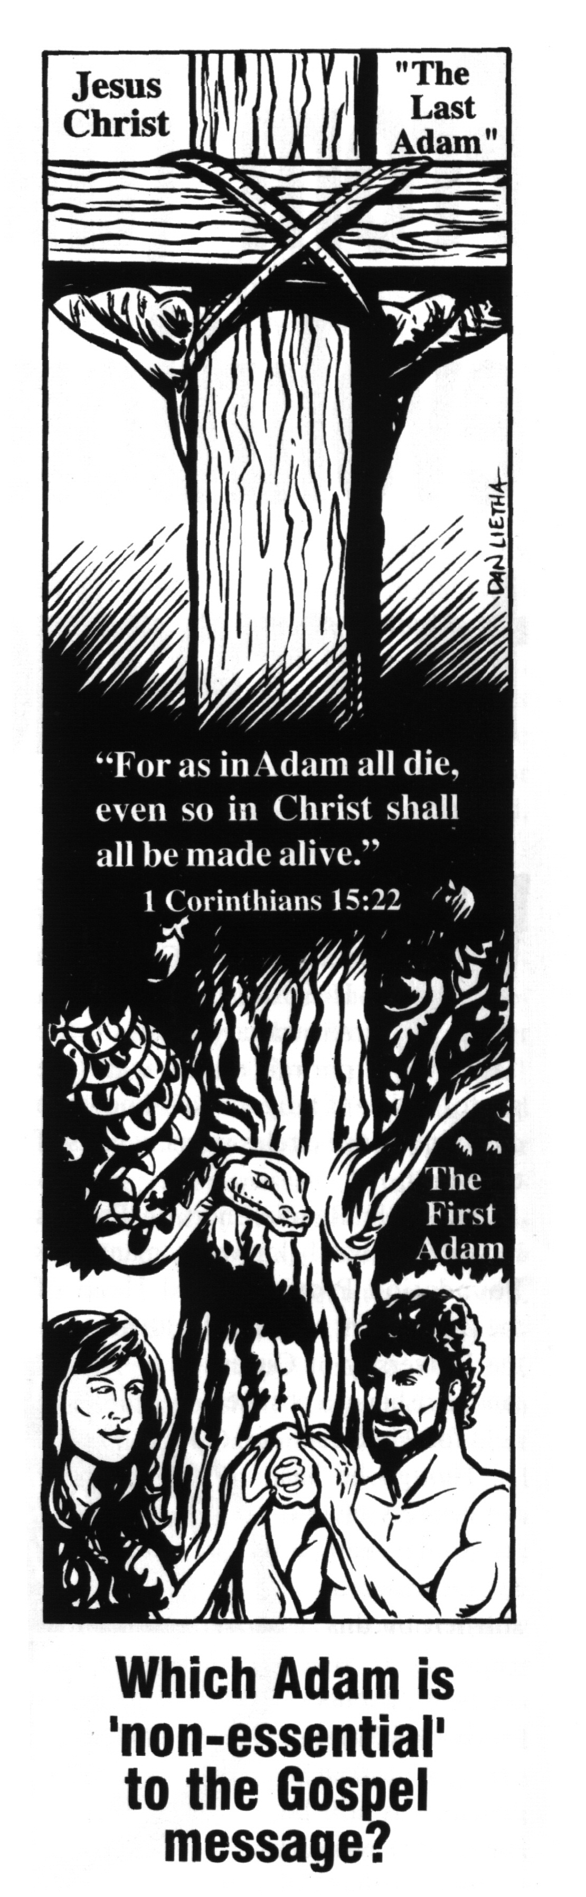
1 Cor. 15: 21, 22, “For since by man came death, by Man also came the resurrection of the dead. For as in Adam all die, even so in Christ all shall be made alive”
1Co 15:45, “And so it is written, ‘The first man Adam became a living being.’ The last Adam became a life-giving spirit”

Slide 6
Genesis
Addresses origins
  How does Genesis affect our outlook?
  How does evolution affect our outlook?

Slide 7
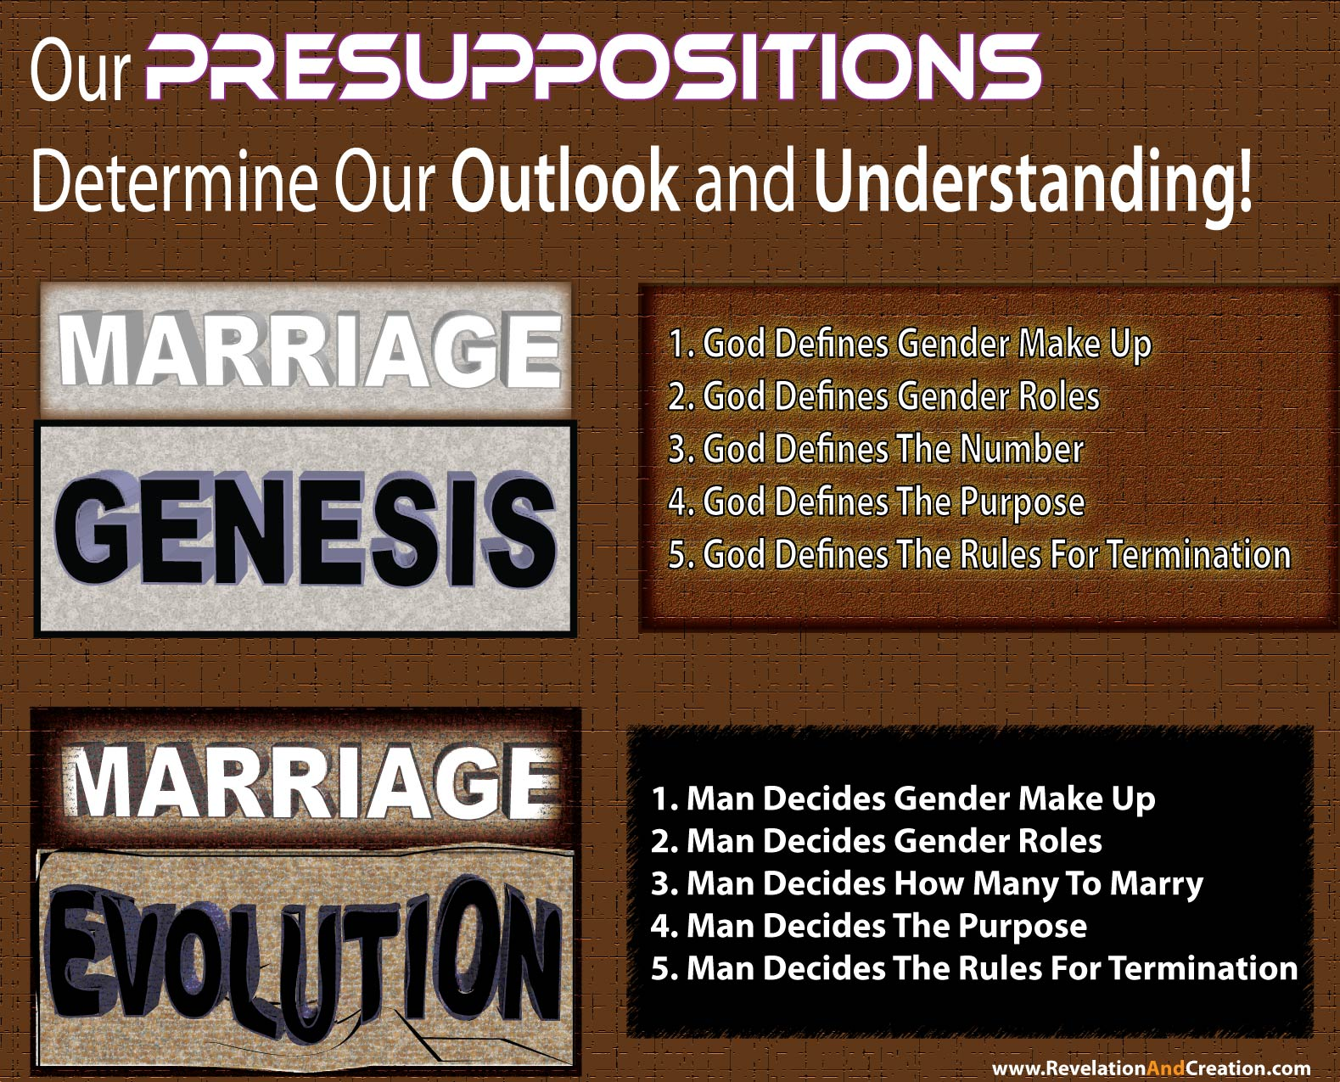

Slide 8
Genesis
The Value Of Genesis
  Helps us understand God’s word
  Helps us understand God’s world
  Helps us understand marriage
  Helps us understand the meaning of clothing
  Helps us understand life
  Helps us understand death
  Helps us understand our weaknesses
  Helps us understand our foe

Slide 9
Genesis 1:1
In the beginning
God created the heavens and the earth
Matter not eternal
Refutes:
  Atheism
  Pantheism
  Polytheism
  Humanism
  Evolution
Notes:
Atheism cannot be true if there is a God
Pantheism cannot be true if there is a God before the creation. Pantheism holds that God and the material universe are the same thing and that He exists in everything, that he is in the forces of nature. But Genesis teaches that God is separate from nature and is before any force in creation.
Polytheism is refuted because there is only one God. The Hebrew word “Elohim” does designate a plurality of persons, but they make up the one true God head. There is a uni-plurality of God (Gen. 1:26). Paul who readily accepted and defended the deity of the Father, Son, and Spirit said, “God is one” (Gal. 3:20). Hence Jehovah is one (Deut. 6:4, “Hear, O Israel, Jehovah our God is one Jehovah,” YLT. Three persons comprise one Jehovah.) There is not a god of light, a god of love, a god of life, a god of death, etc.
Humanism is refuted because God is before any human and is the creator of what is human. He therefore knows what is right for the human race. Man, independent from God does NOT establish truth.
Evolution is refuted because there is a Creator. The world in which we inhabit is not the product of random processes but was designed by an all powerful God.

Slide 10
Approaches Considered
Gap Theory
  Proof-texts given:
    Genesis 1:28 (KJV)
    Jeremiah 4:23-26
    Isaiah 24:1
Notes:
Gap Theory – inserts a gap of millions of years between Genesis 1:1 and 1:2. They assert there was an initial creation in verse one which eventually ended after eons of time in a cataclysm before the creation of Adam and Eve. This, they think explains the geologic ages. It is simply a black hole they have created to throw all the hard to explain things which secularists throw against the Bible (like millions of years, dinosaurs, the fossil record, etc.). These advocates would have verse one start with “but” rather than “the.” They also want it to read that the earth “became ruined and emptied.”
The King James Version adds to the confusion by translation 1:28 as “replenish” the earth when it should simply read “fill” (NKJV, see also “fill” Gen. 1:22; 42:25). Gap theorists run to Jeremiah 4:23-26 as proof that the earth was once full and then emptied. But this passage is speaking metaphorically about Jerusalem (3:14, 22). They also add Isaiah 24:1 as commentary on some supposed early creation that ended before Adam. But the context supports no such idea. The previous chapters deal with the nations, Babylon, Moab, Damascus, Samaria, Ethiopia, Egypt, etc. The word “earth” should be translated land (YLT). He obviously returns to the people of God in this passage and Isaiah speaks of his land as barren and made empty. The indication for this comes from 24:2-5 where we see priests and the transgression of law and the covenant. Hence the city is emptied (24:10, 12). This is therefore most likely referring to the time when Nebuchadnezzar marched against Jerusalem and destroyed it and carried away its people.

Slide 11
Approaches Considered
Gap Theory
Revelation-Day Theory
The Day-Age Theory
The Nonconsecutive-Day Theory
What Do All These Theories Have In Common?
TIME
Notes:
Revelation Day – Advocates that in six days the Lord revealed to man. This contradicts Exodus 31:17.
The Day-Age – Advocates that each of the seven days are seven ages of time. This also contradicts the ability to understand the Sabbath law (Exod. 20:8-11). Likewise what would the evening and the morning be in each verse (cf. 1:5, 8, etc.). They would have to be millions of years of darkness and millions of years of light which is impossible to believe. You have grass and fruit trees being created millions of years before the sun as well as millions of years before insects were created…hence you have fruit without pollination!
The Nonconsecutive-Day Theory is just as bad. It just embraces that God instantly created everything on that day, but that there were millions of years which still separated the days. What do all these approaches have in common? “Time” They are all theory to buy time and cram it into the Genesis record. Why? To make the bible fit with what some falsely claim as science.

Slide 12
The Only Scriptural Approach
The Literal Day Approach
  Jesus embraced the literal day by placing the creation of male and female at the beginning of creation (Mk. 10:6)
  Day is defined as “evening and morning”
  Literal creation week is the basis for our seven day week
  “Seasons” and “Years” cannot be understood with metaphorical days
  (Gen. 1:14)

Slide 13
Stages of Land/Ocean
SPIRIT
FACE OF THE DEEP/WATERS
Stage 1 (Gen. 1:2)

Slide 14
Stages of Land/Ocean
FACE OF THE DEEP/WATERS
Waters Above
Firmament
Waters Below
Stage 2 (Gen. 1:6, 7)

Slide 15
Stages of Land/Ocean
FACE OF THE DEEP/WATERS
Waters Above
Firmament
Waters Below
Dry Land
Stage 3 (Gen. 1:9, 10)

Slide 16
Stages of Land/Ocean
Waters Above
Heaven
[Seas]
Earth
[Dry Land]
Firmament
“For this they willfully forget: that by the word of God the heavens were of old, and the earth standing out of water and in the water” (2 Pet. 3:5, NKJV)
Notes:
The effect is that these waters encircled the earth. This would in effect, cause a relatively warm uniform climate throughout the entire globe. Storms and air masses would have been inhibited. The first time we read of wind is after the flood incidentally (Gen. 8:1). There would have been no rain (cf. Gen. 2:4, 5). Lush greenery over the entire land. There would not have been any ice or even desert regions. It has been estimated that there are over 5 million mammoth remains buried all along the coast of northern Siberia and Alaska. By the sheer size and number of these creatures, it demands that vast vegetation was abundant there. The world’s oceans today are deeper than they were then. Also, the world’s mountains today are higher than they were then which we will likely discuss in a later class.

Slide 17
Characteristics of God in Genesis 1
God is powerful
God does what He says
The power of His word
(Ps. 33:9; Heb. 11:3)
From Him and in Him is light
(Gen. 1:3; cf. 2 Cor. 4:6)
What is truly “good” is of “God”
(Gen. 1:4, 10, 12, 18, 21, 25, 31; cf. Jas. 1:17)

