Slide 1
Theme Of The Bible
“The Redemption Of Man From Sin”
Section IX: Genesis 14
(Abram the Hebrew & The Battle of the Kings)
All verses from the NKJV unless noted.
Notes:
Slides Inserted from “Sodom and Gomorrah, Battle of the Kings” follow.

Slide 2
Sodom And Gomorrah
“Do you see a man who excels in his work? He will stand before kings; He will not stand before unknown men” (Pr 22:29)
Battle of the Kings
(Gen. 14)
All verses are from the NKJV unless otherwise noted
Notes:
The focus of our study today is going to be staged in the 14 chapter of the ancient book of Genesis. Abraham and Lot are the central figures of the broad context that started back in Genesis 12 with the promise that was given to Abraham and yet we find them separated from each other in chapter 13 and in chapter 14 ultimately reconnected in a political war that has both of them involved in by the decisions of greedy or rebellious kings.
Our focus is on the battle of the kings mentioned in Genesis 14, and yet we see the newcomer to the area of Canaan, Abraham, being elevated over them all. Such literally happened to Abraham as the Proverb 22:29 teaches. He not only stood before them, but in many respects, stood above them.

Slide 3
General Outline of “Sodom and Gomorrah—Battle of the Kings” (Gen 14)
Introduction (effect, opposition by Bible critics, evidences from archaeology and ancient literature)
Battle of the kings
Battle with “materialism”
Battle with “success”

Slide 4
The Effect of the Biblical Account on Our Modern Language
We describe wicked places as “Sodom and Gomorrah”
Some sermons are filled with “fire and brimstone”
legal term “sodomy”
BUT DID THESE CITIES EVER
LITERALLY EXIST?
NON-BELIEVERS SAY “TOO INCREDIBLE!”
Notes:
“The 20th-century German Bible critic, Theodor Noldeke asserted that ‘The whole story of Sodom and Gomorrah is unhistorical and comparatively late in origin’” (http://www.aish.com/societyWork/sciencenature/Biblical_Archeology_Sodom_and_Gomorrah.asp).

Slide 5
Bible Critics Have Asserted:
the names of the Mesopotamian kings are fictional
there was no extensive travel in the days of Abraham like Genesis teaches as pertaining to this Mesopotamian march
there was no line of march, east of Palestine
Notes:
He and others asserted that (1) the names of the Mesopotamian kings are fictional; (2) that there was no extensive travel in the days of Abraham like Genesis teaches that this Mesopotamian military undertook and (3) that there was no line of march, east of Palestine (see Free, Joseph P. and Vos, Howard F., Archaeology and Bible History, p. 52, copyright 1992, Revised Ed.)

Slide 6
Evidence Contraire
Archaeologist’s spade has shown the names are good Near Eastern names
Ancient Babylonian tablets mention names like “Abarama” and “Abamrama”
Ancient Babylonian contract found restricting the use of rented wagons from being driven to the Mediterranean coastlands
Elamite king named “Kudur-Mabug” claimed to be prince of the land of Amurru (probably included Palestine)
Source: Free, Joseph P. and Vos, Howard F., Archaeology and Bible History, p. 52, © 1992, Revised Ed
Notes:
However, the archaeologist's spade has shown that the names given in Genesis are good Near Eastern names. Though not referring to Abraham in the Bible, ancient Babylonian tablets have been found that mentions the name Abarama and Abamrama which are close to the Hebrew Abraham (ibid.). Also a Babylonian contract has been found on a clay tablet restricting the use of rented wagons from being driven to the Mediterranean coastlands which dismisses the charge that ancient travel was not extensive. Furthermore, an Elamite king named Kudur-Mabug claimed to be prince of the land of Amurru which probably included Palestine (ibid.).
“…in the early 1920s, Dr. Nelson Glueck discovered evidence of an ancient route between Mesopotamia and the Dead Sea area. Traces of the actual route, which had been covered by the desert storms, were uncovered. Mention of the route was subsequently found in cuneiform tablets in Mari and in Ebla.
By 1924, the previously doubtful Albright became convinced of the possibility of some ancient inhabited area near the barren eastern bank of the Dead Sea. His expedition had found some meager remains of an early Bronze Age structure assumed to have been a fortress or temple. It was located on a mound, known as Bab edh-Dhra, overlooking the desert floor some 550 feet below” (aish.com.)
About 40 years later, a large cemetery was found at Bab edh-Dra which I will mention later on.

Slide 7
Affirmed to Have Existed by Bible Writers
By Moses (Gen. 10; 13; 14; 18; 19; Deut. 29; 32)
By the prophets (Is. 1:9, 10; 3:9; 13:19; Jer. 23:14; 49:18; 50:40; Lam. 4:6; Ezek. 14:46; 16; Amos. 4:11; Zep. 2:9)
By Jesus (Matt. 10:15; 11:23, 24; Mk. 6:11; Lk. 10:12; 17:29)
By the apostles (Rom. 9:29; 2 Pet. 2:6; Jude v. 7; Rev. 11:8)
REJECT SODOM’S HISTORY; REJECT ALL BIBLE!
Notes:
Its clear that if you reject the old historicity of Genesis, you have to reject the authority of the New Testament.
Isaiah 1:9, “Unless the LORD of hosts Had left to us a very small remnant, We would have become like Sodom, We would have been made like Gomorrah.”
Lamentations 4:6, “The punishment of the iniquity of the daughter of my people Is greater than the punishment of the sin of Sodom, Which was overthrown in a moment, With no hand to help her!”
Matt. 11:23, “And you, Capernaum, who are exalted to heaven, will be brought down to Hades; for if the mighty works which were done in you had been done in Sodom, it would have remained until this day.”
Luke 17:28, 29, “Likewise as it was also in the days of Lot: They ate, they drank, they bought, they sold, they planted, they built; but on the day that Lot went out of Sodom it rained fire and brimstone from heaven and destroyed them all.”

Slide 8
Affirmed to Have Existed by Non-Biblical Sources
Josephus
“But Lot’s wife continually turning back to view the city as she went from it, and being too nicely inquisitive what would become of it, although God had forbidden her so to do, was changed into a pillar of salt; for I have seen it, and it remains at this day” (Antiquities of the Jews, 1:11:203)
Ebla Clay Tablets (northern Syria)
In 1975, about 17,000 tables were unearthed dating ca. 2400 BC
One tablet is a geographic atlas listing 289 places according to William Shea
210 = Admah
211 = Sodom
Notes:
Cf. Luke 17:31, 32

Slide 9
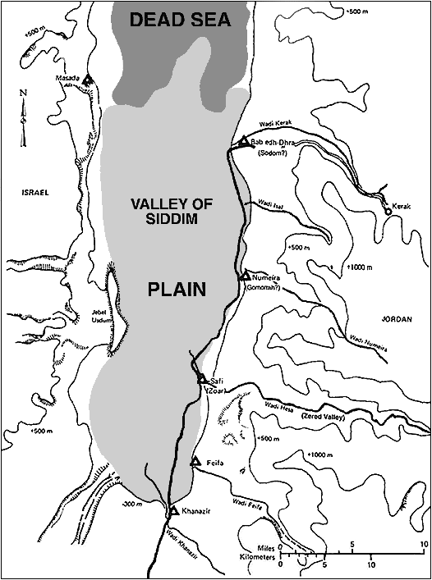
Sodom
Gomorrah
Map of the area south of the Dead Sea, showing the proposed locations of the Biblical Cities of the Plain.
(Bryan G. Wood, www.BibleArchaeology.org, used with permission)
Three Other Proposed Sites Matching the “FIVE” of Genesis 14!
Notes:
This map shows the estimated extent of the Dead Sea in Abraham’s day.

Slide 10
Once Upon A Time
Sodom was of extraordinary beauty and fertility
“And Lot lifted his eyes and saw all the plain of Jordan, that it was well watered everywhere (before the LORD destroyed Sodom and Gomorrah) like the garden of the LORD, like the land of Egypt as you go toward Zoar. Then Lot chose for himself all the plain of Jordan, and Lot journeyed east. And they separated from each other” (Gen. 13:10, 11)
It resembled the Garden of Eden and the lush areas of Egypt
It was “well watered everywhere” (superbly irrigated)

Slide 11
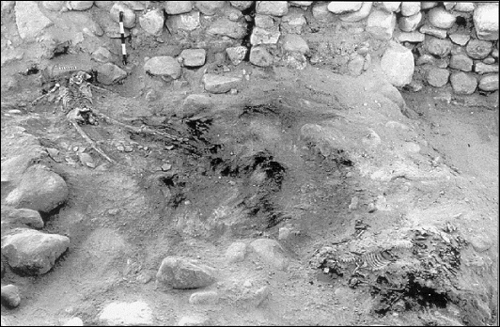
Archaeological Jewels in the Ruins of Sodom & Gomorrah
Large Cemetery
Necessitates a large living population within the area
Fortified Walls
~10 acres enclosed with a 23 foot wide wall
13 feet wide walls at Numeira (Gomorrah)
Implicates threats from others (cf. Gen. 14)
Average Height Taller than Today
Skeletal remains indicate an average of 5’9” – 6’4” (aish.com)
Thanks to the research of Bryan G. Wood, PhD, of Associates For Biblical Research, www.BiblicalArchaeology.org article, “The Discovery of the Sin Cities of Sodom and Gomorrah” (originally published in Bible And Spade Magazine, Summer 1999)
Notes:
RE: PICTURE: “Two victims of the destruction of Numeira. These two skeletons were found adjacent to the east tower, lying in the ashy debris of the conflagration which brought the city to an end. They were buried under the collapsed stones from the tower.”
RE: Average height of man today. I could not get a universal fixed number but I could on various nations. For Japan and Mexico, the average height of a man was 5’7” and women being 5’2” and 5’1” respectively. White and Black American men average 5’10” but the grand average of all American males is 5’9.4”; women 5’3.8”.

Slide 12
Archaeological Jewels in the Ruins of Sodom & Gomorrah
Large Cemetery
Necessitates a large living population within the area
Fortified Walls
~10 acres enclosed with a 23 foot wide wall
13 feet wide walls at Numeira (Gomorrah)
Implicates threats from others (cf. Gen. 14)
Average Height Taller than Today
Skeletal remains indicate an average of 5’9” – 6’4” (aish.com)
Healthy Diet
Paleo-botanical studies suggest a rich diversity of crops grown
Wheat, barley, grapes, lentils, figs, flax, etc.
A cluster of grapes were found in Numeira with their skin still preserved
The structure collapsed around and sealed them off from the outside
Indicates freshly harvested and perhaps time of year
Note how this archaeological find echoes Deuteronomy 32:32
Thanks to the research of Bryan G. Wood, PhD, of Associates For Biblical Research, www.BiblicalArchaeology.org article, “The Discovery of the Sin Cities of Sodom and Gomorrah” (originally published in Bible And Spade Magazine, Summer 1999)
Notes:
RE: Average height of man today. I could not get a universal fixed number but I could on various nations. For Japan and Mexico, the average height of a man was 5’7” and women being 5’2” and 5’1” respectively. White and Black American men average 5’10” but the grand average of all American males is 5’9.4”; women 5’3.8”.

Slide 13
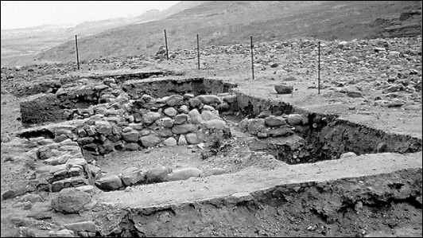
Excavation area at Numeira as it appeared following the 1977 season. “Occupied for less than a century, the remains were better preserved at Numeira [Gomorrah, sjw] than at Bab edh-Dhra [Sodom, sjw]. Textiles, string, rope, seeds, and even a cluster of grapes survived amazingly well. Every room was filled with ash and burned debris from the dreadful holocaust that overtook the city.”
Thanks to the research of Bryan G. Wood, PhD, of Associates For Biblical Research, www.BiblicalArchaeology.org article, “The Discovery of the Sin Cities of Sodom and Gomorrah” (originally published in Bible And Spade Magazine, Summer 1999)

Slide 14
The Battle of the Kings RANSACKING SODOM
(1)
Genesis 14
“Then they took all the goods of Sodom and Gomorrah, and all their provisions, and went their way” (Gen. 14:11)
Notes:
Sodom was destroyed twice. Once it was ransacked in Genesis 14 and then utterly destroyed in Genesis 19, about 20 years later.

Slide 15
Genesis 14:1-4
An ancient event that happened about 2000 BC
It was an ancient event in Moses’ day as he had to clarify and correlate the “modern” names for the old names (vv. 2, 3, 7, 8, 17)
“Siddim” = “Field” (v. 3)

Slide 16
Genesis 14:1-4
Revolt!
Kings rebelling against kings
Kings of the Plain rebelled after 12 full years of serving
Because of the trading routes from the East down through Egypt, it was in every nation’s interest to have control of the Jordan area
About 1000 mile journey
Notes:
“The importance of keeping open the valley of the Jordan is obvious to every one who has interest enough in the subject to look at a map. That valley was the main route for trading caravans and for military expeditions between the Euphrates and Egypt. Whoever held that valley might prove a most formidable annoyance and indeed an absolute interruption to commercial or political relations between Egypt and Elam, or the Eastern powers” (Expositor’s Bible Commentary)

Slide 17
Kings Versus Kings
Eastern Kings
Kings of the Plain
Amraphel (sayer of darkness)
Arioch (lion-like)
Chedorlaomer
Hebrew transliteration of Kudur Lagamar
“…Lagamar was the name of one of the Chaldean deities…” (Expositors Bible Commentary)
Tidal (great son)
Bera (son of evil)
Birsha (with iniquity, an evil son who beholds)
Shinab (splendor of the father)
Shemeber (lofty flight)
No-named king of Bela (destruction)
Notes:
ked'uhr-lay-OH-muhr

Slide 18
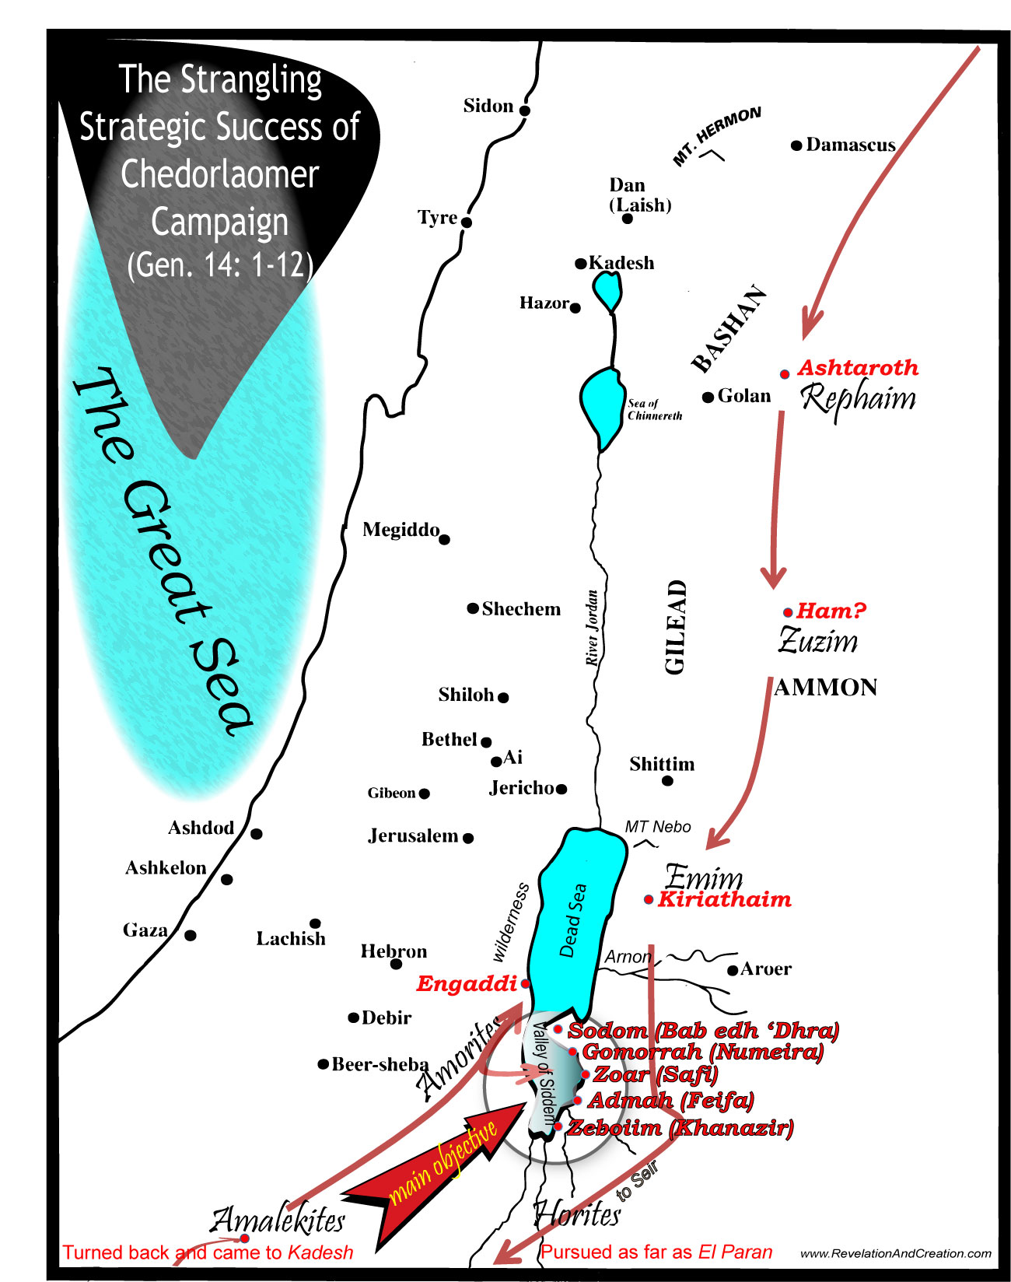
Chedorlaomer’s Strategy & Success (Gen. 14:5-12)
Attacked Rephaim in Ashteroth
Zuzim in Ham
Emim in Shaveh Kiriathaim
Notes:
Cheorlaomer and his military did not just go and attack the cities of the plain directly. They were like a massive bulldozer clearing the path of the King’s Highway from any political road block for the trading of Mesopotamia and Egypt. It is interesting to note that his strategy plundered nations of giant men all around the cities of the Plain which would accomplish several things. 1) It would put fear into the inhabitants of Sodom that may lend to their surrender without fighting. 2) It would prevent Chedorlaomer’s military being ambushed from behind by neighboring sympathizers. 3) It would create a noose around the cities of the plain eliminating any trade coming in or going out.
[CLICK] Chedorlaomer’s first success was against the Rephaim in Astaroth (spelled Ashteroth in Gen. 14:5). Now these giants were not annihilated as Og, a Rephaim (and also called a king of the Amorites Deut. 31:4), existed there during Moses’ day several centuries later. Scripture gives us an inclination as to the size of these Rephaim as it relates to Og (see Deut. 3:11; note material and size of bedstead – iron to support his weight and dimensions to accommodate his gigantic size 9 cubits its length X 4 cubits in width making it 13 ½ feet long and six feet wide. Og could easily have been 12 feet tall.)
[CLICK] Next Chedorlaomer attacked the Zuzim in Ham. The exact location of Ham is still debatable but it makes sense that it would be in this general area. The Zuzim were another race who lived in the area where the Ammonites would inherit. They are noted for being great and numerous as the Anakim in Deut. 2:20, 21. So the Zuzim survived this attack an it is possible that some of them were put in Chedorlaomer’s military as he continued to dominate the opposition.
[CLICK] Next he attacked the Emim in Kiriathaim. The Emim would also survive and continue to dwell in what would become the Land of Moab. When the Moabites later had to deal with them, it was such a frightening ordeal that they gave them the name Emim which means “terrors” (cf. Deut. 2:10, 11).

Slide 19
Chedorlaomer’s Strategy & Success (Gen. 14:5-12)
Attacked Rephaim in Ashteroth
Zuzim in Ham
Emim in Shaveh Kiriathaim
Horite in Mount Seir (as far as El Paran)
Turned back and came to Kadesh attack Amalekites
Notes:
I am sure at this point, that the kings of Sodom and Gomorrah thought they would be attacked next. But to their surprise, Chedorlaomer bypassed them and went in pursuit of the Horites in Mount Seir. THE HORITES WERE DWELLERS IN CAVES and lived at this time in the area that Esau’s descendants would later take over (Deut. 2:12).
Evidently, God was with Edom in dispossessing them as he was with Israel getting into Canaan (cf. Deut. 2:5). Their famed father was called “Seir,” a name that remained upon the land even after Edom took it (Gen. 36:20). These kings from Mesopotamia pursued them as far as the wilderness.
[CLICK] The Bible makes a notation in verse 7, “then they turned back” which means they stopped on the course and turned around with yet another enemy in their cross-hairs—the Amalekites. They came to Kadesh and attacked all the country of the Amalekites. Remember the Amalekites would later attack Moses and the children of Israel after they left Egypt.
[CLICK]

Slide 20
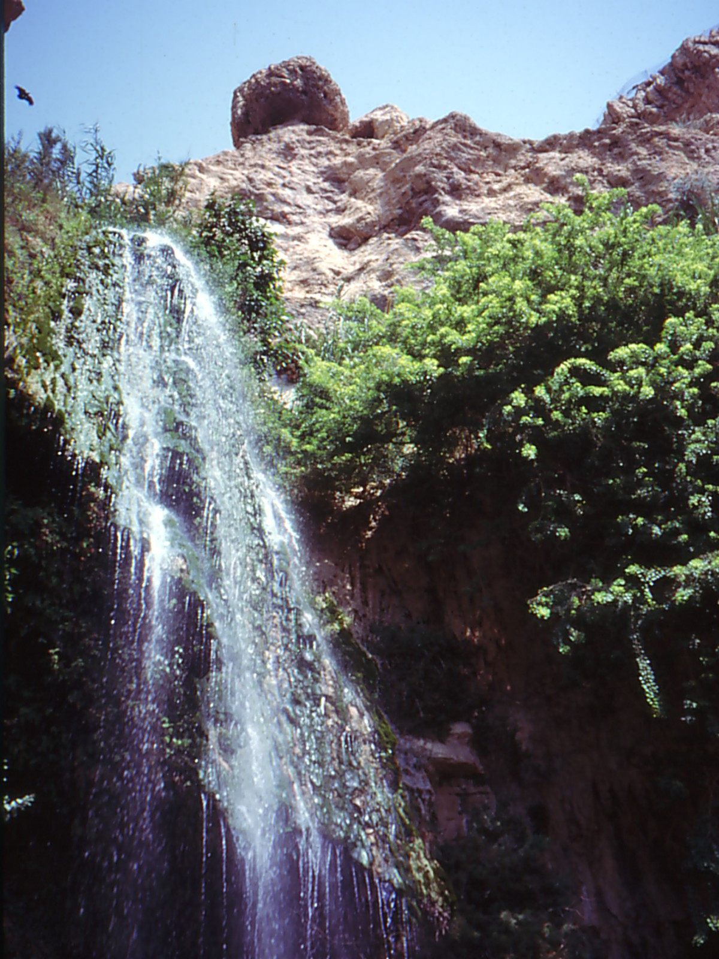
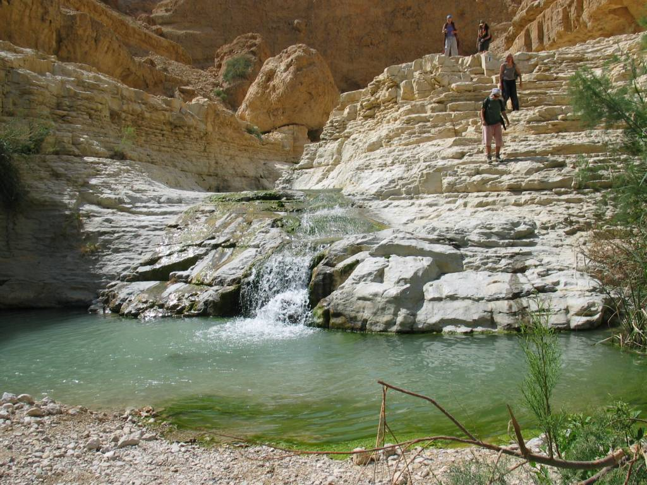
Chedorlaomer’s Strategy & Success (Gen. 14:5-12)
En Gedi
Attacked Amorites in Hezezon Tamar (Engaddi)
Notes:
Then they attacked the Amorites who dwelt in Hezezon Tamar (Engaddi, also spelled “En Gedi” a beautiful oasis on the western shore of the Dead Sea, spoken of in Song of Solomon 1:14, “My beloved is to me a cluster of henna blooms In the vineyards of En Gedi”). But the Amorites who dwelt here were rough men. “The Amorites were warlike mountaineers. They are represented on the Egyptian monuments with fair skins, light hair, blue eyes, aquiline noses, and pointed beards” (Easton’s Dictionary). Evidently they too were large in stature, “Yet it was I who destroyed the Amorite before them, Whose height was like the height of the cedars, And he was as strong as the oaks; Yet I destroyed his fruit above And his roots beneath” (Amos 2:9).
They were wicked at this time, but had not yet reached the level of wickedness to warrant their extermination. "But in the fourth generation they shall return here, for the iniquity of the Amorites is not yet complete” (Gen. 15:16). In fact it was some of these Gentiles who befriended Abraham and became his allies in pursuing these Mesopotamian kings (Gen. 14:13). When Chedorlaomer attacked the Amorites in Engaddi, they were only about 20 miles away from Abraham in Hebron.
There is a bit of foreshadowing irony seen in this chapter with Abraham and the Amorites as the Concise Bible Dictionary suggests, “A remnant out of the Gentile nations was thus associated with the heir of promise, though Lot (a type of Israel after the flesh) had separated from him.”

Slide 21
Sodom and Her Cities Were Smashed (Gen. 14:8-12)
Kings fled – not pretty
Mortal kings can let you down
Take care who is your king (1 Sam. 8:18; Eccl. 10:16, 17; Hos. 13:10; Zech. 9:9; Jn. 12:15)
Fleeing and falling (14:10)
“some fell there” in their own asphalt pits
Is your footing sure (Job 31:4-15; Ps. 18:36)
Our Lord’s feet were pierced for when we slipped!
Our Lord’s feet were pierced because He didn’t run!
He can deliver us from the pit (Ps. 40)
“I have restrained my feet from every evil way, That I may keep Your word” (Ps. 119:101; cf. 119:105)
Notes:
Eccl. 10:16 “Woe to you, O land, when your king is a child, And your princes feast in the morning!
Blessed are you, O land, when your king is the son of nobles, And your princes feast at the proper time--For strength and not for drunkenness!”
Hosea 13:10, “I will be your King; Where is any other, That he may save you in all your cities? And your judges to whom you said, `Give me a king and princes'?”
Zech. 9:9, “Rejoice greatly, O daughter of Zion! Shout, O daughter of Jerusalem! Behold, your King is coming to you; He is just and having salvation, Lowly and riding on a donkey, A colt, the foal of a donkey.”
“You enlarged my path under me, So my feet did not slip” (Ps. 18:36).

Slide 22
LOT Had “A LOT” to Lose
A BATTLE OVER MATERIALISM
(2)
(14:11, 12; cf. 13:6-13)
ABRAHAM
Had A “LOT” to Rescue

Slide 23
The Decision At Bethel
Strife existed between Abraham’s servants and Lot
Land was not able to support them both (13:6, 7)
Abraham graciously offered Lot to choose what land to have; Abraham would separate from him
Lot’s decision was based on economic self-interest and not God’s promise (13:10, 11)
Pitched his tent even as far as Sodom
Did not seriously consider the moral influence such a choice would have on his family (13:12)
Abraham stayed in the promised land of Canaan (13:12; cf. 12:6-8)
Notes:
God gives us forks in the road to test our wisdom in choices. Abraham passed well but Lot failed miserably.

Slide 24
Lot Lost It All!
“Then they took all the goods of Sodom and Gomorrah, and all their provisions, and went their way. They also took Lot, Abram's brother's son who dwelt in Sodom, and his goods, and departed” (Gen. 14:11, 12)
All the movable possessions
All the food supply
Lot’s own life – the shrewd reduced to a slave!
It was all lost in an instant
What do you imagine he thought about as he departed the plain for that 1000 mile journey to Mesopotamia?
Notes:
The fleeting nature of riches (1 Tim. 6:17; Pr. 23:5; 27:24; Eccl. 2:18).
Lot could have thought with regret for moving to such a place. He could have thought “Why Me?” when he had sought to maintain righteousness while living among the immoral. We ought to balance these thoughts with what Solomon wrote in Ecclessiastes 9:2.
Mathew Henry, “Note, further, Many an honest man fares the worse for his wicked neighbours. It is therefore our wisdom to separate ourselves, or at least to distinguish ourselves, from them (2 Cor. vi. 17), and so deliver ourselves, Rev. xviii. 4. (2.) As smarting for the foolish choice he made of a settlement here. This is plainly intimated when it is said, They took Abram's brother's son, who dwelt in Sodom. So near a relation of Abram should have been a companion and disciple of Abram, and should have abode by his tents; but, if he choose to dwell in Sodom, he must thank himself if he share in Sodom's calamities.”

Slide 25
Abraham Retrieved It All
₁₄ Now when Abram heard that his brother was taken captive, he armed his three hundred and eighteen trained servants who were born in his own house, and went in pursuit as far as Dan.
¹⁵ He divided his forces against them by night, and he and his servants attacked them and pursued them as far as Hobah, which is north of Damascus.
₁₆ So he brought back all the goods, and also brought back his brother Lot and his goods, as well as the women and the people (Gen. 14:14-16)
Notes:
It was a military success for Abraham, though outnumbered he had God on his side and an amazing strategy which employed the element of surprise. He pursued them as far as Dan which is to the north at the base of the imposing Mount Hermon and of the springs of the Jordan River.
The enemy was lulled to sleep thinking all was won. They had completely smashed all opposition, and now in a moment of probable enjoyment, their guard was down. Chedorlaomer did everything right except for one thing he did not consider--the “X” factor. He did not consider the Jehovah/Abraham factor, nor did he probably even know them. But like one robbing from Ben Cartwright on the Ponderosa, he would soon learn Abraham, one of the great faith heroes of history.
Abraham had the tactical success of attacking them at night. Who knows what the enemy was thinking but I am sure confusion like this was never felt by them before or afterwards.

Slide 26
The Battle With “SUCCESS”
(3)
GENESIS 14:17-24
Notes:
You might think that this is an odd thing to suggest…as if there is a battle with success being an opponent. Abraham was involved in a military battle and won decisively. But it can often be a danger for men who reach such high success and fall thereafter (Deut. 8:11-20; Uzziah, 2 Chron. 26:16; Hezekiah, 32:24-26, possibly Isaiah 39).
Abraham just took out an army that slaughtered giants and kings. All the news ringing through Canaan is “ who is the God of Abraham.” We have an expression for someone who is raised up out obscurity and hits a home run with success and fame as a “Rock Star.”

Slide 27
Abraham
Won a victory that no one else in the Trans-Jordan valley could win (not even the Rephaim)
The king of Sodom (a city estimated to have been in existence for about 1000 years at this time) is wanting to greet Abraham (Gen. 14:17)
The King of Salem is blessing him (Gen. 14:18-20)
Yet Abraham remained wise, humble and God-fearing!

Slide 28
Perhaps it was that Divine Intervention and Revelation from Melchizedek
That helped Abraham remain composed
That bolstered his faith to win in faith as well as war
That helped provide that “way of escape” in how to deal with temptation and the goods of Sodom (1 Cor. 10:13)
“Bless the LORD, O my soul, And forget not all His benefits” (Ps. 103:2)

Slide 29
RECALL
₁₈ Then Melchizedek king of Salem brought out bread and wine; he was the priest of God Most High.
₁₉ And he blessed him and said: "Blessed be Abram of God Most High, Possessor of heaven and earth;
_{20a} And blessed be God Most High, Who has delivered your enemies into your hand."

Slide 30
Abraham Listened!
Abraham Gave a Tithe
“And he gave him a tithe of all” (14:20_{b})
Do we give as well as Abraham?
How do we respond to our Melchizedek in giving (2 Cor. 9:6-11)?
Abraham repeated the truth to the King of Sodom
₂₁ Now the king of Sodom said to Abram, "Give me the persons, and take the goods for yourself."
₂₂ But Abram said to the king of Sodom, "I have raised my hand to the LORD, God Most High, the Possessor of heaven and earth,
₂₃ that I will take nothing, from a thread to a sandal strap, and that I will not take anything that is yours, lest you should say, `I have made Abram rich' --
Notes:
1. In essence, the foreshadowing of preaching the gospel to the uncircumcision is seen here in Genesis 14. Had the king of Sodom listened to Abraham the way Abraham listened to Melchizedek, I am convinced that Sodom would have been spared that dreadful day of the Lord on the horizon.
In fact, the king of Sodom was probably there when Melchizedek visited Abraham as the outline suggests an interruption in vv. 17, 21.
2. Sodom will be rebuilt (with 23 foot wide walls). Life will continue to go on and this salvation will soon be forgotten. The moral quality of the city-state will wax worse over the next two decades.
3. Furthermore, what about Lot? He will continue to live in Sodom until it is finally overcome by God in the great judgment of fire and brimstone about 20-26 years from now.

Slide 31
Will You?
Will you take up the example of faith in Abraham?
Will you raise your hand up to the LORD God Most High, the Possessor of heaven and earth?
A manner of making an oath and contract with God (cf. Ezek. 20:5, 6; Rev. 10:5, 6)
Have you made a commitment to the Lord in Baptism (Rom. 6:1-12)?
Will you refuse Sodom’s allurements?
Lot wanted to live there despite the moral jeopardy; Abraham didn’t want any of their things even when he could have had them all (cf. Moses, Heb. 11:24)!
How will you respond to the gospel?
What Will Your Answer Be?

