Slide 1
Theme Of The Bible
“The Redemption Of Man From Sin”
Section XIII: Genesis 25:19-28:22
(The Promise: Isaac - Jacob)
All verses from the NKJV unless noted.

Slide 2
Two Sons—Two Nations: Jacob and Esau (25:19—34)
Pleading with the Lord (25:21)
  20 years after their marriage before they had children (see 25:20, 26)
  God still expects us to pray to Him despite what He promises to fulfill (Gen. 17:19; Is. 65:24)
Struggle within (25:22, 23)
  Inquiry of the Lord
  Twins = two nations within (Esau, hairy; Jacob, supplanter)
  Older shall serve the younger
    Fulfilled when they were nations, not as individuals, 2 Sam. 8:14
Notes:
The Lord knew what Isaac wanted before he asked. Isaac’s mother died when he was 37, he was married at 40, had children at 60, died at 180 (Gen. 32:28).

Slide 3
Two Sons—Two Nations: Jacob and Esau (25:19—34)
Esau—a skillful hunter, a man of the field (25:27)
Jacob—a mild man, dwelling in tents
  “mild” — (blameless, Job 1:1; perfect, Song 5:2)
  Idea of complete, lacking nothing, sound
Children of partiality (Gen. 25:28)
  Isaac’s love based on the carnal appetite (27:4)
  Rebekah’s love more likely based upon the social manner, nature, and spirituality of Jacob over Esau
  Esau—hunter and conqueror
  Jacob—domestic builder and shepherd
  Parental partiality only sows seeds of problems which will later grow into hatred and contention

Slide 4
Two Sons—Two Nations: Jacob and Esau (25:19—34)
Despising Versus Desiring the Birthright (25:29-34)
  The birthright fell to the firstborn and granted a double portion of the inheritance (Deut. 21:17)
  Esau despised his birthright because he willingly made common that which was special—a bowl of food
    Decision based on immediate gratification/appetite and not the delayed blessings which came with it
    Problem of short sighted, compulsive, and worldly decision making versus a patient waiting of permanent blessings (Lk. 15:11-13; Mal. 3:13-18)

Slide 5
Esau’s Character
Left his right to share in the promise to Abraham—despising his birthright
Married Hittite women who brought grief to his parents (Gen. 26:34, 35)
Married a third woman to try to gain their favor (Gen. 28:6-9)
Found no place for repentance for selling his birthright (Heb. 12:16, 17)

Slide 6
Esau’s Character
Consequence: As a nation, Esau inherited the rugged south while Jacob inherited the glory of the land of promise; Esau was given over to idles while a Israel was given prophets and priests (see Mal. 1:2-3)
Applications:
  Do we have a birthright which we can despise? How might we despise it?
  Is being weary a valid reason to sell out and quit (Heb. 12:1-4; 10:35-39)?
Notes:
Read Romans 8:14-17; 2 Peter 1:2-11.

Slide 7
Isaac & Abimelech
(Gen. 26)
Famine (26:1)
Do not go down to Egypt (26:2)
Reiteration of promise to Abraham (26:3-5)
  Isaac obeys (26:6)
Familiar failure (26:7-11)
  That Sarah was Abraham’s sister was a half-truth
  That Rebekah was Isaac’s sister had no truth in it
  Even these Gentiles know that adultery is wrong and brings guilt upon a people
Notes:
These Philistines of long ago show a higher moral standard than what is understood in our own country today!

Slide 8
Isaac & Abimelech
(Gen. 26)
Blessed and envied (26:12-22)
  The Gentiles envied Isaac’s success
    Eccl. 4:4; Prov. 27:4; Gen. 37:11; 1 Sam. 18:6-9; Mk. 15:10
Notes:
The greedy pursuit of gain has always been a problem with mankind. Envy is born out of such and has been the vice that led to much of the sorrows experienced under the sun (Gen. 37:11; 1 Sam. 18:6-9; Mk. 15:10).

Slide 9
Isaac & Abimelech
(Gen. 26)
Blessed and envied (26:12-22)
  The Lord’s blessing and good success does:
    Not mean the absence of trials and opposition
    Not require only waiting, but also working
    Require humility
  Isaac was made to depart several times and dug several wells which he could not use or was taken from him due to the contention of his neighbors
    Esek (contention/quarrel)
    Sitnah (enmity)
    Rehoboth (spaciousness)

Slide 10
Restating the promise (26:23-25)
  Need to appreciate how much of the promise to Abraham is spoken of in the Bible

Slide 11
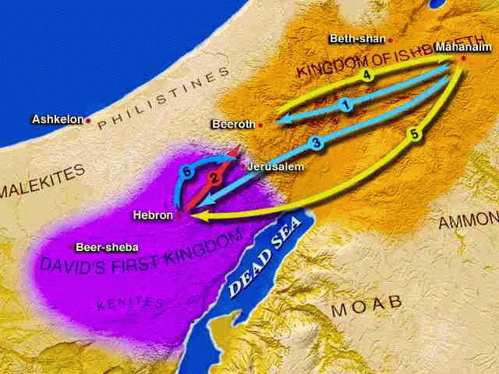
Restating the promise (26:23-25)
Beersheba “well of the sevenfold oath”
  Connected with Abraham (Gen. 21:22-34)
  Wearied from contention, Isaac retires here, calls upon the Lord

Slide 12
Treaty with Abimelech (26:26-33)
Failure of Esau (26:34, 35)

Slide 13
Isaac Blesses (27)
Genesis 27:1-4
Isaac determined to bless Esau in spite of:
  Esau’s aggravating choice to marry Hittite women
  Esau’s selling and profaning the birthright (confirmed with an oath, 25:33)
  God’s original promise about the children (25:23)
Sad to see someone make such an important decision based on such low reasons
  Ironically, Esau’s original problem is now seen as Isaac’s problem
  Proves the power of appetite (contrast Matthew 4:1-4)

Slide 14
Applications & Warnings
The Lure of Forbidden Fruit (Gen. 3:6)
The Lure of Fertile Fields (Gen. 13:10, 11, 13)
The Lure of Appetite (Gen. 25:29,30,33)
The Lure of Silver and Gold (Josh. 7:21; Jud. 16:5, 6)
The Lure of Women (1 Kin. 11:1, 4)

Slide 15
Isaac Blesses (27)
Genesis 27:5-17
Rebekah’s plan to counter Isaac’s mistake—appeal to his senses
  Savory food
  Smell of clothes
  Hair from goats on hands and neck

Slide 16
Isaac Blesses (27)
Genesis 27:18-29
Jacob (supplantor) supplanted his father and gained the blessing (27:36)
Isaac, moved by the physical was deceived
Thought Question: “Was this a blessing of faith (Heb. 11:20)?”
Blessed a man through the act of being deceived is not by faith
The blessing of faith came later when Isaac was moved by faith rather than sense (Gen. 28:1-4)

Slide 17
Esau’s Response
Genesis 27:30-46
  Esau cried bitterly but did not repent (27:34, 38; cf. Heb. 12:16, 17)
  Esau was responsible for selling his birthright but lied; he was self-deceived (27:36)

Slide 18
Esau’s Response
Genesis 27:30-46
  Esau hated his brother more than his own profane actions (27:41)
    The relationship of hatred and murder (1 Jn. 3:15)
    Comforted himself to kill Jacob after his father’s death
    Thought death was “at hand” (27:41)
      No one can know when one may die; Isaac continued to live at least twenty years afterwards (Gen. 31:41; 35:27-29)

Slide 19
Genesis 28
Genesis 28:1-5 — Isaac’s blessing by faith
Genesis 28:6-9 — Esau marries again
Genesis 28:10-22 —Jacob’s vision
Notes:
Note on Esau—This shows that Esau knew that his parents were not pleased with his choices.

Slide 20
Genesis 28:10-22
Jacob’s ladder, a stairway to heaven, angels (messengers) ascending and descending
  Communication is opened up toward heaven

Slide 21
Genesis 28:10-22
Reiteration of the promise to Abraham—the purpose of which is to restore communication and fellowship between God and man
  In your seed (28:14)
  Jesus is the Seed (Gal. 3:16, 19)
  Jesus is the ladder (Jn. 1:51; 3:13-21)
House of God and gate of heaven (28:17)
  Jesus is the gateway and the church is God’s house (1 Tim. 3:15, 16)

