Slide 1
AFTERWARD
“at a later time or after an event that has been mentioned previously” (Encarta)

Slide 2
Afterward?
How Often Do We Think Of What Follows
When we do things
When we say things
When we frequent places
When we approve things

Slide 3
Proverbs 20:17
“Bread gained by deceit is sweet to a man, But afterward his mouth will be filled with gravel.”
Mouth
Filled
With Gravel
BREAD GAINED
AFTERWARD
DECEIT

Slide 4
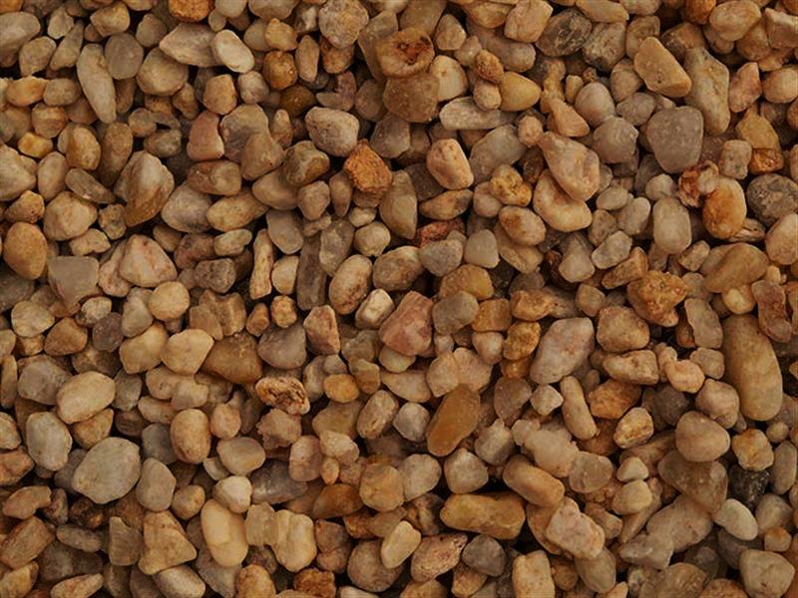
From Bread To Gravel
Accepting the enticement of foolishness (Prov. 9:13-18)
Forbidden consumption (Gen. 3:6, 7)
Youthful lust (Prov. 7:6-27)
Self guidance (Prov. 14:12)
Intoxication (Prov. 20:1; 23:29-35)

Slide 5
Eccl. 11:9, 10
9 Rejoice, O young man, in your youth, And let your heart cheer you in the days of your youth; Walk in the ways of your heart, And in the sight of your eyes; But know that for all these God will bring you into judgment.
10 Therefore remove sorrow from your heart, And put away evil from your flesh, For childhood and youth are vanity.

Slide 6
Psalm 73:24
“You will guide me with Your counsel, And afterward receive me to glory.”
Asaph went through a trial of confusion (73:1-16)
Found answers to his dilemma when he went to the sanctuary of God (73:17-20)
Grieved over his thinking and conduct (73:21, 22)
Confidence in God, His grace, and His counsel (73:23-28)

Slide 7
Psalm 73:24
“You will guide me with Your counsel, And afterward receive me to glory.”
Receive Me To GLORY
GUIDE ME
AFTERWARD
YOUR COUNSEL

Slide 8
The Time To Prepare For Glory Is Today!
2 Corinthians 6:1, 2

Slide 9
Today
Today
Afterward
Accepted Time
Psalm 32:6
Too Late!
Matthew 25:1-13
ARE YOU PREPARED TODAY?

