Slide 1
“Complacency”
1. Satisfied
“self-satisfied and unaware of possible dangers”
(Encarta)
“an underestimation”
Notes:
We are talking about a calm sense of well-being coupled with being oblivious to any real danger. This results in an underestimation of a situation. The polar opposite of complacency is not good either. Where complacency results in an underestimation of reality, anxiety is an over estimation and results in a lack of faith in God. Israel displayed both of poor qualities in Deut. 1. They were first too anxious to trust and obey (Deut. 1:26-32). Then they switched and ran the other way to ignoring God’s word and went into danger (Deut. 1:41-46)

Slide 2
“Complacency”
conceit | unaccountable | self-assurance | indifference
Notes:
Similar attitudes associated with the complacent mind. Complacency can easily set into our personal lives, our business ventures, and our faith. One person observed, “Just because we feel safe, does not mean we are safe. On the contrary, ‘feeling safe all the time’, could be the biggest threat to our well being, because we are drifting into that complacent mode” (http://toolboxtopics.com/Contributed/Complacency%20%202.htm). Complacency dulls our senses and slowly and gently leads our minds to sleep.
Conceit is often an ingredient in the complacent mind. The conceited person or narcissist is right in his own eyes. He is the one who is doing well and knows the facts. He is the one whom others should in fact want to be more like. “Do you see a man wise in his own eyes? There is more hope for a fool than for him” (Prov. 26:12).

Slide 3
Some Causes Of Complacency
Poor assessment and self-will
  Matt. 22:1-5, 11, 12
Laziness
  Matt. 25:24-26
False peace
  Jer. 2:35, 36
Conceit
  Rev. 3:16-18
Notes:
Poor assessment-stems from wrong thinking, in this case, light thinking which stems from self-will. (see also Prov. 1:7, 24-32)
Laziness is a sin. It is also one of the leading factors for the complacent mind.
False peace is related to a false assessment. It is dangerous when we think we can no longer be taught, or have need of no improvement or perceive ourselves in one way, when God and everyone else sees us in totally different way.
Conceit –This leads to another symptom and a cause of complacency which is being conceited. Laodicea thought they were good and in need of nothing and hence they were lukewarm.

Slide 4
Some Causes Of Complacency
Familiarity
  Mk. 6:4; Rev. 2:4
Contentment in a comfort zone
  Matt. 25:18; 2 Cor. 13:5
Notes:
Familiarity, this is a big problem in the business world. Sometimes the familiarity of it all lulls us to sleep. It is ironic that to drive a car well, you have to be familiar with the gears, the brakes, the lights, blinkers, the road, the laws, etc. But then this repititious contact breeds “over-confidence” and we do not drive as well. Do you know that nearly ¼ of all car accidents happen within 1 mile from home (http://www.calculateme.com/car-insurance-articles/where-accidents-happen.htm)? Further over 2/3 of all accidents occur within 10 miles from home! Only 1% of accidents occur over 50 miles from home.
I was reading of one who was dealing with complacency in aircraft maintenance who made this point. A mechanic must be familiar and well acquainted with the parts, but then he presents a danger of becoming complacent when he is too familiar with what he is doing.
Sometimes we use our familiarity with the Bible to make us think that we do not need to continue to open the bible and seek, learn and test our thinking. Can our reverence toward God be lessened or lost altogether by our thinking we are too familiar with Him? I am convinced that this was a part of Ephesus’ problem in losing their first love (Rev. 2:4). If it becomes our problem, it is not because we know it all, but because we do not know enough. The ability to really know Jesus is a lifetime goal which requires our constant energy and attention (Phil. 3:8-11).
Comfort zone—How would you describe a person who wants to dwell in what is comfortable to him? This is connected to being fearful or perhaps lazy. One may say “I am afraid” like in Matthew 25 to the one talent man, but Jesus sees if it is really laziness. He has defined areas that he doesn’t want to extend or breech. The image that comes to my mind is a couch-potato. The person who is content to remain in what is comfortable is not going to challenge himself.
It is like someone wrote, “This is best described as the ‘couch potato’. …This individual is operating in the comfort zone 100% of the time. He has become too lazy to look for and recognize the risks in his lifestyle” (http://www.greyowl.com/articles/complac_article.pdf).
This is unhealthy. We were created to grow and to be challenged. The person who doesn’t want to be challenged will become angry with those who challenge him to do better. He will become disturbed by those who want him to try a new take or a new task.

Slide 5
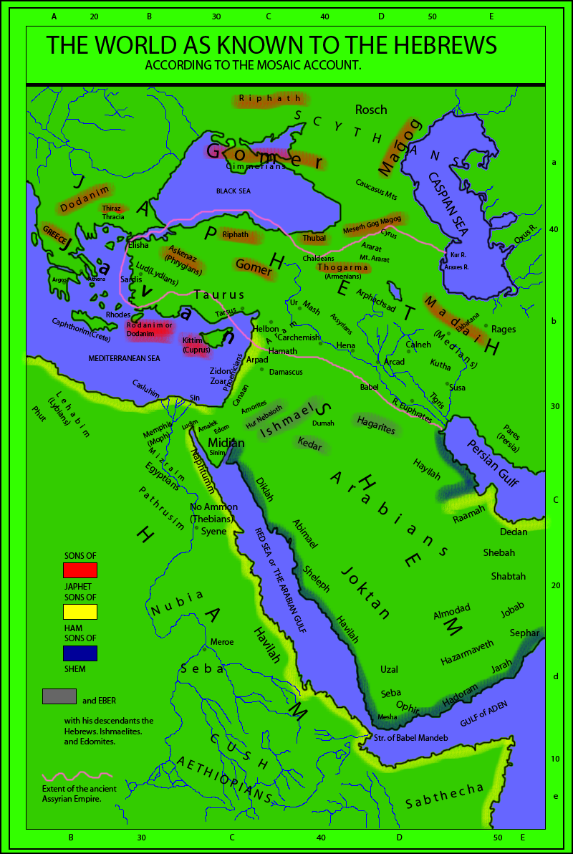
Amos 6:1-8
“Woe To you who are at ease in Zion”
Trusted in what would fail (6:1)
Did not learn lesson that weakness existed in other strong cities (6:2)
Put off judgment (6:3)
Comforted in temporal prosperity (6:4)
Self-pleasing (6:5-7)
Conceited (6:8)
Notes:
Calneh, built by Nimrod in the land of Shinar, Genesis 10:9. “It was built by Nimrod, #Ge 10:10, and after a long growth to power, wealth, and security, through near one thousand three hundred years, was at last ruined…” (Matthew Poole).
Hamath, was at the northern border of Israel’s promised land. Albert Barnes noted, “To judge from the present site, it in some respects resembled Samaria. It lay in a narrow oval valley of the Orontes; its citadel on a round hill in the center. The city rises up the steep sides of the hills which enclose it (Colossians Squire, in Walpole Mem. 323-325). Vast water-wheels, some of a diameter of 67 (Squire, l. c. “at least 70 feet,” Burckh. l. c.), 80, 90 (Thomson, The land, ii. 278) feet, raise the water of the Orontes to supply, by aid of aqueducts, the upper city, or to water the neighboring gardens.” Yet it was recently conquered by Tiglath-pilesar and served as a fresh example of the wrath of God (see Poole).
Israel was going to be afflicted from the entrance of Hamath all the way to valley of Arabah (Amos 6:14).
Gath, though giants walked from within and without of this cities past, it too fell. An interesting mentioning of cities who were great in power and yet all fell. There is also a gravitating nearness of each respected city named with reference to Israel.

Slide 6
In our Next Lesson
The Cure For Complacency

Slide 7
1 Corinthians 6:1, 2
¹ We then, as workers together with Him also plead with you not to receive the grace of God in vain.
² For He says: "In an acceptable time I have heard you, And in the day of salvation I have helped you." Behold, now is the accepted time; behold, now is the day of salvation.

