Slide 1
Scripture Reading
JAMES 5:7-9
7 Therefore be patient, brethren, until the coming of the Lord. See how the farmer waits for the precious fruit of the earth, waiting patiently for it until it receives the early and latter rain.
8 You also be patient. Establish your hearts, for the coming of the Lord is at hand.
9 Do not grumble against one another, brethren, lest you be condemned. Behold, the Judge is standing at the door!

Slide 2
DO NOT
GRUMBLE
AGAINST ONE ANOTHER, BRETHREN
JAMES 5:9
THE MISUSE OF THE TONGUE
IN THE BOOK OF JAMES

Slide 3
5 Even so the tongue is a little member and boasts great things. See how great a forest a little fire kindles!
6 And the tongue is a fire, a world of iniquity. The tongue is so set among our members that it defiles the whole body, and sets on fire the course of nature; and it is set on fire by hell.
JAMES 3

Slide 4
the need to bridle the tongue
1:26
speak as if you were in judgment
2:12
beware of the untrained tongue
3:1ff
the tongue set against members
3:6; 4:11, 12; 5:9
IN JAMES

Slide 5
“Do not speak evil of one another, brethren. He who speaks evil of a brother and judges his brother, speaks evil of the law and judges the law. But if you judge the law, you are not a doer of the law but a judge.”
JAMES 4:11
1 Peter 2:1 | Ephesians 4:31, 32
SPEAKING EVIL → SLANDER, GOSSIP
= speaking against and judging the law!

Slide 6
Do not grumble against one another, brethren, lest you be condemned. Behold, the Judge is standing at the door!”
JAMES 5:9
GRUMBLE AGAINST → GROAN WITH COMPLAINT
= condemnation by the JUDGE who's at the door!

Slide 7
Do not grumble against one another, brethren, lest you be condemned. Behold, the Judge is standing at the door!”
JAMES 5:9
MARK 14:4-6
4 But there were some who were indignant among themselves, and said, "Why was this fragrant oil wasted?
5 "For it might have been sold for more than three hundred denarii and given to the poor." And they criticized her sharply.
6 But Jesus said, "Let her alone. Why do you trouble her? She has done a good work for Me.

Slide 8
“unloving, unforgiving, slanderers, without self-control, brutal, despisers of good”
(2 Tim. 3:3)
“Then Jesus was led up by the Spirit into the wilderness to be tempted by THE DEVIL.”
Matthew 4:1
Greek: diabolos

Slide 9
Don’t believe “about-talk” – Acts 21:21, 24
Don’t repeat “about-talk” – Prov. 11:13; 17:9
Attach the name of the “informer” to the “information” – 1 Cor. 1:11; Prov. 26:20
Do not associate – Prov. 20:19; Titus 3:8-11
SOLUTIONS TO SLANDER

Slide 10
“The first one to plead his cause seems right, Until his neighbor comes and examines him.”
Proverbs 18:17

Slide 11
“Moreover if your brother sins against you, go and tell him his fault between you and him alone. If he hears you, you have gained your brother.”
Matthew 18:15

Slide 12
20 For I fear lest, when I come, I shall not find you such as I wish, and that I shall be found by you such as you do not wish; lest there be contentions, jealousies, outbursts of wrath, selfish ambitions, backbitings, whisperings, conceits, tumults;
21 lest, when I come again, my God will humble me among you, and I shall mourn for many who have sinned before and have not repented of the uncleanness, fornication, and lewdness which they have practiced.
2 CORINTHIANS 12

Slide 13
CORINTHIAN DIVISION:
IN TEACHERS (1 COR. 1:10-3:23)
IN ETHICS (1 COR. 5; 6)
IN LIBERTIES (1 COR. 8-10)
IN WORSHIP (1 COR. 11-14)
IN DOCTRINE (1 COR. 15)
IN PERSONAL CONVERSATIONS (2 COR. 12:20)
20 For I fear lest…lest there be contentions, jealousies, outbursts of wrath, selfish ambitions, backbitings, whisperings, conceits, tumults;
21 …and I shall mourn for many who have sinned before and have not repented …
2 CORINTHIANS 12

Slide 14
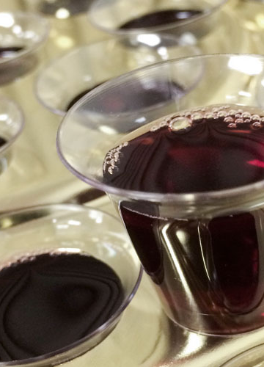
The Lord’s Supper
1 Corinthians 15:1-8

Slide 15
THE RIGHT USE OF THE TONGUE IN JAMES
Speak so as to include God in your plans – 4:13-17
Speak only what you mean – 5:12
Pray & sing in sorrow and joy – 5:13
Confess your sins – 5:16

