Slide 1
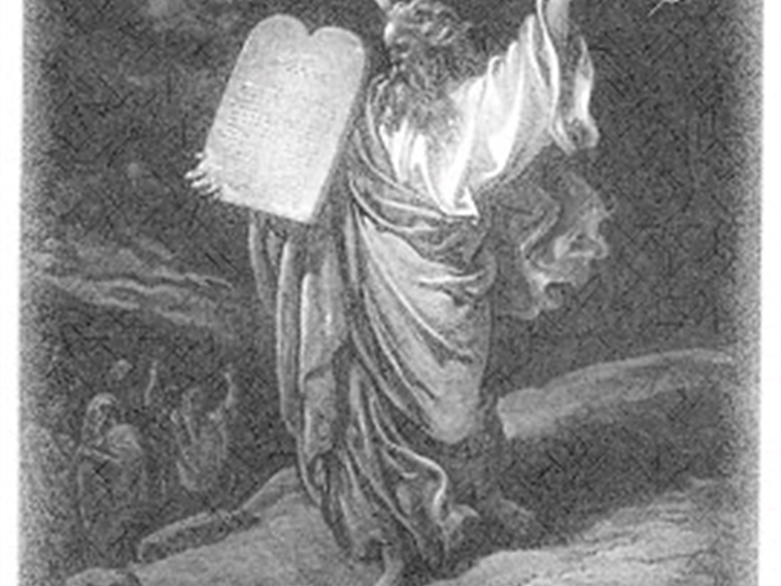
And The weight of Sin
The Prayer of Moses
WEIGHT
Psalm 90:7-10

Slide 2
The Enormity of Sin
In WHO It Angers (90:7)
2 Kings 22:13; Ephesians 5:3-7; Psalm 2:12

Slide 3
In his brother’s sons, Leviticus 10:1-3
In his sister, Numbers 12:9-12
In the 40 years, Numbers 14:33-37
In Korah, Numbers 16:31-35
In fiery serpents, Numbers 21:4-6
At Baal of Peor, Numbers 25
Against himself, Numbers 20

Slide 4
The Enormity of Sin
By WHO They Anger (90:7)
By WHO Sees It (90:8)
SIN

Slide 5
How God Sees Sin:
As a hog and a dog’s repulsive behavior
2 Peter 2:18-22
Nauseating
Revelation 3:15, 16
Crucifies afresh the Son of God
Hebrews 6:4-6

Slide 6
The Enormity of Sin
By WHO They Anger (90:7)
By WHO Sees It (90:8)
By WHAT it Destroys (90:9, 10)
Extinguishes the quantity of our time
Injures the quality of our time
finishing with a sigh
boasting in sorrow

Slide 7
Lord, You have been our DWELLING PLACE in all generations. (Psalm 90:1)
To Correctly Understand Man Is To First Understand God
To Correctly Understand God Is To Keep His Commandments and Abide In Him
The one who practices sin does not know Him (1 Jn. 3:4-7)

Slide 8
How Can We Enter The Dwelling Place Today?

Slide 9
Cannot Enter When We Are Attached To Sin
Psalm 24:3, 4
3 Who may ascend into the hill of the LORD? Or who may stand in His holy place?
4 He who has clean hands and a pure heart, Who has not lifted up his soul to an idol, Nor sworn deceitfully.
1 Corinthians 6:9
“Do you not know that the unrighteous will not inherit the kingdom of God? Do not be deceived. …”

Slide 10
Be Saved From His Wrath And Dwell In His Love Today!
Romans 5:9, “Much more then, having now been justified by His blood, we shall be saved from wrath through Him.”
Romans 6:3, 4, “Or do you not know that as many of us as were baptized into Christ Jesus were baptized into His death? Therefore we were buried with Him through baptism into death, that just as Christ was raised from the dead by the glory of the Father, even so we also should walk in newness of life.
“To the praise of the glory of His grace, by which He has made us accepted in the Beloved” (Eph. 1:6)

