Slide 1
Where Does MAN’S UNBELIEF In Creation Lead?

Slide 2
ATHEISM
And The
BEGINNING
of
CREATION

Slide 3
from NOTHING came
SOMETHING
???

Slide 4

What Is Atheism?
Defined wrongly even by professed “atheists”
“Atheism is usually defined incorrectly as a belief system. Atheism is not a disbelief in gods or a denial of gods; it is a lack of belief in gods. Older dictionaries define atheism as ‘a belief that there is no God.’”
  Source: www.atheists.org
An Atheist?

Slide 5
Who Is A Bible Atheist?
God “denier”
  Psalm 14:1
God “suppressor”
  Psalm 10:4
God “forgetter”
  Proverbs 30:8, 9; Luke 12:16ff
Word “repudiator”
  Titus 1:15, 16; Jeremiah 5:1ff
“…having no hope and without God [Gk. atheos] in the world” (Eph. 2:12)

Slide 6

“If the foundations are destroyed, What can the righteous do?”
Psalm 11:3
America’s Crumbling Culture
OBERGEFELL v. HODGES
June 26, 2015
Attack Against Family
Homosexual Marriage as a Fundamental Right
ROE v. WADE
Jan. 22, 1973
Attack Against Life
Rights Trump Life
SCOPES TRIAL
Jan. 21, 1925
Attack Against Creation
Right to Replace with Evolution

Slide 7

‘You shall not lie with a male as with a woman. It is an abomination” (Lev. 18:22)
AND
“Love…does not rejoice in iniquity, but rejoices in the truth” (1 Cor. 13:4-6)

Slide 8

Love Lost
LUST WON!
“Therefore God also gave them up to uncleanness, in the lusts of their hearts, to dishonor their bodies among themselves…For this reason God gave them up to vile passions. For even their women exchanged the natural use for what is against nature” (Rom. 1:21, 26)

Slide 9
Love Lost
LUST WON!
“Likewise also the men, leaving the natural use of the woman, burned in their lust for one another, men with men committing what is shameful, and receiving in themselves the penalty of their error which was due”
(Rom. 1:27)

Slide 10
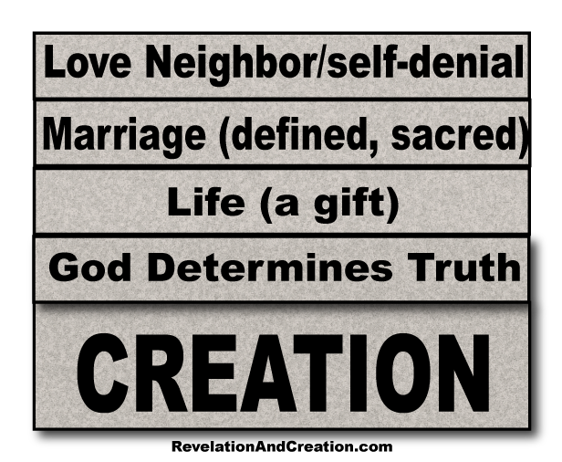
“If the foundations are destroyed, What can the righteous do?”
Psalm 11:3

Slide 11
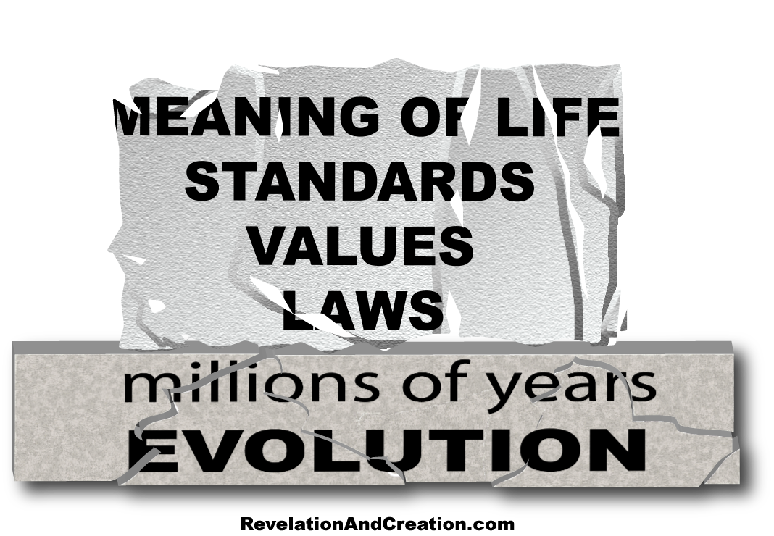
“If the foundations are destroyed, What can the righteous do?”
Psalm 11:3

Slide 12
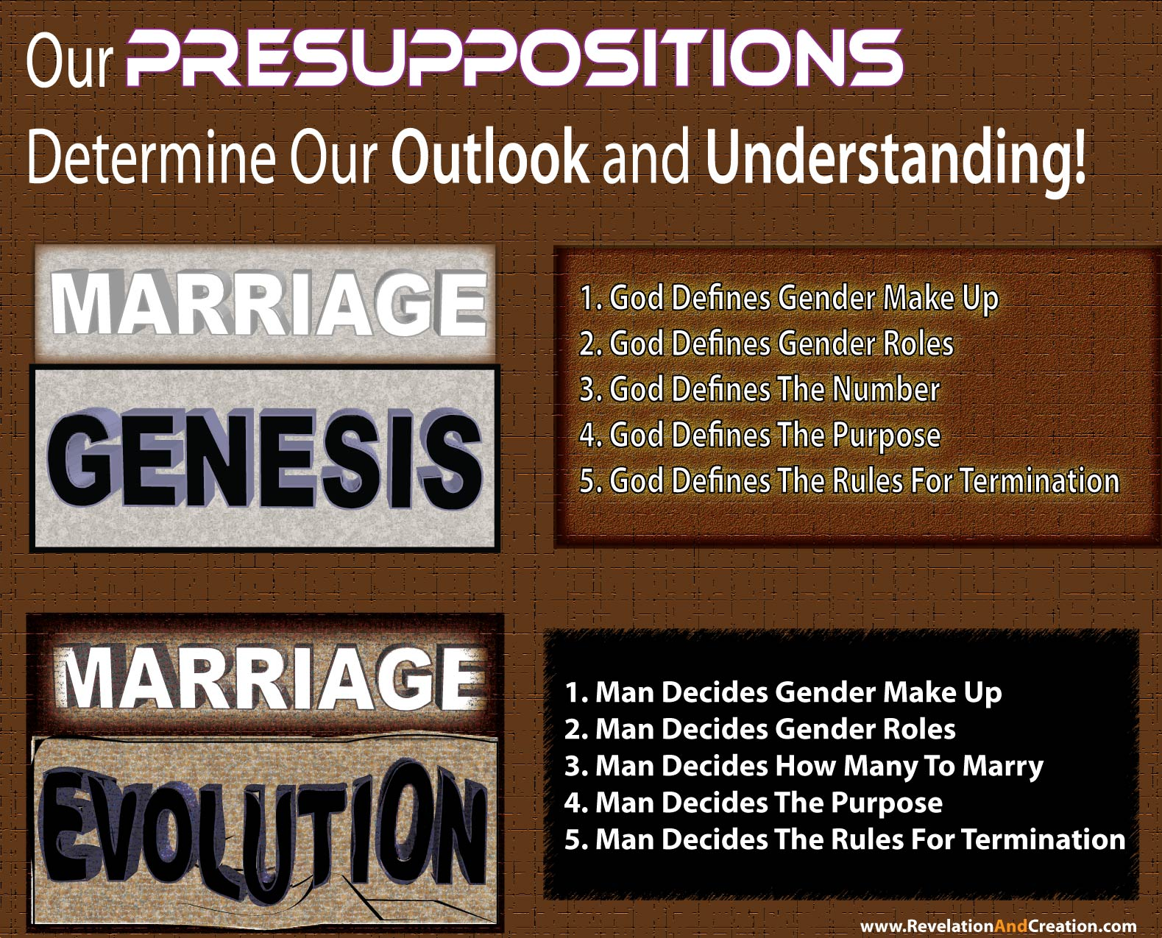

Slide 13
Essential To Our Faith, Purpose, Walk, and Identity

Slide 14
Where Does MAN’S UNBELIEF In Creation Lead?

Slide 15
Limits the mighty works of Jesus
Frustrates the disciples’ works
Ignores credible testimony
Obstructs the promises of God
Promotes wicked behavior
Departs from God

