Slide 1
Institutionalism & The Church (3)
“But He answered and said, ‘Every plant which My heavenly Father has not planted will be uprooted’” (Matt. 15:13)

Slide 2
The WORK God Has Given To The Church
Preach the gospel - 1 Thess. 1:8; Acts 11:22-24; Phil. 1:5-7
Edify the saints - 1 Cor. 14:26; Eph. 4:11-12; Acts 11:22f; 13:1-2
Relieve needy saints – Acts 6:1-6;
1 Cor. 16:1; 2 Cor. 8-9; 1 Tim. 5:16
  Excludes non-Christians
  Excludes rich saints

Slide 3
“Whatever the individual CHRISTIAN can do, the CHURCH can do!”
Really?

Slide 4
How About?
“Whatever the individual HEBREW can do, the TEMPLE can do!”
Why Then Did Jesus Drive Out The Buyers/Sellers & The Money Changers?
Beginning of Ministry
End of Ministry
John 2:13-17 | Mark 11:15-19

Slide 5
Was Jesus Opposed To
Oxen, sheep, and doves?
Men selling these animals?
Changing money?
Why Then Did Jesus Drive Out The Buyers/Sellers & The Money Changers?
Beginning of Ministry
End of Ministry
John 2:13-17 | Mark 11:15-19

Slide 6
As Individuals, They
Could give of what they had personally grown (Deut. 12:6, 7; Neh. 10:35-39)
  Given to Levites and to the storehouses of the temple
Could purchase appropriate animals from others for sacrifices (Jn. 13:29; 2 Sam. 24:20-25; Ezr. 7:15-20; Neh. 10:31)
Could exchange money (Deut. 14:22-27)
Buying/Selling/Exchanging Was Not The Work Of The Temple But Of The Individual!
Changed the purpose of the temple

Slide 7
LIKEWISE, NO AUTHORITY FOR:
The church to engage worldly fund raising activities (bake sales, car washes, financial seminars, etc.)
    John 2:16, “Take these things away! Do not make My Father’s house a house of merchandise!”
    1 Corinthians 16:1, 2
The church must consistently stay within the confines of the Scriptures for her work
    Mark 11:16, 17, “And He would not allow anyone to carry wares through the temple. Then He taught, saying to them, ‘Is it not written, “My house shall be called a house of prayer for all nations”? But you have made it a “den of thieves.’ ”

Slide 8
The Church IS Distinguished From The individual

Slide 9
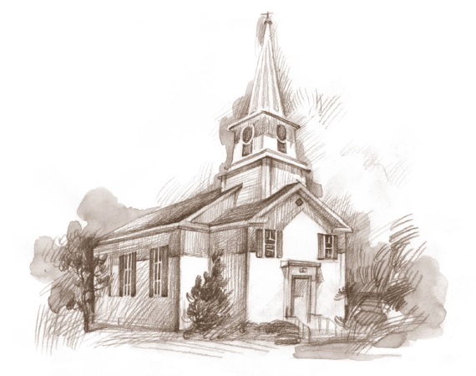


The Christian
The Church
Wears The Name “Christian”
(Acts 11:26; Acts 26:28; 1 Pet. 4:16)
Where is the church authorized to wear the name “Christian?”

Slide 10
The Christian
The Church
May Have Spoken In Tongues In The Assembly
(1 Cor. 14:26-29)
Where was the whole church permitted to speak in tongues in the assembly (1 Cor. 14:23)?

Slide 11
The Christian
The Church
May Eat Vegetables And/Or All Things
(Rom. 14:2, 3)
Where is the whole church permitted to eat all things “as a church” (Rom. 14:17; 1 Cor. 11:34)?

Slide 12
The Christian
The Church
May Esteem/Observe A Day
(Rom. 14:5, 6)
Where is the church permitted to observe days (Gal. 4:10, 11)?

Slide 13
The Christian
The Church
May Lend To One Who Asks
(Matt. 5:42; Lk. 6:34, 35)
Where is the church permitted to lend to anyone?

Slide 14
The Christian
The Church
May buy/sell for profit
(Lk. 22:36; Jas. 4:13; Prov. 31:16)
Where is the church permitted to buy and sell such?

Slide 15
“If any believing man or woman has widows, let them relieve them, and do not let the church be burdened, that it may relieve those who are really widows” (1 Tim. 5:16)
WHO is CHARGED?
To Relieve Widows?
To Relieve Those Who Are Really Widows?
THE
CHURCH
THE
INDIVIDUAL

Slide 16

TWO DISTINCT TREASURIES
THE
CHURCH
Individual
CHURCH
Method of Raising
Honest Labor (Eph. 4:28)
Voluntary Offering (1 Cor. 16:1, 2)
Oversight
Self (Acts 5:3, 4)
Elders (Acts 11:30)
Use
Contribution
(2 Cor. 9:7)
Taxes (Rom. 13:6, 7)
Domestic (1 Tim. 5:8)
Sharing
(1 Tim. 6:18; Gal. 6:10)
Preaching Gospel (Phil. 4:15, 16; 2 Cor. 11:8)
Relieving Needy Saints
(Acts 4:32-34)

Slide 17
THREE DISTINCTIONS
15 "Moreover if your brother sins against you, go and tell him his fault between you and him alone. If he hears you, you have gained your brother.
16 "But if he will not hear, take with you one or two more, that ‘by the mouth of two or three witnesses every word may be established.’
17 "And if he refuses to hear them, tell it to the church. But if he refuses even to hear the church, let him be to you like a heathen and a tax collector.
1 MAN – NOT THE CHURCH
Church Cannot Act Here!
2 OR 3 – NOT
THE CHURCH
THE CHURCH!
Matthew 18:15-18

Slide 18
2 Timothy 2:15
“Be diligent to present yourself approved to God, a worker who does not need to be ashamed, rightly dividing the word of truth.”
Let’s appreciate the distinctions made in scripture (local church, universal church, individual liberties versus congregational limitations; etc.)

