Slide 1

Membership
John 6:66
What will your reaction be?
ACTS 2:37
Part 2
“For as the body is one and has many members, but all the members of that one body, being many, are one body, so also is Christ” (1 Cor. 12:12)
All verses are from the NKJV unless otherwise noted.
Notes:
Commendation of Jim’s article in the bulletin.

Slide 2
“Membership” Presents A Challenge To Us!
Test yourselves
  “Examine yourselves as to whether you are in the faith. Test yourselves. Do you not know yourselves, that Jesus Christ is in you? —unless indeed you are disqualified. But I trust that you will know that we are not disqualified” (2 Cor. 13:5, 6)
Membership models itself in every person’s actions (Eph. 4:16)
  Value membership, value the work
Notes:
“from whom the whole body, joined and knit together by what every joint supplies, according to the effective working by which every part does its share, causes growth of the body for the edifying of itself in love” (Eph. 4:16)

Slide 3
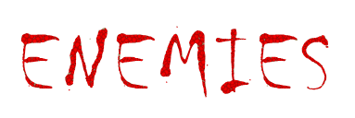
Of
“Church Membership”

Slide 4
1) Strong Desire For Other Things
18 Now these are the ones sown among thorns; they are the ones who hear the word,
19 and the cares of this world, the deceitfulness of riches, and the desires for other things entering in choke the word, and it becomes unfruitful
Mark 4:18, 19
Notes:
“Here there was no lack of soil, perhaps good soil; but what was deficient was a careful husbandry, the extermination of the thorns and weeds….In this case, the profession of a spiritual life is retained, but the power of religion is by degrees eaten out” (Richard Chenevix Trench, Parables Of Our Lord,” p. 31).

Slide 5


WORLD Competes With WORD
Cares of this world (Lk. 14:16-21; 21:34)
Deceitfulness of riches (Lk. 12:15-21; 1 Tim. 6:9, 10)
“Respectable worldliness” presents a threat
  Many of the things are not inherently wrong
  A life that is crammed full of worldly activities has a way of nudging the word out of view
  “Adulterers and adulteresses! Do you not know that friendship with the world is enmity with God? Whoever therefore wants to be a friend of the world makes himself an enemy of God” (Jas. 4:4)

Slide 6
2) Forsaking The Assembling
22 let us draw near with a true heart in full assurance of faith, having our hearts sprinkled from an evil conscience and our bodies washed with pure water.
23 Let us hold fast the confession of our hope without wavering, for He who promised is faithful.
24 And let us consider one another in order to stir up love and good works,
25 not forsaking the assembling of ourselves together, as is the manner of some, but exhorting one another, and so much the more as you see the Day approaching.
(Heb. 10:22-25)
Notes:
““Willfully absenting oneself from the assembly is like removing a piece of coal from the fireplace. The fiery coal that is removed from the presence of the other hot coals will die out more quickly than had it been left in a heap with the others.” (Attendance Problems, Glendol McClure).

Slide 7
“Faithful Attendance”
Is what Jesus expects of me to give the congregation where I am a member
  Attendance is the life of the church—will this church die because of the lack of my attendance?
  “How can I possibly convince God that my relationship with Him is the most important one in my life if I will not even attend all the services (Acts 2:42)?” (Kyle Campbell, ibid.)

Slide 8
Clarification
Being sick and unable to come is not forsaking
(2 Tim. 4:20)
Traveling out of the area due to business, vacation, etc., is not forsaking when attending a faithful church for worship (Rom. 16:1, 2)
Certain situations in scripture have been noted as an “excusable absence” (uncleanness, travel problems, Num. 9:10-13; Acts 27:33)
“Therefore, my beloved, as you have always obeyed, not as in my presence only, but now much more in my absence, work out your own salvation with fear and trembling” (Phil. 2:12)

Slide 9
Why Would Christians Neglect Congregational Assembling?
Because some were deterred by fear of persecution
Because some were simply not interested
Because some were dissatisfied by a preacher, teacher, member
Because some were embracing other religions
Because some had doubts about the necessity of this duty
BUT NONE WERE ACCEPTABLE!

Slide 10
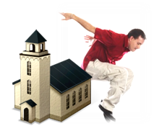

3) Church Hoppers and Drifters

Slide 11


Church Hopping
church “A”
church “B”
church “C”
“church hopping” (macro) – the constant changing of churches
  “have faith will travel”
    “A devout drifter” or “invisible spectator”
  Looking for something more exciting
    Views the church as “what can it do for me?”
  No commitment to any one church
    Becomes angry at sermon, didn’t get way in men’s meeting
Notes:
As one Matthew Lester wrote, “I’m not proud of the fact that I’m a church hopper. I’m a devout drifter committed to nothing…. I’ve become a Sunday morning anthropologist, seeking to watch something different when it all begins to look familiar. ” (Confessions of a church hopper).
-------------------------
Church Hopping
by Steve Higginbotham
Have you heard about the man who was the only survivor of a shipwreck? He swam ashore to an uncharted island and lived there for the next five years. Finally, sailors spotted the smoke of his campfire and rescued him from the island. As they were leaving the island, the man stood on the back of the boat, gazing at the tiny island that had sustained him for the past five years. The sailor interrupted the reflective silence by asking the man what the three huts were for. The man said, "the first hut was my home. The second hut was where I went to church. And the third hut was where I used to go to church before I got mad and left."
The sad thing about this story is that it is an accurate caricature of what so many people are doing today. When a person gets his feelings hurt, he leaves for another congregation. When a person is offended, he leaves for another congregation. When a person doesn't get his way, he leaves for another congregation. Instead of working through difficulty, being patient, practicing forgiveness and brotherly kindness, and being dependable, people use their membership, and the threat of leaving, as a form of bribery to get their way. When they don't get their way, off they go to another congregation to exchange their old problems for a set of new ones yet to be realized. Then the process begins again.
I wonder if much of the "church hopping" we see today would cease if people were more concerned about what they can contribute to a congregation rather than focusing upon what a congregation can do for them. I believe we would all be better off if we would focus "less on self, and more on Thee."
Copyright © 2004, South Green Street Church of Christ, Glasgow, Kentucky Permission is granted to copy these articles.

Slide 12
Church Hopping
church “A”
church “B”
church “C”
“church hopping” (micro) – frequently attending a chosen handful of different churches
  Challenged commitment levels to a local work
  Convenience driven worship
    Worship planned around the day’s activities (a birthday, outings, a family get together, sporting event, etc.)

Slide 13
Clarification
X
church “A”
church “B”
church “C”
Moving to an area and visiting nearby congregations to “join” as a member is not church hopping
Leaving a congregation out of necessity to “join” another congregation is not church hopping (Acts 9:26)
  Leaving a church because of doctrinal error and joining another church is not church hopping
  Church hoppers usually have no intent of “joining” a church

Slide 14
Clarification
X
church “A”
church “B”
church “C”
Worshipping with another congregation due to business/travel obligations is not church hopping (Rom. 16:1, 2)
  Church hoppers make the decision to worship with another church on the basis of convenience or some selfish reason
Preaching sermons at another church is not church hopping (Titus 1:5)
  Church hoppers generally hop so that they do not have to have any responsibility placed upon them

Slide 15

Church Hopping
church “A”
church “B”
church “C”
Doesn’t follow the example of Paul (Acts 9:26)!
  “Therefore I urge you, imitate me” (1 Cor. 4:16)
  Is without any scriptural authority
Is destructive to the local church membership by not advancing edification of “every part doing its share” (Eph. 4:16)
  Cannot help the church grow
  Cannot perform the share of work
  Cannot be counted on to fulfill any responsibilities
Flies under the radar of “oversight” (Heb. 13:17)

Slide 16
Ephesians 4:15, 16
“but, speaking the truth in love, may grow up in all things into Him who is the head—Christ—from whom the whole body, joined and knit together by what every joint supplies, according to the effective working by which every part does its share, causes growth of the body for the edifying of itself in love”
  “There is indeed a PERSONAL responsibility that EACH member has to FULLY support the local work” (Bobby Holmes, e-mail 6/04/2009, emp. his)
Notes:
I ran my sermon charts by brethren that I value my their opinion and pleaded for some input on them. “But in the multitude of counselors there is safety” (Prov. 11:14).
Joe Price, Dan Torres and Bobby Holmes e-mailed back and I particularly like this quote from Bobby. After stating that this presentation dealt with the subject in a thorough and fair-minded way, he said….

Slide 17
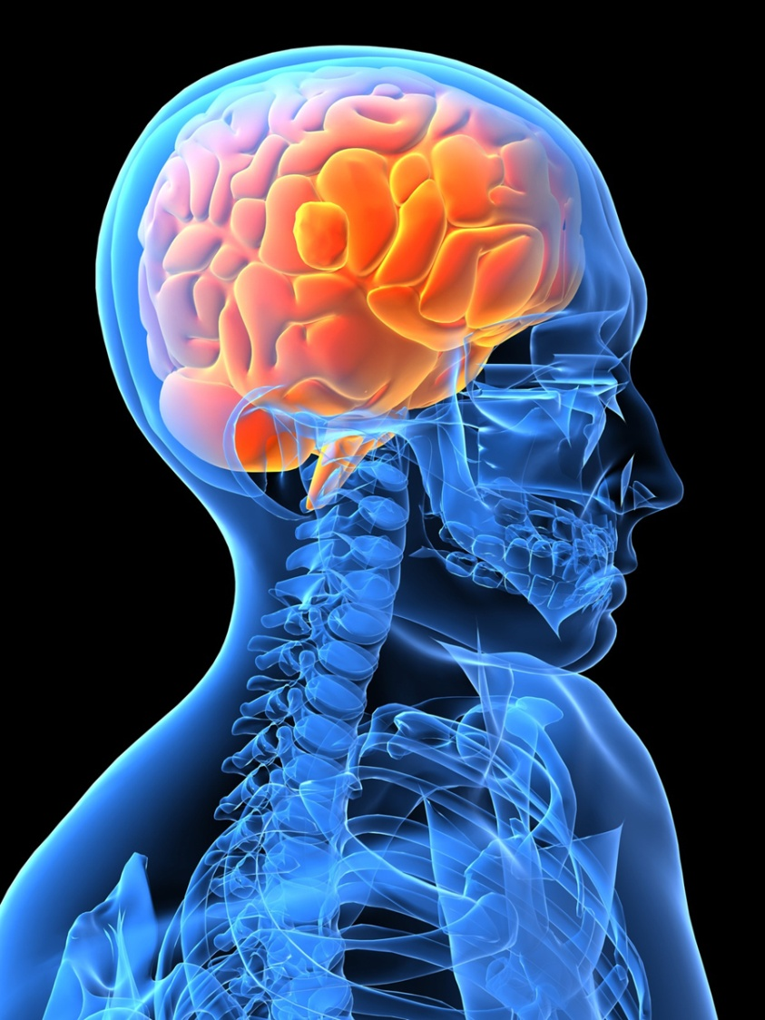
Ephesians 4:15, 16
(phrase focus)
  “Him who is the head” (guided)
    Jesus as head
    from whom all guidance, vigor and growth comes
    As in another similitude, “I am the vine, you are the branches. He who abides in Me, and I in him, bears much fruit; for without Me you can do nothing” (Jn. 15:5)

Slide 18
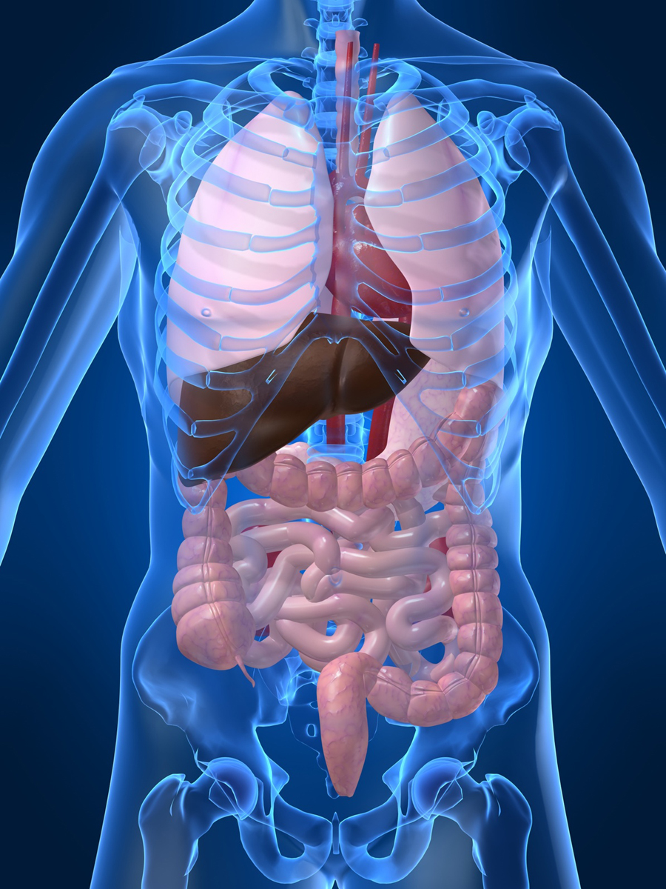
Ephesians 4:15, 16
(phrase focus)
  “joined and knit together” (harmony)
    harmony in the work and fabric of faith
    In your physical anatomy, everything is in its best place!
    In God’s spiritual body each member is in his/her PROPER place UNITED to the other members!
      1 Corinthians 12:12-18
    threatened when pride and false ideas creep into the membership (Col. 2:18, 19)
Notes:
Joined and knit together is threatened when people begin to use other people as the basis for their understanding.

Slide 19

Ephesians 4:15, 16
(phrase focus)
  “every part does its share” (supply)
    none are overtaxed; proportionately involved; each share is important; no idleness
    every part should supply something
    if you don’t supply your share, then your lack is taxed on another
Notes:
When every part does its share, none are overtaxed. How effective is the knee doing the foot’s part?

Slide 20

Ephesians 4:15, 16
(phrase focus)
  “causes growth of the body” (edification)
    each part doing a little causes a great effect
    No useless parts; you are needed here
Notes:
RE: causes growth…none are overtaxed…your lack is taxed upon another. What happens if your feet are no longer useful for walking? How effective are knees for walking?

Slide 21
Church Hopping
church “A”
church “B”
church “C”
“But seek first the kingdom of God and His righteousness, and all these things shall be added to you” (Matt. 6:33)

Slide 22

If Jesus
Died On A Cruel Cross
So That I Can Be A Member Of HIS SPIRITUAL BODY, Shouldn’t I Want To Be Actively Joined To A Local Body Of Believers?
Ephesians 5:30, “For we are members of His body, of His flesh and of His bones.”

