Slide 1
Misconceptions About The
Introduction
CHURCH OF CHRIST
Notes:
God’s people have always been misrepresented (Deut. 16:3; Matthew 11:18, 19; False supposition, Acts 2:13; God’s ministers were slandered, Romans 3:8).

Slide 2
1. The church of Christ is a denomination
The Denominational Problem

Slide 3
A Denominational Church
was built by man away from truth
was built after the Lord’s Church
may accept most of what the Bible teaches
is full of good people
has earthly headquarters
is larger than the local church and smaller than the universal church
Notes:
ACCEPT MOST TRUTH, BUT NOT ALL. How many protestants accept Acts 2:38 ? How many Catholics accept (Matt. 23:9)? How many “oneness” churches accept (John 5:31, 31, 37)? How many Calvinists believe in Hebrews 3:12? This is because they are built and governed by the opinions of men rather than the word of God.
Christ’s church has its headquarters nowhere on earth. It is only in heaven (Heb. 8:1).

Slide 4
One of Two Choices
EITHER:
  you accept the denominational explanation of denominationalism and the church
OR:
  you accept the Bible’s explanation of the church and reject denominationalism

Slide 5
One of Two Choices
EITHER:
  God designed and approves of denominationalism
OR:
  God did not design and does not approve of denominationalism
Mt 15:13, “But He answered and said, ‘Every plant which My heavenly Father has not planted will be uprooted.’”
Notes:
1Co 1:10 Now I plead with you, brethren, by the name of our Lord Jesus Christ, that you all speak the same thing, and that there be no divisions among you, but that you be perfectly joined together in the same mind and in the same judgment.
Joh 10:16 "And other sheep I have which are not of this fold; them also I must bring, and they will hear My voice; and there will be one flock and one shepherd.
Joh 17:11 "Now I am no longer in the world, but these are in the world, and I come to You. Holy Father, keep through Your name those whom You have given Me, that they may be one as We are.
Joh 17:21 "that they all may be one, as You, Father, are in Me, and I in You; that they also may be one in Us, that the world may believe that You sent Me.
Joh 17:22 "And the glory which You gave Me I have given them, that they may be one just as We are one:

Slide 6
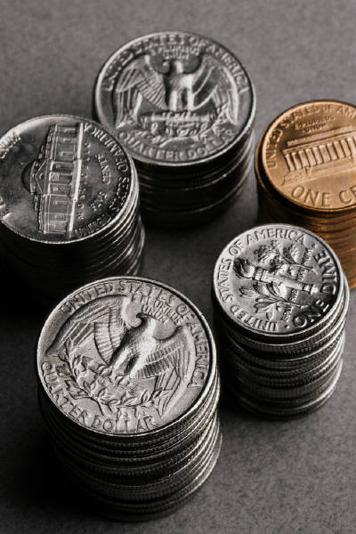

“Denominational Concept”
the church is composed of different denominational churches
Notes:
The denominational concept of the church is illustrated in these “denominations of a dollar.” They say that a dollar has denominations of quarters, dimes, nickels and pennies. You don’t deny that a quarter is a part of a dollar do you? Likewise, in the invisible church there are denominations.
“The Catholic Church may be a quarter, the Methodist a dime, the Pentecostal Church a nickel, the Assembly of God church may be one of those special quarters, and you ‘church-of-Christers’ may be an Indian head penny.”

Slide 7
“Denominational Concept”
Jesus = Vine; Churches = Branches
Lutheran
Methodist
Catholic
Baptist
V I N E
CHRIST
Presbyterian
Notes:
Denominational advocates will sometimes say that Jesus is the vine and all denominations are branches of Him.

Slide 8
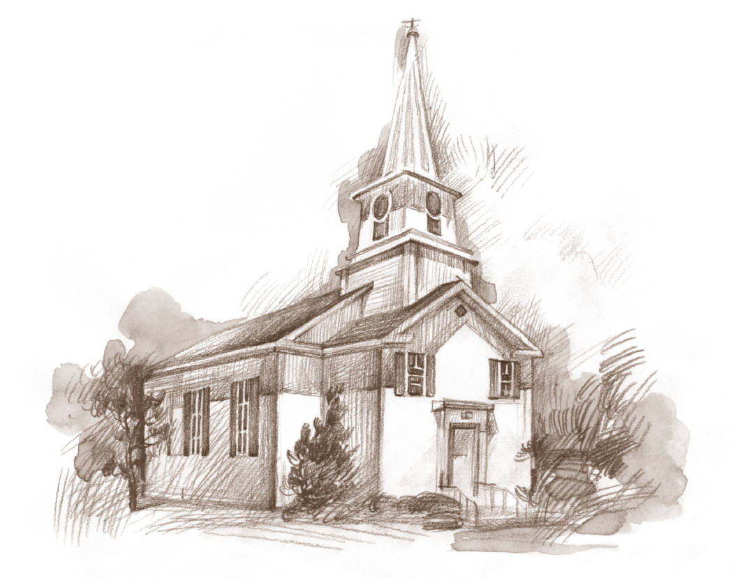
“Denominational Concept”
Jesus = Vine; Churches = Branches
The
Invisible Church
Baptist
Catholic
NOT BIBLICAL!
Methodist
Lutheran
Pentecostal
Notes:
They say that Baptist, Catholics, etc. make up the church of Christ.
[CLICK] This is not the biblical picture however. I will prove it if you will allow the Bible to be the standard of truth; will you allow the Bible to be the 12" ruler?

Slide 9
John 15:4, 5
BIBLE
VIEW
4 "Abide in Me, and I in you. As the branch cannot bear fruit of itself, unless it abides in the vine, neither can you, unless you abide in Me.
5 "I am the vine, you are the branches. He who abides in Me, and I in him, bears much fruit; for without Me you can do nothing.
(NKJV)
WHO?
THE INDIVIDUAL!
Notes:
The illustration of money is not a biblical illustration. If it were biblical, the church would be a dollar that is composed of individual pennies and not bodies of pennies.
The biblical picture of the church is seen in John 15:4, 5 where Jesus shows that individuals constitute the branches. Who are the branches? [CLICK] “YOU” are! [CLICK]

Slide 10
Biblical Concept
Jesus = Vine; Individuals = Branches
Peter
James
John
Phoebe
V I N E
CHRIST
Paul
Notes:
The correct biblical view of the church is that individual saints make up the church. Whether the church is spoken of in scripture in the universal sense or local sense, it is always composed of individuals.
Jesus chose the picture of a vine to illustrate his church in John 15.

Slide 11
The One Singular Church
Universal Concept

Slide 12
Ephesians 5:23 and the ‘Singularity’ of the Church
For the husband is head of the wife, as also Christ is head of the church; and He is the Savior of the body.
how many husbands?
how many wives?
how many Christ’s?
how many saviors?
How many churches?
Notes:
How many husbands do you see here? How many wives do you see here? How many Christ’s do you see here? How many savior’s do you see here? How many churches do you see here?
Believing that Jesus built thousands of churches makes him out to be a spiritual polygamist! If you insist that Jesus has many churches that he is head of, then why not also insist that your wife should have subject herself to many men or that your husband should be the head of many wives?

Slide 13
Eph. 5:23 “Christ is head of the church”
For the husband is head of the wife, as also Christ is head of the church; and He is the Savior of the body.
Catholic
THIS
head
Baptist
head
Lutheran
church
Pentecostal
NOT THIS!
Notes:
I want you to underscore Paul’s expression “Christ is head of the church” in your bibles. He is the head of the church. [CLICK] The denominational concept is that Christ is the head of many churches/bodies. [CLICK]
This would surely be a physical atrocity and freak of nature. That is what the denominational concept does to Jesus and the church.

Slide 14
Eph. 5:23 “Christ is head of the church”
For the husband is head of the wife, as also Christ is head of the church; and He is the Savior of the body.
THIS
head
Pope
Christ
church
church
NOT THIS!
Notes:
Christ doesn’t share his position of head with no one. He is head of the church. He is not, one of the heads.

Slide 15
Corruption of the local Church
CHURCH
elder
elder
elder
ELDER (bishop)
church
church
church
ACTS 14:23,
“So when they had appointed elders in every church, and prayed with fasting, they commended them to the Lord in whom they had believed.”
ORIGINAL
CATHOLIC
Notes:
All elders were originally the same as bishops (Titus 1:5-7). Which of these diagrams represent the truth? Was the government of the church originally one church that was overseen by a plurality of elders, or was it one elder oversees a plurality of churches (Acts 14:23)?
Eventually in churches one elder became more prominent and began to distinguish himself from the others as the presiding bishop. Paul had warned elders that men would eventually come from within the eldership speaking perverse things to draw men to themselves (20:29, 30). Eventually bishops from various churches began to have meetings to settle issues which would arise. In these meetings the one who chaired eventually grew to a standing of the “city bishop.” He presided over these meetings. Through time and the evolution of apostasy, this city bishop began to wield more power and perhaps compete with other bishops. Eventually the bishop of Rome became the most prominent and began to be referred to as the Pope or “papa.” This marked the full grown child of apostasy who began to be formed in the womb of deception with the council of Nicaea in 325 and grew to the full form in 606 with Pope Boniface III at the helm as the universal bishop or pope. None of this was the way it was in the beginning.

Slide 16
Apostasy into Denominationalism
(1 Timothy 4:1-3; 2 Timothy 4:1-5)
606—Pope Boniface III
1517—Protestant Denominationalism
  Martin Luther—95 theses nailed to the door
Notes:
Men protested the Roman Papal church. All protestant denominations that exist today began after 1517. It is generally believed that on October 31, Martin Luther nailed his 95 grievances to the door of the Wittenberg Castle church. This is what began protestant denominationalism, the protesting of the Roman Catholic Church.

Slide 17
PROTESTANT DENOMINATIONS
  1530 Lutheran Church, Augsburg, Germany
  1535 Presbyterian, Switzerland
  1571 Dutch Reformed Church, Holland
  1607 Baptist Church, London, England
  1729 Methodist Church, London, England
  1830 Mormon Church, Seneca, New York
  1898 Pentecostal Holiness, Anderson, South Carolina
  1917 Foursquare Gospel, Los Angeles, California
Notes:
As you can see, all these started a long time after the New Testament. Protestant denominationalism is too new to be true.

Slide 18
Origin of the True Church
ORIGINATED
  Not With Man, Ps. 127:1; Jn. 15:5
  Planned in the mind of God, Eph. 3:10, 11
  Implemented by Jesus Christ, Matt. 16:18
Notes:
Psalm 127:1, “Unless the LORD builds the house, They labor in vain who build it; Unless the LORD guards the city, The watchman stays awake in vain.” "I am the vine, you are the branches. He who abides in Me, and I in him, bears much fruit; for without Me you can do nothing” (Jn. 15:5). “Not that we are sufficient of ourselves to think of anything as being from ourselves, but our sufficiency is from God” (2 Cor. 3:5).
The church was not conceived in man, but in God. Founded by Jesus, not man. It is God planned…Christ built. The Challenge: Name one thing we teach that originated with Alexander Campbell.

