Slide 2
the

Slide 3
THE WISE – 7:24
Attentive – “whoever hears”
Right teaching – “these sayings of Mine”
Obedient – “and does them”
1. ALL HEARERS ARE BUILDERS

Slide 4
THE WISE – 7:24
Attentive – “whoever hears”
Right teaching – “these sayings of Mine”
Obedient – “and does them”
BULDS AN ENDURING HOUSE – Matt. 7:25
OPENS GATE INTO THE KINGDOM – Matt. 7:21
ADOPTED INTO GOD’S FAMILY – Matt. 12:46-50
KEY TO SPIRITUAL UNDERSTANDING – Jn. 7:17

Slide 5
THE WISE – 7:24
Attentive – “whoever hears”
Right teaching – “these sayings of Mine”
Obedient – “and does them”
1. ALL HEARERS ARE BUILDERS
CONTRASTED
THE FOOLISH – 7:26
Attentive – “everyone who hears”
Right teaching – “these sayings of Mine”
Disobedient – “and does not do them”

Slide 6


THE ROCK – 7:25
How? Lk. 6:47, 48
Psa. 1:2; Lk. 10:39; Eph. 3:18, 19
2. TWO FOUNDATIONS
CONTRASTED
THE SAND – 7:26
On the earth—no foundation at all – Lk. 6:49; Col. 3:1, 2

Slide 7
3. ALL BUILDINGS ARE TESTED
The nature of the test: rain, flood, wind
The impartiality of the test: same peril falls upon both houses
1 Peter 5:8-10

Slide 8
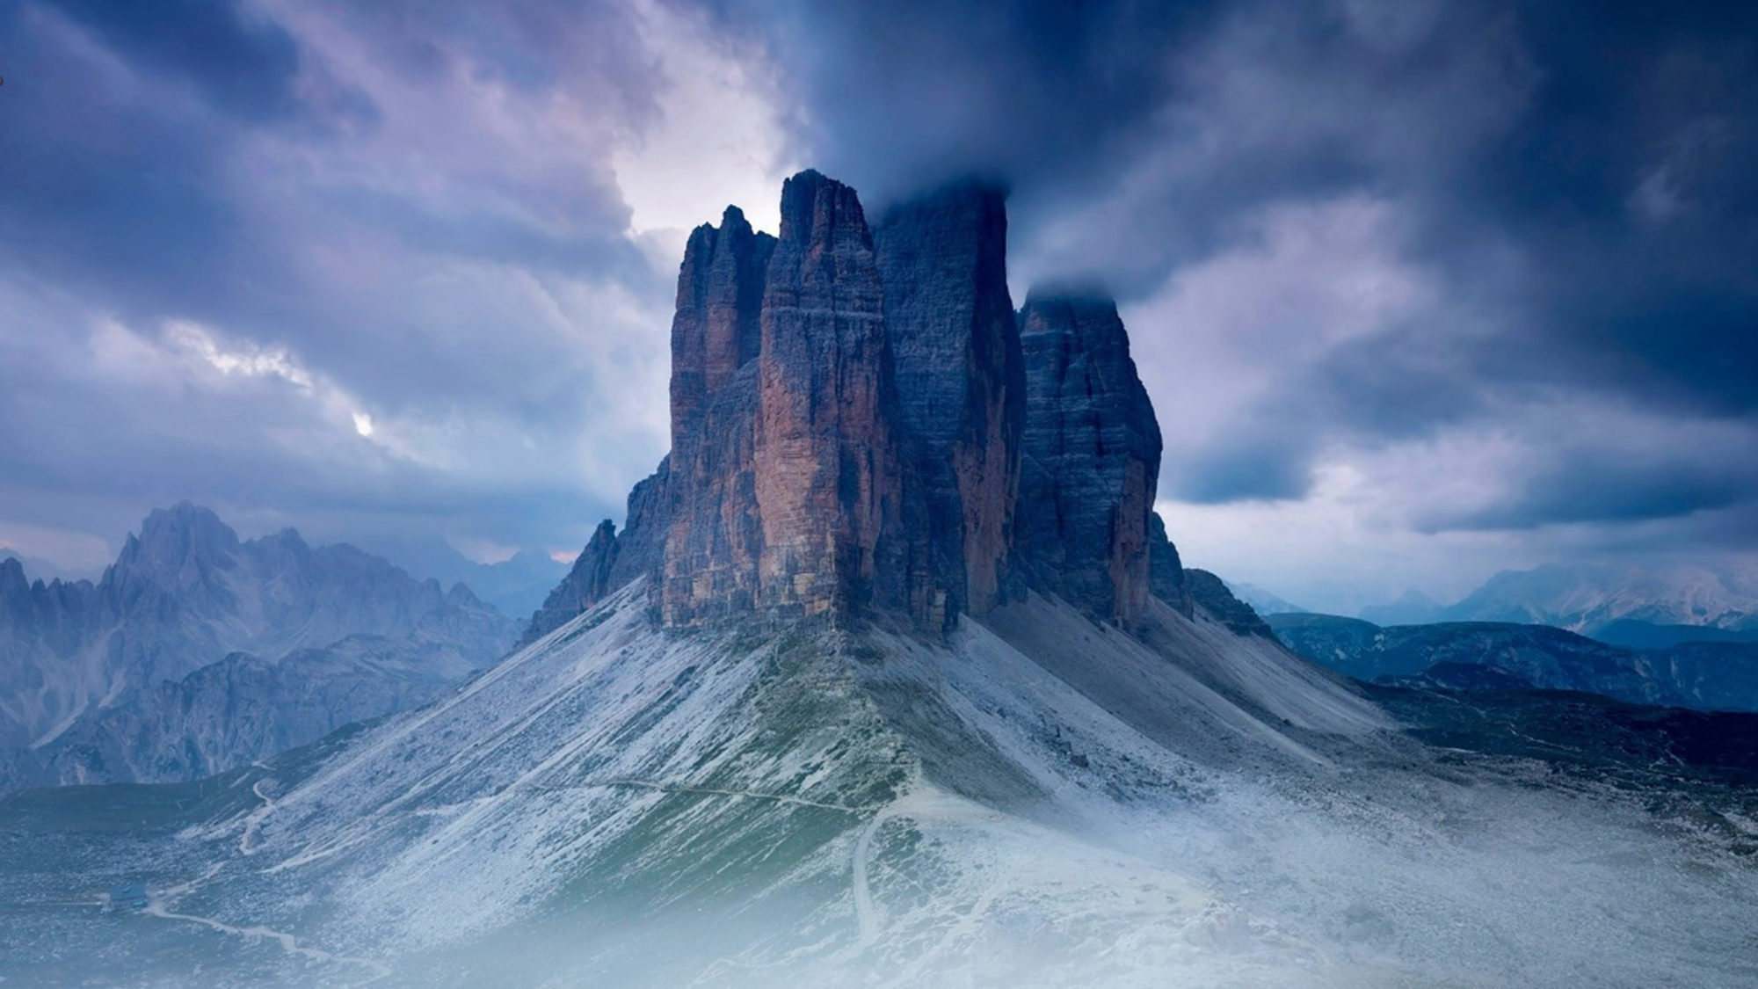
“It did not fall, for it was founded on the rock”
(Matt. 7:25)
4. ONLY ONE BUILDING WILL STAND
“and could not shake it, for it was founded on the rock”
(Lk. 6:48)
1 John 2:16, 17, “For all that is in the world—the lust of the flesh, the lust of the eyes, and the pride of life—is not of the Father but is of the world. And the world is passing away, and the lust of it; but he who does the will of God abides forever.”

Slide 9

"But he who heard and did nothing is like a man who built a house on the earth without a foundation, against which the stream BEAT vehemently; and immediately it fell. And the ruin of that house was GREAT."
THE RUIN
OF THAT
HOUSE WAS GREAT:
Its suddenness
Its completeness
Its finality
LUKE 6:49

Slide 10
“Blessed are those who do His commandments, that they may have the right to the tree of life, and may enter through the gates into the city.”
REVELATION 22:14

