Slide 1
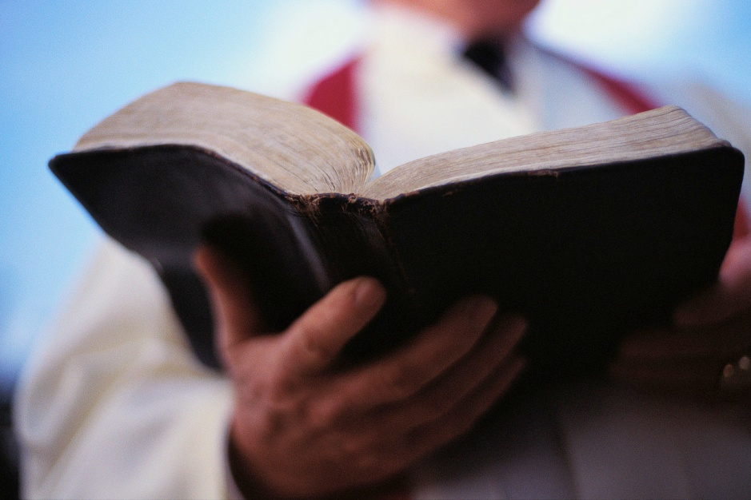
“A GOSPEL MEETING”
“And they were preaching the gospel there” (Acts 14:7)
“But Peter, standing up with the eleven, raised his voice and said to them, ‘Men of Judea and all who dwell in Jerusalem, let this be known to you, and heed my words’” (Acts 2:14)
Notes:
We are preparing for our gospel meeting. I wanted to preach an acrostic sermon on “A gospel meeting” to help prepare our minds for this unique week that we are getting ready to enter into. The first gospel meeting to ever occur was that which happened in Acts 2. This is where thousands were assembled to hear the gospel of the kingdom of heaven preached fully.

Slide 2
A GOSPEL MEETING
SSEMBLING
“not forsaking the assembling of ourselves together, as is the manner of some, but exhorting one another, and so much the more as you see the Day approaching” (Heb. 10:25)
Notes:
A gospel meeting provides us an opportunity to assemble together. I strongly encourage you to plan on attending every meeting.

Slide 3
A GOSPEL MEETING
SSEMBLING
ATHERING
We gather for the great gathering!
  “Immediately therefore I sent to thee; and thou hast well done that thou art come. Now therefore are we all here present before God, to hear all things that are commanded thee of God” (Acts 10:33)
  “There were many lamps in the upper room where they were gathered together” (Acts 20:8)
  “Now, brethren, concerning the coming of our Lord Jesus Christ and our gathering together to Him, we ask you” (2 Thess. 2:1)

Slide 4
A GOSPEL MEETING
SSEMBLING
ATHERING
PPORTUNITY
To grow in the grace and knowledge of God (2 Pet. 3:18)
To do good (Gal. 6:10)
To invite the lost to come and see
(Jn. 1:46; 4:29)

Slide 5
A GOSPEL MEETING
SSEMBLING
ATHERING
PPORTUNITY
AVING
The saving power of the gospel is displayed
  “For I am not ashamed of the gospel of Christ, for it is the power of God to salvation for everyone who believes, for the Jew first and also for the Greek” (Rom. 1:16)
Notes:
I wonder if some gospel meetings have left out the saving power of the gospel and filled with the wisdom of men.

Slide 6
A GOSPEL MEETING
SSEMBLING
ATHERING
PPORTUNITY
AVING
REACHING
Romans 10:12-17
2 Timothy 4:2

Slide 7
A GOSPEL MEETING
SSEMBLING
ATHERING
PPORTUNITY
AVING
REACHING
DIFICATION
“So now, brethren, I commend you to God and to the word of His grace, which is able to build you up and give you an inheritance among all those who are sanctified” (Acts 20:32)
“Again, do you think that we excuse ourselves to you? We speak before God in Christ. But we do all things, beloved, for your edification” (2 Cor. 12:2)

Slide 8
A GOSPEL MEETING
SSEMBLING
ATHERING
PPORTUNITY
AVING
REACHING
DIFICATION
OOKING
A gospel meeting provides us opportunity to look at Jesus our King (Heb. 12:12)
  What He did
  What He taught
  How He handled various situations
KIN
G
“He who says he abides in Him ought himself also to walk just as He walked”
(1 Jn. 2:6)

Slide 9
A GOSPEL MEETING
SSEMBLING
ATHERING
PPORTUNITY
AVING
REACHING
DIFICATION
OOKING
IND
Mind of the Lord (Rom. 11:4; Lev. 24:12)
Mind of the Spirit (Rom. 8:5-8)
Mind of Christ (1 Cor. 2:16; Phil. 2:5; 1 Pet. 4:1, 2)
Gird up the loins of your mind (1 Pet. 1:13)
Sound mind (2 Tim. 1:7)
Renewing your mind (Rom. 12:2)
Try my mind”
(Ps. 26:2)
Notes:
A gospel meeting provides us opportunity to work on our mind. Mind work is an important work of being a Christian. We would not know how we ought to think about things unless God revealed to us His mind on the matter.
RE: 1 Peter 4:1, 2, - Know that the mind needs armed or fortified. Most of the wars that we engage in as Christians are fought with the mind. When we have the mind of Christ, mentally ready for the challenge. We are mentally ready to die. We are mentally ready to resist temptation. We are called to do just that in verse two regarding the “rest of his time.” Do you have mental armor on? We are in battle and must have the mind working in the way that is right. When we don’t have that armor, then we seek compromise.
With the mind properly armed we won’t have to make a decision if we are going to the gospel meeting. It’s already decided. We don’t have to decide if about worldliness and the lust thereof. We have already decided not to live the rest of our lives in lewd, lust, drunkennes, revelries, drinking parties, etc. It’s already decided that smoking, doping, drinking, dancing, pornography, and the like are opponents of truth. When we befriend these types of sins, our minds are not armed with the mind of Christ. BTW, do you know that the purpose of having any gospel meeting is to arm our minds with Christ? Who here desires to have that mind? Who here is pursuing that mind? Who wants to have their mind renewed? Who wants a healthy sound mind? Only when we truly purse and capture the mind of Christ, the Mind of the Spirit and the Mind of the Lord, and seek to emmulate can we then pray like David, “try my mind.”

Slide 10
A GOSPEL MEETING
SSEMBLING
ATHERING
PPORTUNITY
AVING
REACHING
DIFICATION
OOKING
IND
XPOSING
Darkness
“And have no fellowship with the unfruitful works of darkness, but rather expose them” (Eph. 5:11)
Notes:
A part of gospel meetings is to expose the works of darkness.

Slide 11
A GOSPEL MEETING
SSEMBLING
ATHERING
PPORTUNITY
AVING
REACHING
DIFICATION
OOKING
IND
XPOSING
NDURANCE
HEBREWS 10:36-39

Slide 12
A GOSPEL MEETING
SSEMBLING
ATHERING
PPORTUNITY
AVING
REACHING
DIFICATION
OOKING
IND
XPOSING
NDURANCE
IME
TO BE
HOLY
1 Peter 1:13-17

Slide 13
A GOSPEL MEETING
SSEMBLING
ATHERING
PPORTUNITY
AVING
REACHING
DIFICATION
OOKING
IND
XPOSING
NDURANCE
IME
NTERCEDING
1 Tim. 2:1
Notes:
“Therefore I exhort first of all that supplications, prayers, intercessions, and giving of thanks be made for all men” (1 Tim. 2:1)

Slide 14
A GOSPEL MEETING
SSEMBLING
ATHERING
PPORTUNITY
AVING
REACHING
DIFICATION
OOKING
IND
XPOSING
NDURANCE
IME
NTERCEDING
OW
2 Cor. 6:2
Notes:
Gospel meetings express the urgency of now. We have an awful time with procrastination. Gospel meetings help us resolve to answer the call now. Pressing people to move to God with urgency is not always easy. In fact, it can be down right discouraging, disheartening. Notice some of the descriptions and scenarios that God’s ministers find themselves in. Read 2 Cor. 6:1-10.

Slide 15
A GOSPEL MEETING
SSEMBLING
ATHERING
PPORTUNITY
AVING
REACHING
DIFICATION
OOKING
IND
XPOSING
NDURANCE
IME
NTERCEDING
OW
O

Slide 16
Matthew 28:18-20
18 And Jesus came and spoke to them, saying, "All authority has been given to Me in heaven and on earth.
19 "Go therefore and make disciples of all the nations, baptizing them in the name of the Father and of the Son and of the Holy Spirit,
20 "teaching them to observe all things that I have commanded you; and lo, I am with you always, even to the end of the age." Amen.

