Slide 1
Get Back To The Bible
AMERICA!

Slide 2
The Bible Is Available Today…But Is It Still Lost?

Slide 3
LOST
In churches who, “TAKE THE BIBLE SERIOUSLY BUT NOT LITERALLY.”
By preachers who misapply it, replace it with man’s ideas/wisdom, ride hobbies…
Rom. 4:2, 3 → 3:28; 4:9-12; Jas. 2:21, 23
Acts 20:26, 27
In “believers” when it is not practiced
Jas. 2:24
In the family where it is nudged out by “things”
Eph. 6:4

Slide 4
LOST
In our schools
A New Jersey school having young children chant a song of praise to President Obama (2009)
Pennsylvania ruling to not allow the Bible in “Show And Tell” time

Slide 5
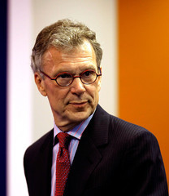
LOST
In our political leaders:
Disgrace it/use it for personal gain
Quote it out of context or malign it
Tom Daschle quoting Isaiah 9:10 on 9/12/01
Ridicule those who appeal to it (as “legalist,” “fundamentalists,” “intolerant,” “bigoted,” etc.

Slide 6
Ridiculed!
“And even if we did have only Christians in our midst, if we expelled every non-Christian from the United States of America, whose Christianity would we teach in the schools? Would we go with James Dobson’s, or Al Sharpton’s? Which passages of Scripture should guide our public policy? Should we go with Leviticus, which suggests slavery is ok and that eating shellfish is an abomination? How about Deuteronomy, which suggests stoning your child if he strays from the faith? Or should we just stick to the Sermon on the Mount – a passage that is so radical that it’s doubtful that our own Defense Department would survive its application? So before we get carried away, let’s read our bibles. Folks haven’t been reading their bibles” (Barack Obama, “Call To Renewal,” June 28th, 2006)

Slide 7
The Bible regulates slavery…it doesn’t endorse it as something that is good
Deuteronomy and Leviticus were given to one nation, Israel
Served a purpose to bring men to Christ (Gal. 3:24; 2 Tim. 3:15)
Showed the problem of sin (Gal. 3:19)
Were done away by Jesus’ death (Eph. 2:15).
The Sermon on the Mount was not given to a government’s defense department but to individuals who should be willing to suffer for righteousness and win others to Christ.

Slide 8
Romans=obscure; Sermon on the Mount=Central?
“I will tell you that I don't believe in gay marriage, but I do think that people who are gay and lesbian should be treated with dignity and respect and that the state should not discriminate against them. So, I believe in civil unions that allow a same-sex couple to visit each other in a hospital or transfer property to each other. I don't think it should be called marriage, but I think that it is a legal right that they should have that is recognized by the state. If people find that controversial then I would just refer them to the Sermon on the Mount, which I think is, in my mind, for my faith, more central than an obscure passage in Romans. That's my view. But we can have a respectful disagreement on that” (Barack Obama, November 2, 2008).

Slide 9
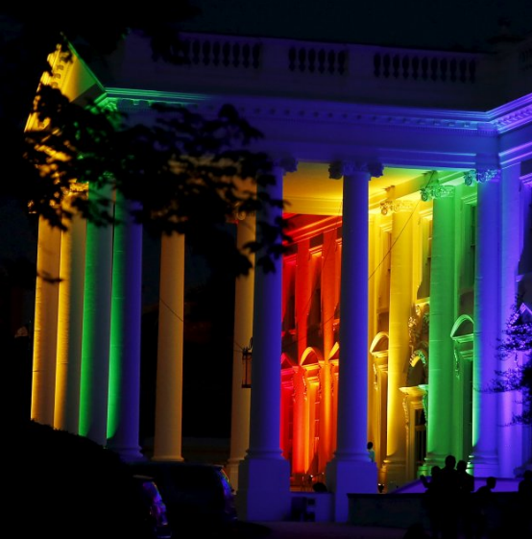
Romans=obscure; Sermon on the Mount=Central?
“I will tell you that I don't believe in gay marriage…”
But lit up the white house in rainbow colors to support the Supreme Court’s pro homosexual marriage decision June 26, 2015
Previously asserted that the Sermon on the Mount is radical, then confesses it is more central to his faith?
Isaiah 9:16, “For the leaders of this people cause them to err, And those who are led by them are destroyed.”

Slide 10
Disparaging Words: Were Not Always Leveled At The Bible By People in Authority
"The Bible is worth more than all other books which have ever been printed" – Patrick Henry
"The Bible is the best book in the world" – John Adams
"A thorough knowledge of the Bible is worth more than a college education" – Theodore Roosevelt
"I believe the Bible is the best gift God has given to man" – Abraham Lincoln
Is it a “radical” gift filled with obscurity?

Slide 11
Who Said?
“Can we resolve to reach, learn, and try to heed the greatest message ever written—God's word and the Holy Bible. Inside its pages lie all the answers to all the problems that man has ever known.”
COMPARE: Now we are told it is radical and obscure!

Slide 12
Who Said?
“We face great challenges in this country, but we've faced great challenges before and conquered them. What carried us through was a willingness to seek power and protection from One much greater than ourselves, to turn back to Him and to trust in His mercy. Without His help, America will not go forward.”
ANSWER: President Ronald Reagan, Annual National Prayer Breakfast, Feb. 3, 1983
REAGAN WAS RIGHT!

Slide 13
Public Law 97-280

Slide 14
Things Change
Now our Empire State Building celebrates communism (Sept. 30th 2009) by shining forth the colors red and yellow in honor of Communist China’s 60 year anniversary?

Slide 15
A Continued Shift From The Scriptures Is Taking Place!
“There is no doubt that the very nature of faith means that some of our beliefs will never be the same. We read from different texts. We follow different edicts. We subscribe to different accounts of how we came to be here and where we’re going next – and some subscribe to no faith at all. But no matter what we choose to believe, let us remember that there is no religion whose central tenet is hate. There is no God who condones taking the life of an innocent human being. This much we know. We know too that whatever our differences, there is one law that binds all great religions together. Jesus told us to “love thy neighbor as thyself.” The Torah commands, “That which is hateful to you, do not do to your fellow.” In Islam, there is a hadith that reads “None of you truly believes until he wishes for his brother what he wishes for himself.” And the same is true for Buddhists and Hindus; for followers of Confucius and for humanists. It is, of course, the Golden Rule – the call to love one another; to understand one another; to treat with dignity and respect those with whom we share a brief moment on this Earth” (Feb. 5th, 2009).
Then why did President Obama lift the ban on federal funding for international groups promoting abortion?

Slide 16
A Continued Shift From The Scriptures Is Taking Place!
“There is no doubt that the very nature of faith means that some of our beliefs will never be the same. We read from different texts. We follow different edicts. We subscribe to different accounts of how we came to be here and where we’re going next – and some subscribe to no faith at all. But no matter what we choose to believe, let us remember that there is no religion whose central tenet is hate. There is no God who condones taking the life of an innocent human being. This much we know. We know too that whatever our differences, there is one law that binds all great religions together. Jesus told us to “love thy neighbor as thyself.” The Torah commands, “That which is hateful to you, do not do to your fellow.” In Islam, there is a hadith that reads “None of you truly believes until he wishes for his brother what he wishes for himself.” And the same is true for Buddhists and Hindus; for followers of Confucius and for humanists. It is, of course, the Golden Rule – the call to love one another; to understand one another; to treat with dignity and respect those with whom we share a brief moment on this Earth.” (Feb. 5th, 2009)
Places the New Testament teaching on par with Islam

Slide 17
Well…
Our nation has fundamentally changed!
“Therefore I exhort first of all that supplications, prayers, intercessions, and giving of thanks be made for all men, for kings and all who are in authority, that we may lead a quiet and peaceable life in all godliness and reverence” (1 Tim. 2:1, 2)
Song: “Faith Of Our Fathers”
Gird yourself with courage!

Slide 18
Next Lesson:
There was a time when the Bible was lost in Old Testament History
The dangers of losing the Bible
Reasons why we need to get back to the Bible
Why we need to honor the authority of Jesus Christ
The benefits of getting back to the Bible

