Slide 1
Ephphatha
“Be Open”
Mark 7:31-35
Notes:
EHF-uh-thuh
Jesus had just returned from region of Tyre and Sidon and found a Gentile woman display an amazing show of faith.

Slide 2
1) The Impressive Power Of Our Lord To Open
The will to take on our infirmities
  “Surely He has borne our grief's and carried our sorrows…” (Is. 53:4; Matt. 8:14-17)
The power to open what was shut through His very word (Mk. 7:34, 35)
Notes:
The will to take on our infirmities. Even his willingness to handle us in our state…Willing to handle (7:33; 1:40, 41; 5:41; Lk. 7:14)
His power on earth was displayed in various ways pertaining to the frailties of our earthly bodies. to cure leprosy (Mk. 1:40-42)
To restore health (Jn. 4:46-54; Lk. 7:1-10; etc.)
To cast out demons (Mk. 7:29, 30)

Slide 3
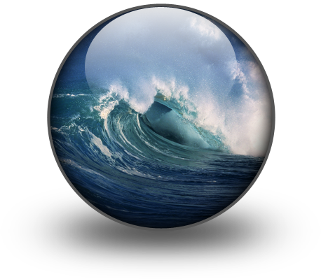
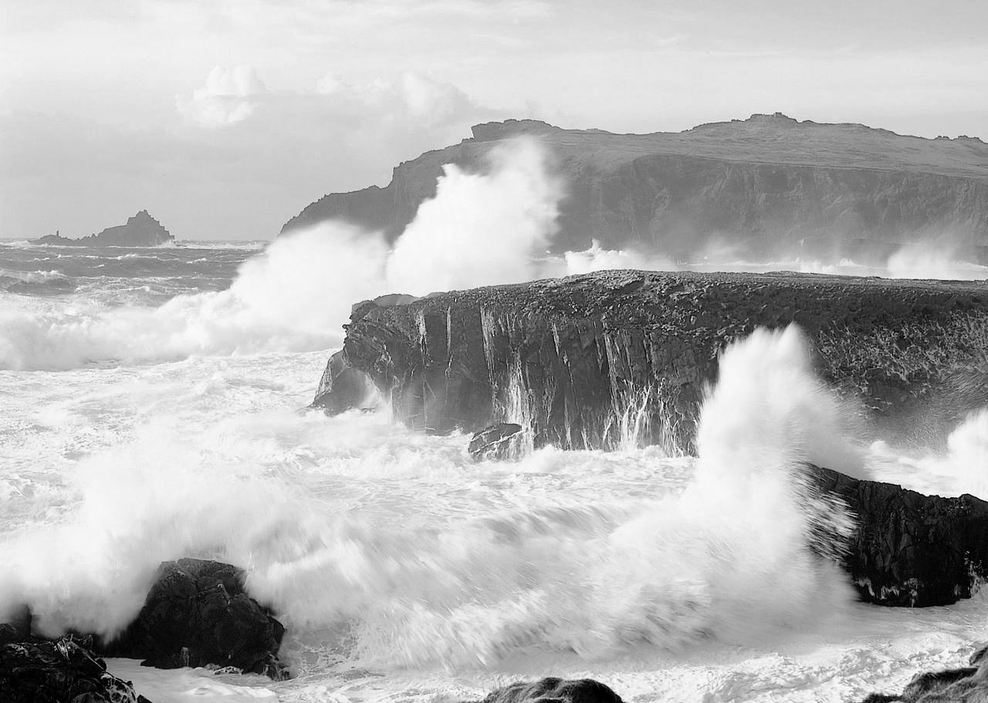
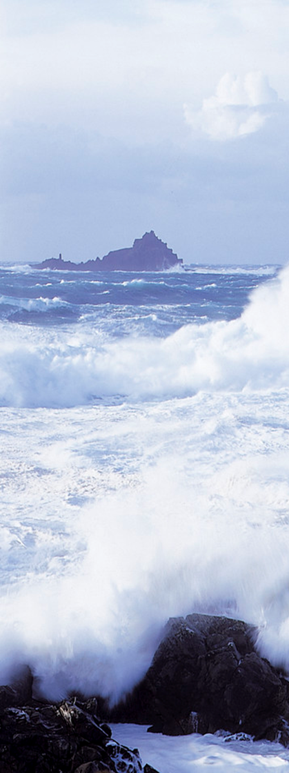
Psalm 107
24 They see the works of the LORD, And His wonders in the deep.
25 For He commands and raises the stormy wind, Which lifts up the waves of the sea.
26 They mount up to the heavens, They go down again to the depths; Their soul melts because of trouble.

Slide 4
THROUGH HIS SPOKEN WORD
IMPRESSIVE POWER
Mark 4:39, “Then He arose and rebuked the wind, and said to the sea, ‘Peace, be still!’ And the wind ceased and there was a great calm.”
Psalm 33:9, “For He spoke, and it was done; He commanded, and it stood fast.”
John 11:43, 44, “… He cried with a loud voice, ‘Lazarus, come forth!’ And he who had died came out bound hand and foot with graveclothes…”

Slide 5
THROUGH HIS WRITTEN WORD
IMPRESSIVE POWER
Romans 1:16, “For I am not ashamed of the gospel of Christ, for it is the power of God to salvation for everyone who believes, for the Jew first and also for the Greek.”
Hebrews 4:12, “For the word of God is living and powerful, and sharper than any two-edged sword, piercing even to the division of soul and spirit, and of joints and marrow, and is a discerner of the thoughts and intents of the heart” (see also 2 Tim. 3:15-17)

Slide 6
The IMPRESSIVE COMMAND!
To create (Genesis 1)
To destroy (Genesis 7)
To confuse (Genesis 11)
To kill (Numbers 16:30-32)
To make alive (John 11:43, 44)
To make the impossible possible (Numbers 17)
To save (Dan. 3:20-27)
“Now see that I, even I, am He, And there is no God besides Me; I kill and I make alive; I wound and I heal; Nor is there any who can deliver from My hand” (Deut. 32:39)

Slide 7
The Power Of Freewill!
As impressive as God’s commandments are:
….His word will not override man’s freewill
Jesus opened the ears and mouth of the “deaf and mute” through His word (Mk. 7:34, 35)
  But He would not force man to heed His word with his ears (Mk. 7:36)
  But He will not force men to confess Him with the mouth
  Jesus opened the eyes of the blind, but He will not force man to look into His word
God provided freewill to man so that he can choose to do good or evil, to love or hate, to obey or rebel (Deut. 30:15-20; Rev. 3:8)
Notes:
Read Deuteronomy 30:15-20. Freewill is a beautiful thing. It says that you are capable of your own decision making. It says that you are also responsible for them.

Slide 8
2) The Enticement of Satan To Open And Shut
Jesus can open that which was shut; He can free what Satan has bound (cf. Lk. 13:16)
Satan tempts man to open what God wants closed and close what God wants opened
“Then the serpent said to the woman, ‘You will not surely die. For God knows that in the day you eat of it your eyes will be opened, and you will be like God, knowing good and evil’” (Gen. 3:4, 5)

Slide 9
Satan’s Original Lies
“The Word of God Cannot Be Trusted”
  “Now the serpent was more cunning than any beast of the field which the LORD God had made. And he said to the woman, ‘Has God indeed said, “You shall not eat of every tree of the garden”?’” (Gen. 3:1)
  “?” = Question Word = Doubt
  This has been an issue for every generation since
Notes:
Likewise He can open the ear, but will not force the ear to be opened to the word….open eye, but not force the eye to read His word.

Slide 10
A Rejection Of God’s Word Every Time
Modernism: “Rejecting what is traditional and old”
Evolution: “All living things share a common descent”
  (the human animal, animal rights, survival of the fittest, eugenics, abortion, racism, etc.)
Relativism: “there is no absolute truth”
Notes:
MODERNISM seeks to separate from what is old. Yet in doing so, the modernist also separates himself from truth because truth is old. Jeremiah 6:16
EVOLUTION: Jesus told us that a good tree cannot bear bad fruit nor can a bad tree bear good fruit (Matt. 7:17). I think people need to seriously wake up and consider the kind of fruit that evolution has produced. All kinds of deviant behavior has been made more respectable by reducing man to an animal. Fornication, adultery, eugenics, racism and abortion can all be justified by a strict Darwinian approach to life.
RELATIVISM: is shipwrecked from its own affirmation. If there is no absolute truth, then you cannot affirm an absolute like, “there is no absolute truth.” Relativism is simply a rejection of right and wrong. People run to extremes when they run away from truth and reason. Further the statement that says “All is relative” is also a contradictory affirmation. This would mean that everything is relative. But then the statement “all is relative” would have to only be relative. Further, if all is relative and if there is no truth beyond the scope of one’s personal belief of what truth is, then it is impossible for anyone to ever be accused of being wrong and it is impossible for one to ever recognize his own faults. Truth and error can no longer exist in a pure relativistic world. Someone could believe fire is cool and in his own world he must be correct!

Slide 11
A Rejection Of God’s Word Every Time
Naturalism: “The universe is guided and controlled by purely natural laws and natural forces”
  “The Cosmos is all that is or was or ever will be” (Carl Sagan)
Humanism: “Man, independent of God, determines truth”
Situation Ethics: “God’s laws can sometimes be set aside depending on the situation”
Notes:
NATURALISM: Yet this cannot be. What natural law or force governs memory? Information itself is something that is not material. We are told in the scriptures that Jesus created all things and upholds all things by the word of His power (Heb. 1:2, 3; see also 1 Cor. 2:14).
HUMANISM. The scriptures show just the opposite to be true (Prov. 14:12; Jer. 10:23; Prov. 1:7)
SITUATION ETHICS. Is simply the product or offspring of many of these other doctrines. Where naturalism, humanism and relativism absolutely deny the place for God, situation ethics runs with them in only denying God’s word when it is inconvenient to keep it. The man, of course, has the all needed wisdom in knowing when he is to set aside God’s law and when to keep it.

Slide 12
Satan’s Original Lies
“The Character of God is Questionable”
  EXAGGERATIVE
    “but of the fruit of the tree which is in the midst of the garden, God has said, ‘You shall not eat it, nor shall you touch it, lest you die.’ Then the serpent said to the woman, ‘You will not surely die’” (Gen. 3:3, 4)

Slide 13
Satan’s Original Lies
“The Character of God is Questionable”
  EXAGGERATIVE
  DECEPTIVE
    “For God knows that in the day you eat of it your eyes will be opened”
  SUPPRESSIVE
    “…and you will be like God…”
  UNLOVING
    “…and you will be like God, knowing good and evil”
Notes:
“Unloving” –Hence the charge that God is keeping back something that you should be able to enjoy. You will be like God, knowing good and evil. I can picture the woman thinking, “Why wouldn’t God want me to know the difference between good and evil as He does.” This is the brutal part of the lie and a scenario which reveals itself all too often on the landscape of lies. It is the mixture of truth and error. Satan is the king of deception. So he offers the woman more than she will get. He offers her the opportunity to be like God and to know good and evil as God does.
Albert Barnes noted, “And it did not make them know good and evil altogether, as God knows it, but in an experimental sense, as the devil knows it. In point of knowledge, they became like God; in point of morality, like the tempter.” People do the same thing today when they want to mislead someone. They say something to give a wrong impression, but at the same time could be true in another sense. It is like the flimsy excuse of a person wanting to cease attending a sound church to attend a more liberal or digressive one and he uses the line, “My family and I can serve the lord better this church.” Or another who tried to justify his leaving by taking a point made in a sermon out of context whereby it was taught that you need to be a member of the local church. He takes that and uses it as an excuse to stop driving an hour to worship with a sound church to start attending a weaker church 10 minutes away. Or where one doesn’t want to be accountable for missing services and when you ask where they were, they give the impression that they were at another town meeting with the brethren. Or one who says she was feeling sick, but was really at home painting and may or may not have felt some small amount of nausea that day. Satan told Eve that she would know good and evil. Well she knew evil by experiencing it. I don’t think that is what she thought was a part of the bargain.

Slide 14
Satan’s Original Lies
“The Character of God is Questionable”
  The character of God is tied to His word
    “God’s way is perfect! The promise of the LORD has proven to be true. He is a shield to all those who take refuge in him” (Ps. 18:30, GWV)
    “The counsel of the LORD stands forever, The plans of His heart to all generations” (Ps. 33:11)
Notes:
Likewise He can open the ear, but will not force the ear to be opened to the word….open eye, but not force the eye to read His word.

Slide 15
Satan’s Original Lies
“What Looks Good Must Be Good”
  “So when the woman saw that the tree was good for food, that it was pleasant to the eyes, and a tree desirable to make one wise, she took of its fruit and ate. …” (Gen. 3:6)
  “It is amazing how complete is the delusion that beauty is goodness” (Leo Tolstoy)
  Proverbs 31:30; 6:25; Isaiah 53:2; 1 Pet. 3:3, 4
Notes:
Just because something or someone looks good, doesn’t mean it is good. Regardless of how good and pleasant the forbidden tree looked, it was still evil to eat of it.

Slide 16
James 1:16-18
16 Do not be deceived, my beloved brethren.
17 Every good gift and every perfect gift is from above, and comes down from the Father of lights, with whom there is no variation or shadow of turning.
18 Of His own will He brought us forth by the word of truth, that we might be a kind of firstfruits of His creatures.
Notes:
This passage speaks against being deceived. We need to make sure that we understand the character and nature of God.
He is the author of what is good for all that are good and perfect come from Him.
He is the Father of lights, that is, He created all the lights in the universe. He is light (1 Jn. 1:5; Jn. 3:19). This is why He cannot be the author of sin. Sin is darkness and is inconsistent with the nature of God. He could never tempt someone with evil, because He is devoid of evil.
He is also consistent for there is no variation with Him. As the sun casts various shadows throughout the day on the objects on earth, there is no variation of change with God in heaven. He is the same yesterday, today, and forever.
Furthermore He is not suppressive and unloving, but is good. He has given all good things, but in view of verse 18, we should not overlook the good and perfect gift of His Son, who came down provide the atonement for sins as well as provide a true template or pattern of what righteousness is. Through Him and the truth we can be born again when we open our ears to His word and are immersed into His death for reconciliation (Col. 2:12, 13).

Slide 17

There is a Fountain Open!
"And I will pour on the house of David and on the inhabitants of Jerusalem the Spirit of grace and supplication; then they will look on Me whom they pierced. Yes, they will mourn for Him as one mourns for his only son, and grieve for Him as one grieves for a firstborn.
"In that day a fountain shall be opened for the house of David and for the inhabitants of Jerusalem, for sin and for uncleanness.
Zechariah 12:10; 13:1
Notes:
In the next lesson, I will look at the appeal to open God’s eyes and ears to our cries and petitions.

