Slide 1
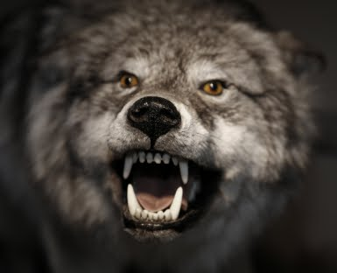
Beware of False Prophets
Matthew 7:15-23
Part 3

Slide 2
Wolves in Sheep’s Clothing
False teachers are dangerous
  Jesus says to beware Matt 7:15
  “Overthrow the faith of some” 2 Tim 2:14-18
False teachers are deceitful
  Appear innocent and harmless
  Deceive others and themselves 2 Tim 3:13

Slide 3
How to Identify the Wolf
Scriptural Method
“You will know them by their fruits”
  Jesus shows how to ID Matthew 7:16-20
  We must examine the fruit that people produce
  Ephesians tested men and found them to be liars Revelation 2:2
  Deceiver/antichrist determined by doctrine 2 John 7-11; 1 John 4:1-4

Slide 4
Our Response to the Wolf
Confront and teach
  Simon the sorcerer (Acts 8)
  Attitude should be quickly apparent Matt 7:6
Publicly note and avoid
  Romans 16:17-20
  “wise in what is good and simple concerning evil”

Slide 5
Our Response to the Wolf
Address false doctrine within congregation
  False doctrine about Old Law was being taught by some from Judea Acts 15:1-6
  Letter to affected congregations 15:22-29
  Positive effect on these congregations 15:30-35
Elders have special responsibility
  Titus 1:10-16
  Some “mouths must be stopped”

Slide 6
Watch for the Wolf
Paul warned the Ephesian elders
  Acts 20:27-31; Revelation 2:2
  Warning did come to pass and they were tested
False teachers are always out there
  2 Peter 2:1-3; 1 John 2:18
  We need to test ALL who teach, all of the time

Slide 7
Sheep Inviting Wolves In
2 Timothy 4:1-5

Slide 8
Obsessed with Own Desires
More “self-focused” than “God-focused”
  2 Timothy 4:1-5
Following our own desires doesn’t end well
  James 1:14-15
Christians are required to cast off lusts
  Ephesians 4:20-24

Slide 9
Will Not Endure Sound Doctrine
Some will turn aside from the truth
  2 Timothy 4:3,4
Often they attack proponents of truth
Persecution of Jeremiah
  Jeremiah 18:1-11, 18; 36:1-3, 20-26

Slide 10
Heap Up For Themselves Teachers
Find someone who will scratch the itch
  2 Timothy 4:3
Some really want to be told a lie
  Isaiah 30:8-11
Want to hear that God is happy with them
  Jeremiah 23:16-17

Slide 11
Never Compromise the Truth
Believing in a lie doesn’t change the truth
  Isaiah 30:12-14
Truth is necessary even when uncomfortable
  Jeremiah 36:27-29a
Our commitment to truth should not waver

