Slide 1
GALATIANS 1:6, 7:
“I marvel that you are turning away so soon from Him who called you in the grace of Christ, to a different gospel, which is not another; but there are some who trouble you and want to pervert the gospel of Christ.”

Slide 2

GRACE
DISPENSATIONALISM
Hyperdispensationalism | Mid-Acts Dispensationalism

Slide 4


Slide 5


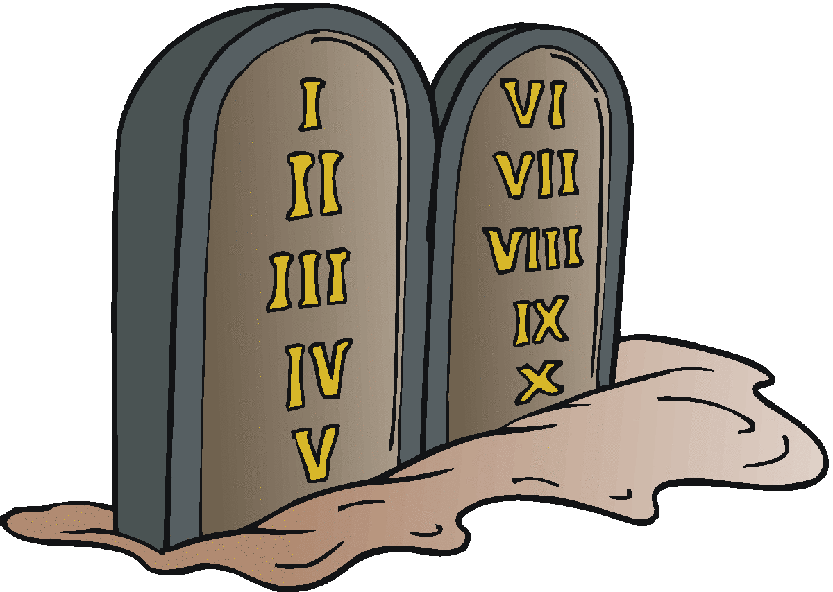
The three major dispensations of time:
Patriarchal: Adam → Moses (presence of law: Rom. 5:13, 14)
Jewish: Moses → Christ (The Law: Rom. 5:13; Eph. 2:14, 15)
Christian: Pentecost → Judgment (the law of the Spirit: Rom. 8:2; 1 Cor. 9:21; by implication, Col. 2:13; Rom. 3:20; 4:15; 1 Jn. 3:4)
family
national
t
international
PATRIARCHAL
JEWISH
CHRISTIAN
creation
Pentecost
J
2500 yrs.
1500 yrs.
J = Judgment Day

Slide 6

1. “Classic Dispensationalism”
Teaches seven dispensations:
  Innocence (Genesis 1:1—3:7)
  Conscience (Genesis 3:8—8:22)
  Human Government (Genesis 9:1—11:32)
  Promise (Genesis 12:1—Exodus 19:25)
  Law (Exodus 20:1—Acts 2:4)
  Grace (Acts 2:4—Revelation 20:3)
  Millennial Kingdom (Revelation 20:4–6)
Assigns a literal interpretation to prophecy
A premillennial view of the second coming

Slide 7
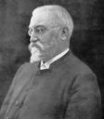
2. “Hyperdispensationalism”
E. W. Bullinger
Church (body of Christ) began after the close of Acts
  A boundary line in Acts 28:28
The Church (body) only revealed in prison-epistles by Paul
1837—1913

Slide 8
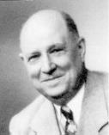
Various Positions Held
3. “Mid-Acts Dispensationalism”
John C. O’Hair
Church (body of Christ) began with Paul’s first journey
  Others assert Acts 9 with Paul’s conversion (Cornelius R. Stam)
      others choose different places in Acts
  Before Paul, the “church” was only a Jewish congregation under Law
  Other apostles worked under Law
1876—1958

Slide 9
Various Positions Held
3. “Mid-Acts Dispensationalism”
John C. O’Hair
Church (body) only revealed in Paul’s epistles (Romans – Philemon)
All other epistles are written for the Jews
1876—1958

Slide 10
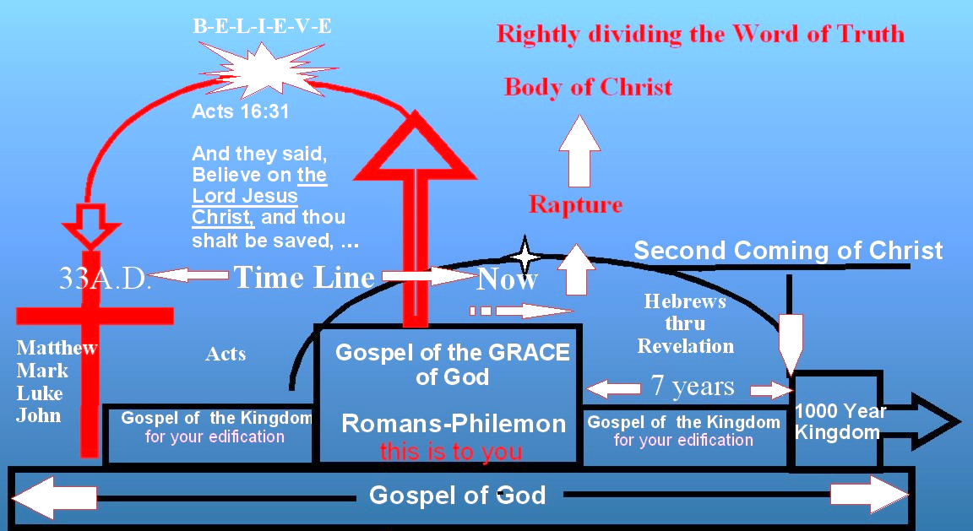
www.absolutetruthkjv.com

Slide 11

STRIKE ONE!
No Premillennial concept of the kingdom in Scripture
Revelation is a book of signs and symbols (Rev. 1:1)
DO NOT TAKE SYMBOLS LITERALLY!

Slide 12
Kingdom: A king and a kingdom
Body: A head and a body
STRIKE TWO!
No Sharp Distinctions Exists Between “Church” “Body” & “Kingdom”
The church of Christ is the kingdom (Matt. 16:18, 19; Rev. 1:4, 9)
The kingdom of Christ is the body (Col. 1:18, 13)

Slide 13
STRIKE TWO!
No Sharp Distinctions Exists Between “Church” “Body” & “Kingdom”
Paul preached the church is the body to Ephesus (Eph. 1:22, 23; 2:16; etc.)
When Paul labored among them, he preached the kingdom (Acts 20:17, 24, 25)

Slide 14
STRIKE TWO!
No Sharp Distinctions Exists Between “Church” “Body” & “Kingdom”
Paul taught the church is the “body” to the Corinthians
(1 Cor. 10:17; 12:12ff)
Yet he taught this church about the “kingdom”
(1 Cor. 4:19, 20; 6:9-11)

Slide 15
STRIKE TWO!
No Sharp Distinctions Exists Between “Church” “Body” & “Kingdom”
30 Then Paul dwelt two whole years in his own rented house, and received all who came to him,
31 preaching the kingdom of God and teaching the things which concern the Lord Jesus Christ with all confidence, no one forbidding him.
Acts 28

Slide 16
STRIKE THREE!
Wrongly Dividing The Word of God
Divorcing the Gospels, Acts, Hebrews thru Revelation from being books written to the church violates God’s rules and results in being lost!
(Deut. 4:2; Prov. 30:6; Rev. 22:18, 19)

