Slide 1


GRACE
DISPENSATIONALISM
Hyperdispensationalism | Mid-Acts Dispensationalism

Slide 2
What is the
MOTIVE
For Mid-Acts & Hyperdispensationalism?
Berean Bible Society
www.bereanbiblesociety.org/are-we-hyper-dispensationalists
“We know how confused we used to be. We can honestly say that this is a more consistent and literal approach to Scripture.
We no longer have to explain away what the Bible clearly says in verses such as Acts 2:38. …We are in agreement with the overwhelming majority of traditional dispensationalism.”
Note: The Confession

Slide 3
What is the
MOTIVE
For Mid-Acts & Hyperdispensationalism?
Berean Bible Society
www.bereanbiblesociety.org/are-we-hyper-dispensationalists
“Our two primary points of disagreement are that we see the Body of Christ starting with the conversion and call of the Apostle Paul and that water baptism is not a requirement for this dispensation.”
Rather than explain away Scripture, the new approach is undermine and erase it!

Slide 4
What is the
MOTIVE
For Mid-Acts & Hyperdispensationalism?
Dispensational Bible Church
www.dispensationalbiblechurch.org/index.php/printed-lessons/7-contradicitons
“To be saved under the gospel of the circumcision, water baptism was a required expression of faith, but water baptism is not required under the gospel of the uncircumcision. If baptism were necessary … Paul would never have said, ‘I thank God that I baptized none of you.’ Thus, whether baptism is necessary for salvation differs under these two gospels.”

Slide 5
Are there two gospels?
Did Peter preach a different gospel from Paul?
Why did Paul thank God for not baptizing many of the Corinthians?

Slide 6
“However, in this very epistle, Paul mentions “the gospel of the circumcision” and “the gospel of the uncircumcision” in the very same verse (2:7). Why, there’s two gospels right there!”
Kurth, Ricky L., “The Berean Searchlight,” p. 16, Aug. 2014.

Slide 7
“The gospel of the circumcision said that you had to be circumcised to be saved (Gen. 17:14), while the gospel of the uncircumcision said that you didn’t have to be circumcised to be saved. …the Galatians were being tempted to return to this gospel of the circumcision…”
Kurth, Ricky L., “The Berean Searchlight,” p. 16, Aug. 2014.

Slide 8
“17. The MYSTERY “Hid in God” was the divine purpose to make of Jew and Gentile a whole new thing, that is, the Church, which is Christ’s Body. The revelation of this Mystery was committed to Paul, and it is in his writings alone that we find the doctrine, position, walk and destiny of the Church (Gal. 1:11,12; Eph. 3:1-9; Col. 1:24-27).”
“Doctrinal Statement of the BEREAN Bible Society.” Berean Bible Society, www.bereanbiblesociety.org/doctrinal-statement-of-the-berean-bible-society/.

Slide 9

The gospel of the church/body
“But contrariwise, when they saw that the gospel of the uncircumcision was committed unto me, as the
gospel of the circumcision was unto Peter” (Gal. 2:7, KJV)
The gospel of the kingdom
*This explains why many of them are KJV only advocates.

Slide 10
GALATIANS 1:6, 7:
“I marvel that you are turning away so soon from Him who called you in the grace of Christ, to a different gospel, which is not another; but there are some who trouble you and want to pervert the gospel of Christ.”

Slide 11

Not a single difference in the “content” between Peter and Paul’s teaching.
The difference was only in the audience.
Galatians 2:7
15:7-10
Who?
“Therefore, whether it was I or they, so we preach and so you believed.”
1 Corinthians 15:11

Slide 12
The same mystery was revealed to all the apostles.
Not “apostle” as of one, but “apostles” as of all!
Galatians 2:7
“…as it has now been revealed by the Spirit to His holy apostles and prophets…”
(see Eph. 3:3-6)
Who?

Slide 13
What did Paul preach?
Among whom did he preach the kingdom of God?
ANS: The Church @ Ephesus,
Acts 20:17
Galatians 2:7
“And indeed, now I know that you all, among whom I have gone preaching the kingdom of God, will see my face no more.”
Acts 20:25

Slide 14
Who did Paul formerly persecute (Gal. 1:22)?
What did Paul once try to destroy?
What did Paul now preach?
Who held this faith when Paul tried to destroy it?
SAME
The Faith!
Those in the churches of Judea!
Galatians 2:7
“But they were hearing only, ‘He who formerly persecuted us now preaches the faith which
he once tried to destroy.’”
Galatians 1:23

Slide 15
The churches in Judea began by the “faith” that was preached to them (Acts 2:21, 32-38, 42; 3:13-20; 4:10-12, 33; 6:7; 7:51-58; 8:1-5, 12, 13; etc.)
Paul tried to destroy that faith (Acts 8:3; 9:1, 22:4, 5; 26:9-11; Gal. 1:23)
After seeing the Lord, he proclaimed that faith
(Acts 9:20, 22, 29; Gal. 1:23)
There is only “one faith” (Eph. 4:5)
Galatians 2:7

Slide 16
11 Consequences of the fallacious Grace-Dispensational Movement
They erase the authority of the Gospels
They erase the relevancy of Acts,
Hebrews → Revelation
They call for two different gospels
  Yet, the apostles taught that the Jews would be saved in the same manner as the Gentiles (Acts 15:7-11)

Slide 17
11 Consequences of the fallacious Grace-Dispensational Movement
They call for two different churches and make the church Paul worked in different from the church spoken of by the Lord in Matt. 16:18
They make Jesus a false prophet
  He predicted the kingdom would come with power in first century (Mk. 9:1)
  Dispensationalism rejects the idea altogether

Slide 18
11 Consequences of the fallacious Grace-Dispensational Movement
They make Paul a false teacher
  He preached the that kingdom was present with power (1 Cor. 4:20; Col. 1:13; 4:11)
They pit Paul’s preaching against the other apostles when there was no difference
  See 1 Cor. 15:11
  Why would Paul join himself to the Jerusalem church if they taught “another gospel” (Acts 9:26-28; Gal. 1:7; 2 Cor. 11:4)?

Slide 19
11 Consequences of the fallacious Grace-Dispensational Movement
They segregate Paul’s preaching to the Gentiles from the preaching to the Jews
  Apollos preached to the Jews (Acts 18:26)
  Yet, brethren who were “saved by grace through faith” in Ephesus commended him (Eph. 2:8, Acts 18:24, 27)
  They exhorted the brethren in Achaia to receive him (Acts 18:27)
CONCLUSION:
the Ephesians did not see two different gospels!

Slide 20
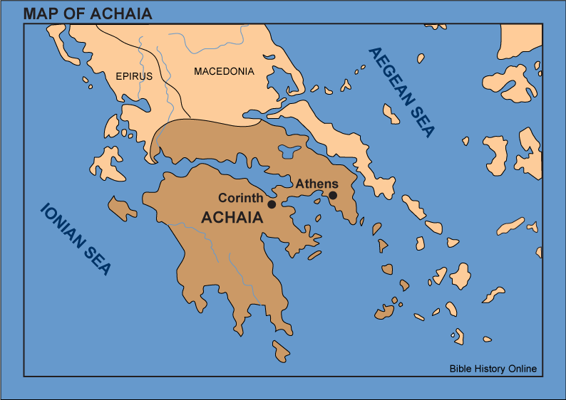
11 Consequences of the fallacious Grace-Dispensational Movement
They segregate Paul’s preaching to the Gentiles from the preaching to the Jews
  At Corinth Apollos “greatly helped those who had believed through grace” (Acts 18:27; 1 Cor. 1:4-9)
  How did Apollos help?
    “for he vigorously refuted
    the Jews publicly, showing
    from the Scriptures that
    Jesus is the Christ”
    (Acts 18:28)
CONCLUSION:
the Corinthians did not see two different gospels!

Slide 21
11 Consequences of the fallacious Grace-Dispensational Movement
They segregate Paul’s preaching to the Gentiles from the preaching to the Jews
  The disciples at Ephesus progressed from Apollos’ preaching
  The disciples at Corinth progressed from Apollos’ preaching
  Paul confirmed he and Apollos were one and both worked in the same field (1 Cor. 3:5-9)
CONCLUSION:
Paul did not see two different gospels!
Paul did not see two different churches!

Slide 22
11 Consequences of the fallacious Grace-Dispensational Movement
Their convoluted exegesis of Scripture violates simple contextual coherency (ex. Insisting two gospels, Gal. 2:7; violating not another, Gal. 1:6ff)
They make two different baptisms. Water baptism for Jewish believers and a spiritual baptism by Paul for Gentile believers

Slide 23
11 Consequences of the fallacious Grace-Dispensational Movement
They make Paul inconsistent in practice for he baptized the Ephesians with water (Acts 19:4, 5, in the name of the Lord, Acts 2:38; 10:47, 48; cf. Eph. 4:5, 5:26)?

