Slide 1
The Prayer
4
JABEZ

Slide 2
Fausset’s Bible Dictionary
“His prayer is one of the most comprehensive in the Bible, and shines forth like a brilliant star in the midst of a genealogical catalog of names; probably offered in setting out in life, an admirable model for youths.”

Slide 3
A Look At Jabez’s Prayer
1 Chronicles 4:10

Slide 4
1) “Oh, that You would bless me indeed…”
It is right to pray to the Lord to bless us
(Ps. 67:1; Gen. 32:26)
  We receive from Him - not by our own strength
  “Every good gift and every perfect gift is from above, and comes down from the Father of lights…” (Jas. 1:17)
  God sent His Son…To bless us!
Notes:
“God be merciful to us and bless us, And cause His face to shine upon us. Selah” (Ps. 67:1)
“And He said, ‘Let Me go, for the day breaks.’ But he said, ‘I will not let You go unless You bless me!’” (Gen. 32:26).

Slide 5
Spiritual Blessings Matter Most!
Acts 3:26, "To you first, God, having raised up His Servant Jesus, sent Him to bless you, in turning away every one of you from your iniquities."
  Sin hampers blessing
Ephesians 1:3, “Blessed be the God and Father of our Lord Jesus Christ, who has blessed us with every spiritual blessing in the heavenly places in Christ”

Slide 6
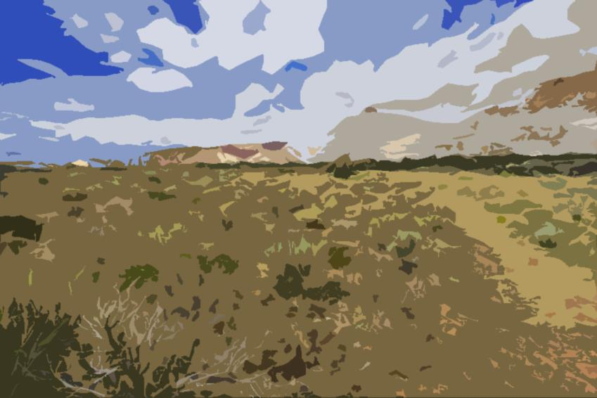
2) “…and enlarge my territory…”
From the encroachment of enemies
  Ps 31:8, “And have not shut me up into the hand of the enemy; You have set my feet in a wide place.”
  Ps 118:5, “I called on the LORD in distress; The LORD answered me and set me in a broad place.”
Notes:
Spiritually we should pray for wide places rather than walking through narrow and dangerous canyons.
Consider Psalm 23 on last point and contrast the green pastures in which to lie down versus the valley of the shadow of death. Death casts a dark gloom over the valley! Likewise, we may often have to walk through the dark valley to arrive at the broad tableland of safety and comfort. Jabez prays to be led by the great Comforter to that tableland and so should we!

Slide 7
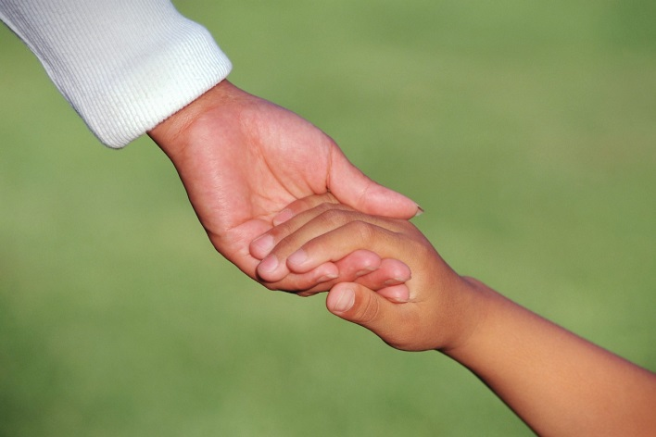
3) “…that Your hand would be with me…”
Ps 119:173, “Let Your hand become my help, For I have chosen Your precepts.”
We should pray for the Lord’s hand to help!
  To guard us from our enemies (Is. 41:10-14; Eph. 6:10-18; Heb. 13:6)
  To guide us through physical trial (2 Cor. 12:9)
  To unify our hearts in obedience (2 Chron. 30:12)
Notes:
2 Corinthians 12:9, “And He said to me, "My grace is sufficient for you, for My strength is made perfect in weakness." Therefore most gladly I will rather boast in my infirmities, that the power of Christ may rest upon me.”

Slide 8
4) “…that You would keep me from evil…”
Matthew 6:13, “And do not lead us into temptation, But deliver us from the evil one. For Yours is the kingdom and the power and the glory forever. Amen.”
John 17:15, “I do not pray that You should take them out of the world, but that You should keep them from the evil one.”
Notes:
Lu 22:40, “When He came to the place, He said to them, ‘Pray that you may not enter into temptation.’”
Lu 22:46 “Then He said to them, ‘Why do you sleep? Rise and pray, lest you enter into temptation.’”

Slide 9
“EVIL”
Does not always appear gruesome
  “Now these things became our examples, to the intent that we should not lust after evil things as they also lusted” (1 Cor. 10:6; 2 Thess. 2:12; Ps. 52:3; Job 15:16)
Is to be abhorred no matter how it looks
  Romans 12:9, “Let love be without hypocrisy. Abhor what is evil. Cling to what is good.”
  We must refuse its every form and not be drawn into it “Abstain from every form of evil” (1 Thess. 5:22)
Notes:
RE: gruesome, the fact that evil can be lusted after, shows that evil can be attractive! There can be pleasure in what is wicked, “that they all may be condemned who did not believe the truth but had pleasure in unrighteousness” (2 Thess. 2:12).
RE: abhor…The fact that we have to be commanded to abhor evil shows that it may not be natural to hate it. That it can look lovely.

Slide 10
“EVIL”
Can partake of it without actually doing the deed (2 Jn. 11; Rev. 18:4)
  Fellowship and support of those practicing/defending sin is partaking of their sin
Notes:
RE: gruesome, the fact that evil can be lusted after, shows that evil can be attractive! There can be pleasure in what is wicked, “that they all may be condemned who did not believe the truth but had pleasure in unrighteousness” (2 Thess. 2:12).
RE: abhor…The fact that we have to be commanded to abhor evil shows that it may not be natural to hate it. That it can look lovely.

Slide 11
Some EVIL Things
“Woe to those who devise iniquity, And work out evil on their beds! At morning light they practice it, Because it is in the power of their hand”
(Mic. 2:1)
Evil alliances (2 Chron. 20:35; Ps. 83:5)
Evil associations (1 Cor. 15:33; Prov. 4:14; 13:20; 1 Cor. 5:9-11)
Evil choices (e.g., from envy making an evil choice: Matt. 27:18, 21)
Evil schemes (Ps. 37:7-9, 12, 13; Prov. 6:14; Prov. 12:2, 3, 5; 2 Tim. 4:14)
Rewarding evil for good (Ps. 35:12; 38:20; 109:5; 2 Cor. 12:15-21; Prov. 17:13)
Notes:
Evil alliances: “After this Jehoshaphat king of Judah allied himself with Ahaziah king of Israel, who acted very wickedly” (2 Chron. 20:35)
Evil association: “He who walks with wise men will be wise, But the companion of fools will be destroyed” (Prov. 13:20)
Evil schemes read Ps. 37:7-9, 12, 13; Prov. 12:2, 3, 5.
Evil for Good…
Ps 35:12 They reward me evil for good, To the sorrow of my soul.
Ps 38:20 Those also who render evil for good, They are my adversaries, because I follow what is good.
Ps 109:5 Thus they have rewarded me evil for good, And hatred for my love. 2Co 12:15, “And I will very gladly spend and be spent for your souls; though the more abundantly I love you, the less I am loved.”
Pr 17:13 Whoever rewards evil for good, Evil will not depart from his house.

Slide 12
5) “…that I may not cause pain!”
“JABEZ” (SORROW, AFFLICTION)
PAIN
  Did not pray to have all pain removed from his life (2 Cor. 4:17; Ps. 119:67)
Notes:
PAIN – He did not pray to have all pain removed from his life. Many preach a personal prosperity gospel. They fail to understand and subsequently deny the benefit of pain. They think that the experience of pain is somehow to be disconnected from true Christianity—that Christianity is to remove all unpleasant things from our lives.
I don’t wish pain on anyone. I don’t enjoy pain, yet if God’s chastening be the plow that cuts us deep into the heart, we should give thanks for it. Plaque, “Happy moments praise God; difficult moments seek God; quiet moments worship God, painful moments trust God; every moment thank God.” Affliction can be one of the best books from which to draw from Christ’s library if we can develop character, perseverance, and hope from it (Rom. 5:3, 4)!
Those periods of heartbreak, despair, disappointment, despondency, fear, and confusion can become the seeds for moments of pause and meditation. When we feel feeble and things we strive to do only seem to exacerbate our trial, we may then be better suited to look up and find what really gives us strength.
In those days of darkness, when our spirit seems broken and the windows of our face become busted floodgates that pour forth tears, yes even then, these trials can still yield into moments of praise and thanksgiving.
It may feel difficult. It can at times even become overwhelming and seemingly unbearable. Depression may constantly seek to veil the sunshine. But if we pause and soberly reassess the moment, if we gain perspective from heaven’s viewpoint, though it be dark, though our arms are heavy, and our voices quiver, we can find those songs in the night even as the Psalmist did in Psalm 42.
From fields sown in tears can the joy of harvest come (Ps. 126:5, 6). We must keep sowing. Causing pain is not sowing seeds of righteousness, but seeds of strife. The Christian who survives is the Christian who does not grow bitter in pain, but pleasantly perseveres, sowing in hope. Pain is not an evil lest we be the cause of it in sin!

Slide 13

5) “…that I may not cause pain!”
“JABEZ” (SORROW, AFFLICTION)
  Did not want to live up to his name
    Did not want to cause pain!
  Did not want to cause pain with sin
    When we sin, we cause pain even in heaven
    “And do not grieve the Holy Spirit of God…” (Eph. 4:30)
Notes:
“And Peter remembered the word of Jesus who had said to him, ‘Before the rooster crows, you will deny Me three times. So he went out and wept bitterly” (Matt. 26:75)
Eph 4:30 And do not grieve the Holy Spirit of God, by whom you were sealed for the day of redemption.

Slide 14
“So God granted him what he requested.”
God Answers Prayer
  “Blessed be God, Who has not turned away my prayer, Nor His mercy from me!” (Ps. 66:20)
  “Confess your trespasses to one another, and pray for one another, that you may be healed. The effective, fervent prayer of a righteous man avails much” (Jas. 5:16)
  John 14:14, “If you ask anything in My name, I will do it.”
    Name (approval, will)
Notes:
We should want to know the name of Christ, so that we know how and what to pray for.

Slide 15
Jabez Teaches that:
Honor is a choice we make by our relationship to God
People will likely label us by what we have caused them (fairly or unfairly)
Prayer works when it is done right
Pain is not inherently evil unless we are the cause of it through sin
Ask for God’s help and seek Him out while young
The past cannot be changed, but the future can (Phil. 3:13)
Notes:
“Brethren, I do not count myself to have apprehended; but one thing I do, forgetting those things which are behind and reaching forward to those things which are ahead” (Phil. 3:13).

Slide 16
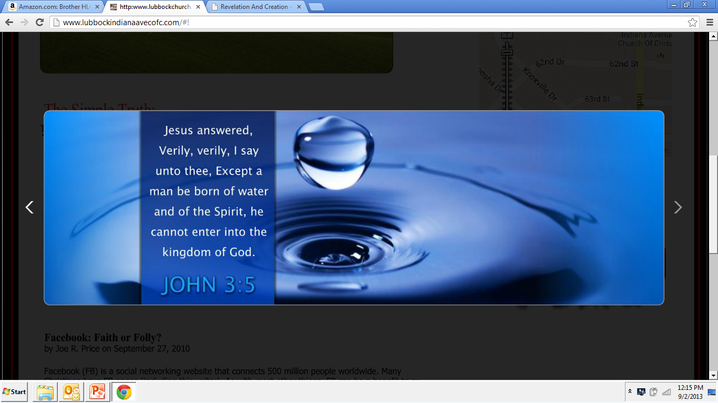
Will You Obey The Gospel Today?
“But the Pharisees and lawyers rejected the will of God for themselves, not having been baptized by him” (Lk. 7:30)

