Slide 1
TO THE SERVICES OF THE NORTH RIDGEVILLE CHURCH OF CHRIST
Scripture taken from the New King James Version®.
Copyright © 1982 by Thomas Nelson. Used by permission. All rights reserved.

Slide 2
A Critical Review of Premillennialism
THE RAPTURE DOCTRINE

Slide 3
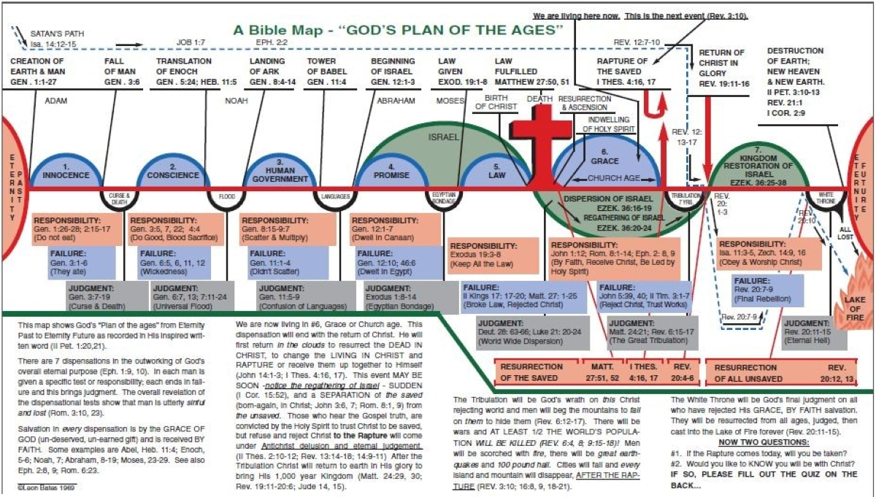

Slide 4
Total Hereditary Depravity
The Dispersion and Regathering of Israel

Slide 5
Ezekiel 36:19, “I scattered them among the nations, and they were dispersed…”
Ezekiel 36 is FULFILLED!
THREE DEPORTATIONS (2 Kin. 24; 25)
605 BC (Daniel taken)
597 BC (Ezekiel with 10,000 people)
587 BC (after which the temple was burnt)

Slide 6
Ezekiel 36:24, “For I will take you from among the nations, gather you out of all countries, and bring you into your own land.”
Ezekiel 36 is FULFILLED!
THREE RETURNS (Ezra; Nehemiah)
536 BC (led by Zerubbabel)
457 BC (led by Ezra)
445 BC (led by Nehemiah)

Slide 7
Total Hereditary Depravity
The Dispersion and Regathering of Israel
Dispensations

Slide 9
NO RAPTURE DOCTRINE TAUGHT IN THE BIBLE!

Slide 10
"Let not your heart be troubled; you believe in God, believe also in Me.
"In My Father’s house are many mansions; if [it were] not [so], I would have told you. I go to prepare a place for you.
"And if I go and prepare a place for you, I will come again and receive you to Myself; that where I am, [there] you may be also.
JOHN 14:1-3

Slide 11
16 For the Lord Himself will descend from heaven with a shout, with the voice of an archangel, and with the trumpet of God. And the dead in Christ will rise first.
17 Then we who are alive [and] remain shall be caught up together with them in the clouds to meet the Lord in the air. And thus we shall always be with the Lord.
1 THESSALONIANS 4:16, 17

Slide 12
1 Thessalonians | Compared | 2 Thessalonians
The Lord Himself will descend from heaven | 4:16 | 1:7 | The Lord Jesus is revealed from heaven
God will bring with Him those who sleep in Jesus | 4:14 | 1:7 | To give you who are troubled rest with us
To wait for His Son from heaven…Jesus who delivers us from the wrath to come | 1:10 | 1:8 | In flaming fire taking vengeance on those who do no know/obey

Slide 13
1 Thessalonians | Compared | 2 Thessalonians
Descend…with the voice of an archangel | 4:16 | 1:7 | From heaven with His mighty angels
Caught up together in the clouds to meet the Lord | 4:17 | 1:9 | Punished from the presence/glory of the Lord
Thus we shall always be with the Lord | 4:17 | 1:9 | Everlasting destruction from the presence of the Lord
Others who have no hope | 4:13 | 1:8 | Those who do not know and obey

Slide 14
John 17:24
“Father, I desire that they also whom You gave Me may be with Me where I am, that they may behold My glory which You have given Me; for You loved Me before the foundation of the world.”

Slide 15
1 Peter 3:21, 22
“There is also an antitype which now saves us—baptism (not the removal of the filth of the flesh, but the answer of a good conscience toward God), through the resurrection of Jesus Christ, who has gone into heaven and is at the right hand of God, angels and authorities and powers having been made subject to Him.”

