Slide 1
THE NORTH RIDGEVILLE CHURCH OF CHRIST
Scripture taken from the New King James Version®.
Copyright © 1982 by Thomas Nelson. Used by permission. All rights reserved.

Slide 2
The Rapture?
The Four Horsemen
The Seven-year Tribulation?
Many Resurrections?
A Critical Review of Premillennialism
THE REIGN OF CHRIST

Slide 3
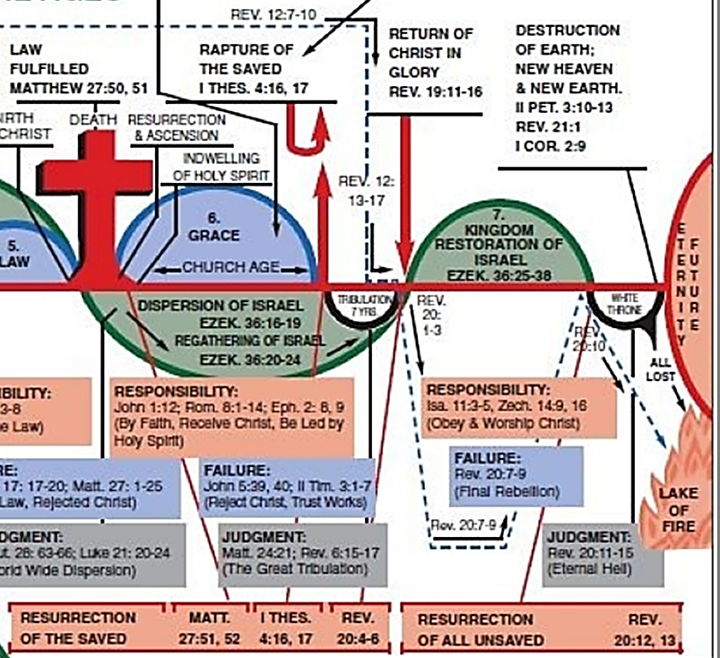
1000-YEAR REIGN ON EARTH WITH THE RESTORATION OF ISRAEL?
Does Jesus reign now?
Where does He reign?
What is meant by the 1000-year reign and how might it apply to saints today?

Slide 4
ANSWERS
Christ has all authority
Christ reigns from heaven
Christ reigns as king and priest

Slide 5
ANSWERS
Christ’s kingdom is not of this world

Slide 6
“Jeconiah” (Matt. 1:12)
28 "Is this man Coniah a despised, broken idol—A vessel in which [is] no pleasure? Why are they cast out, he and his descendants, And cast into a land which they do not know?
29 O earth, earth, earth, Hear the word of the LORD!
30 Thus says the LORD: ‘Write this man down as childless, A man [who] shall not prosper in his days; For none of his descendants shall prosper, Sitting on the throne of David, And ruling anymore in Judah.’"
JEREMIAH 22:28-30

Slide 7
ANSWERS
Christ’s kingdom is not of this world
Christ’s kingdom began in the first century
The Bible doesn’t separate the CHURCH from the KINGDOM
THE PROPHETS | GOSPELS | EPISTLES
Dan. 2:44; Rev. 1:9; Mk. 1:15; 9:1; Col. 1:13; 4:11; etc.

Slide 8
Revelation 20:4-6
What it doesn’t say
reigning on earth
establishing the kingdom on earth
Jesus sitting on a throne in Jerusalem

Slide 9
1000 Years
10 X 10 X 10
Quantitatively: contrasts “a little while” (20:3)
Qualitatively: abundance
John 5: 24, “Most assuredly, I say to you, he who hears My word and believes in Him who sent Me has everlasting life, and shall not come into judgment, but has passed from death into life.”

Slide 10
1000 Years
10 X 10 X 10
Quantitatively: contrasts “a little while” (20:3)
Qualitatively: abundance
John 10:10, "The thief does not come except to steal, and to kill, and to destroy. I have come that they may have life, and that they may have [it] more abundantly.” See Jn. 10:27, 28.

Slide 11
1000 Years
10 X 10 X 10
Quantitatively: contrasts “a little while” (20:3)
Qualitatively: abundance
John 11:25, 26, “…I am the resurrection and the life. He who believes in Me, though he may die, he shall live. And whoever lives and believes in Me shall never die. Do you believe this?"

Slide 12
1000 Years
10 X 10 X 10
Quantitatively: contrasts “a little while” (20:3)
Qualitatively: abundance
John 17:2, 3 "as You have given Him authority over all flesh, that He should give eternal life to as many as You have given Him. And this is eternal life, that they may know You, the only true God, and Jesus Christ whom You have sent.”

Slide 13
1000 Years
10 X 10 X 10
Quantitatively: contrasts “a little while” (20:3)
Qualitatively: abundance
John 17:24, "Father, I desire that they also whom You gave Me may be with Me where I am, that they may behold My glory which You have given Me; for You loved Me before the foundation of the world.”

Slide 14
1000 Years
10 X 10 X 10
Quantitatively: contrasts “a little while” (20:3)
Qualitatively: abundance
Col. 3:3, 4, “For you died, and your life is hidden with Christ in God. When Christ [who is] our life appears, then you also will appear with Him in glory.”

Slide 15
The Faithful Christian
Lives and reigns with Christ – 2 Tim. 2:12; Rev. 3:21
Finds new life when baptized into Christ – Rom. 6:4; Eph. 2:4-6
Will not lose the new life or the blessings found in Christ at death but have them abundantly – Rev 14:13; 2:10; 20:4

Slide 16
Revelation 20:11-15
The GREAT white throne – 20:11
The GREAT gathering – 20:12
The GREAT books – 20:12
The GREAT judgment – 20:13
The GREAT separation/destination – 20:14, 15
The GREAT decision—it is yours!

