Slide 1
TO THE SERVICES OF
THE NORTH RIDGEVILLE CHURCH OF CHRIST
Scripture taken from the New King James Version®.
Copyright © 1982 by Thomas Nelson. Used by permission. All rights reserved.

Slide 2
REVIEW:
NO future dispersion and gathering of Israel
NOT seven major dispensations
NO rapture
Ezekiel 36 is fulfilled in 2 Kings 24; 25; Ezra, Nehemiah
Three: Romans 5:14; Heb. 1:1, 2

Slide 3
NOT SILENT, SECRETIVE, INVISIBLE, OR TEMPORARY!
16 For the Lord Himself will descend from heaven with a shout, with the voice of an archangel, and with the trumpet of God. And the dead in Christ will rise first.
17 Then we who are alive [and] remain shall be caught up together with them in the clouds to meet the Lord in the air. And thus we shall always be with the Lord.
1 THESSALONIANS 4:16, 17

Slide 4
A Critical Review of Premillennialism
SEVEN-YEAR TRIBULATION

Slide 5
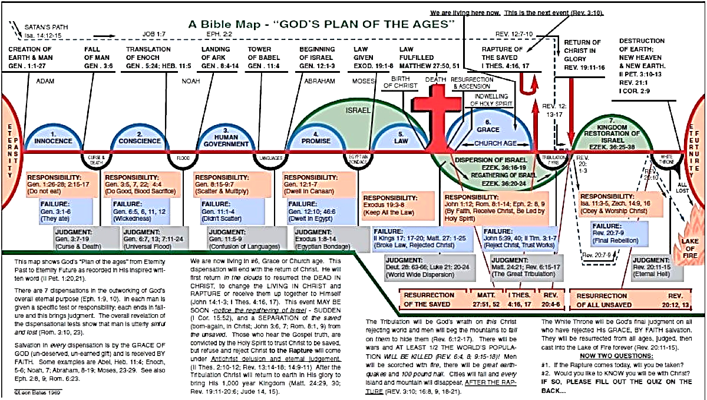
A SEVEN-YEAR TRIBULATION?
NOT TAUGHT IN THE BIBLE!

Slide 6
“TRIBULATION”
IN THE BIBLE
Of Christ’s disciples before the destruction of the temple – Matt. 24:1-14
During the overthrow of Jerusalem – Matt. 24:15-22
During worldwide persecution of the church – Rev. 2:9, 10; 3:10; 7:13, 14

Slide 7
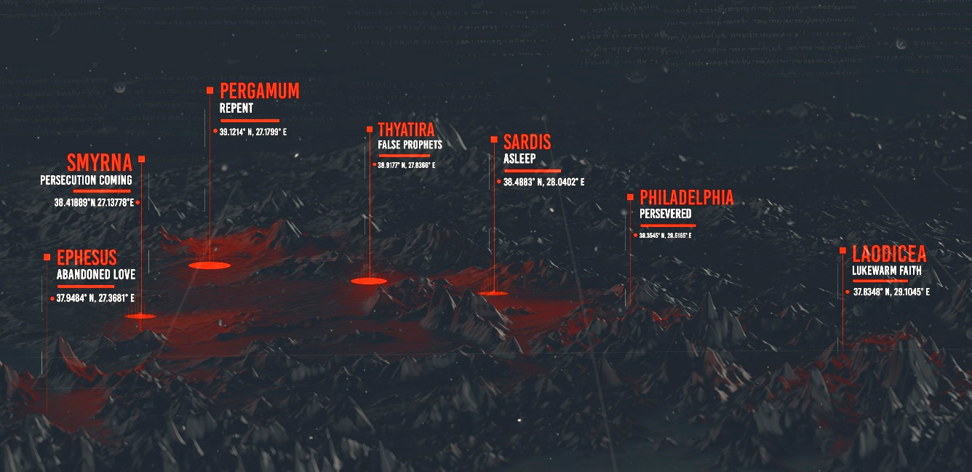
The Seven Churches of Asia
“Because you have kept the word of My perseverance, I also will keep you from the hour of testing, that hour which is about to come upon the whole world, to test those who dwell on the earth” (Rev. 3:10, NASB)

Slide 8
“TRIBULATION”
IN THE BIBLE
A common and expected response from the world – Jn. 16:33
Can have positive effects – Rom. 5:3; 12:12
Should not become the means to separate us from the love of Christ – Rom. 8:35
God doesn’t remove us from it but brings comfort in – 2 Cor. 1:3, 4

Slide 9
Revelation 12
Not addressing a seven-year tribulation on a Christ-rejecting World
Was written to encourage saints during a time when they were being massacred – Rev. 6:9-11

Slide 10
Revelation 12
Assures of Satan’s defeat in three areas:
Satan failed when he tried to destroy the Christ (the male Child) – Rev. 12:1-6
Satan failed when he tried to accuse saints – Rev. 12:7-12; cf. Rom. 8:33, 34
Satan will fail in his earthly persecution of saints (the woman and her offspring)
– Rev. 12:13-17

