Slide 1
Sanctification
“SET APART AS”

Slide 2
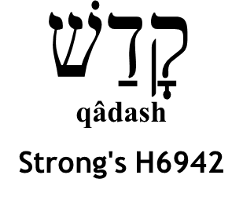
SOME THINGS THAT WERE SANCTIFIED
The seventh day – Genesis 2:3 (first use)
  Did the qualities that are distinctive of a “day” change?
  “Set apart as” God’s Day of Rest
The firstborn – Exodos 13:1, 2
  Did the qualities that are distinctive of the “firstborn” change?
  “Set apart as” God’s
The People– Exodus 19:10
  Did the qualities that are distinctive of being “people” change?
  Set apart as” God’s

Slide 3
SOME THINGS THAT WERE SANCTIFIED
Mount Sinai – Exodus 19:23
  Did the qualities that are distinctive of a mountain change?
  “Set apart as” God’s mountain
An altar – exodus 40:10
  Did the qualities that are distinctive of an altar change?
  “Set apart as” God’s altar

Slide 4
SOME THINGS THAT WERE SANCTIFIED
While these things were sanctified by God, man would not know what this meant or required without instruction and learning.
The seventh day – Genesis 2:3
The firstborn – Exodos 13:1, 2
The people – Exodus 19:10
Mount Sinai – Exodus 19:23
An altar – exodus 40:10
Exodus 20:8-11; 31:12-17; Deuteronomy 5:12-15; Nehemiah 9:13, 14

Slide 5
SOME THINGS THAT WERE SANCTIFIED
While these things were sanctified by God, man would not know what this meant or required without instruction and learning.
The seventh day – Genesis 2:3
The firstborn – Exodos 13:1, 2
The people – Exodus 19:10
Mount Sinai – Exodus 19:23
An altar – exodus 40:10
Exodus 13:11-16; Numbers 3:11-13; 8:13-19

Slide 6
SOME THINGS THAT WERE SANCTIFIED
While these things were sanctified by God, man would not know what this meant or required without instruction and learning.
The seventh day – Genesis 2:3
The firstborn – Exodos 13:1, 2
The people – Exodus 19:10
Mount Sinai – Exodus 19:23
An altar – exodus 40:10
Exodus 19:11-15

Slide 7
SOME THINGS THAT WERE SANCTIFIED
While these things were sanctified by God, man would not know what this meant or required without instruction and learning.
The seventh day – Genesis 2:3
The firstborn – Exodos 13:1, 2
The people – Exodus 19:10
Mount Sinai – Exodus 19:23
An altar – exodus 40:10
Exodus 29:36, 37; 30:28, 29

Slide 8
SANCTIFIED SPOUSE
12 But to the rest I, not the Lord, say: If any brother has a wife who does not believe, and she is willing to live with him, let him not divorce her.
13 And a woman who has a husband who does not believe, if he is willing to live with her, let her not divorce him.
14 For the unbelieving husband is sanctified by the wife, and the unbelieving wife is sanctified by the husband; otherwise your children would be unclean, but now they are holy.
1 Corinthians 7:12-14, NKJV

Slide 9
SANCTIFIED GOD
“But sanctify the Lord God in your hearts, and always [be] ready to [give] a defense to everyone who asks you a reason for the hope that is in you, with meekness and fear”
1 Peter 3:15, NKJV

Slide 10
THE ORDER OF SANCTIFICATION
1 Corinthians 6:11
WASHED (cleansed)
SANCTIFIED (set apart)
JUSTIFIED (made righteous)
  Grace – Rom 3:24
  Faith – Rom. 5:1
  Blood – Rom. 5:9
Acts 22:16
2 Timothy 2:19-21

Slide 11
THE ORDER OF SANCTIFICATION
1 Corinthians 6:11
WASHED (cleansed)
SANCTIFIED (set apart)
JUSTIFIED (made righteous)
Ephesians 5:26
John 15:3; 17:17
Romans 1:16, 17
All are distinct from one another!
All require a response to the word!

Slide 12
SANCTIFICATION
Is not continual cleansing
“A highway will be there, a roadway,
And it will be called the Highway of Holiness.
The unclean will not travel on it,
But it will be for him who walks that way,
And fools will not wander on it.”
  —Isaiah 35:8 (NASB)
God’s highway requires repentance on man’s part: Isaiah 40:1-8!

Slide 13
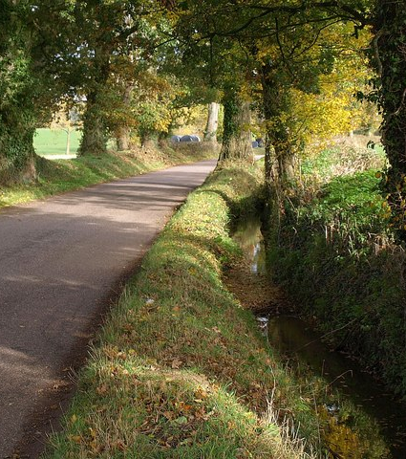


SANCTIFICATION
Is not Continual Cleansing
“If we say that we have fellowship with Him, and walk in darkness, we lie and do not practice the truth. ⁷ But if we walk in the light as He is in the light, we have fellowship with one another, and the blood of Jesus Christ His Son cleanses us from all sin.
—1 John 6, 7 (NKJV)
This Photo by Unknown Author is licensed under CC BY-SA

Slide 14
SANCTIFICATION
Does Not Mean Living Perfectly Sinless
“For [there is] not a just man on earth who does good And does not sin.”
  —Ecclesiastes 7:20 (NKJV)

Slide 15
SANCTIFICATION
Does Not Disable One From Sinning
“My little children, these things I write to you, so that you may not sin. And if anyone sins, we have an Advocate with the Father, Jesus Christ the righteous. ² And He Himself is the propitiation for our sins, and not for ours only but also for the whole world.
  —1 John 2:1, 2 (NKJV)

Slide 16
The Corinthians were SANCTIFIED…but
1 Corinthians 1:1, 2
Were contentious — 1:11-13
Were carnal — 3:1-6
Were proud — 4:18, 19
Were immoral — 5:1ff
Were suing brethren — 6:1ff
Lacked a wise man — 6:5
Were having domestic troubles — 7:1ff
Were idolatrous — 8:1ff
Were challenging Paul’s authority — 9:1, 2
Had wrong ideas about supporting the work of preaching — 9:3ff
Perverted the Lord’s Supper — 11:20-34
Wrangled over spiritual gifts — 12-14
Doubted the resurrection — 15:1ff
Sanctification didn’t cleans their sins; repentance and confession to God did (2 Cor. 7:10, 12:21).

Slide 17
SANCTIFICATION
Distinct from forgiveness and cleansing
1
Distinct from justification
2
Always means “set apart”
4
Doesn’t change intrinsic properties
3

